Slide 1
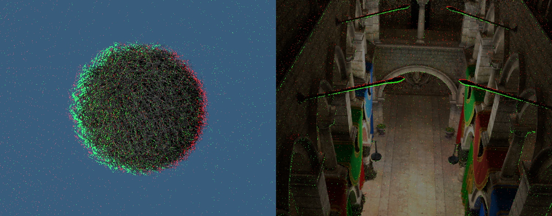
Interactive Stable Ray Tracing
Alessandro Dal Corso^{1,2}, Marco Salvi¹, Craig Kolb¹,
Jeppe Revall Frisvad², Aaron Lefohn¹, David Luebke¹
¹NVIDIA, ²Technical University of Denmark
Notes:
Hi all
Interactive stable ray tracing
Collaboration btw NVIDIA and DTU

Slide 2
Comparison with previous work
Video
Notes:
Start with some results…
Improve in temporal stability, and sharpness.

Slide 3
Problem:
How do we improve temporal stability?

Slide 4
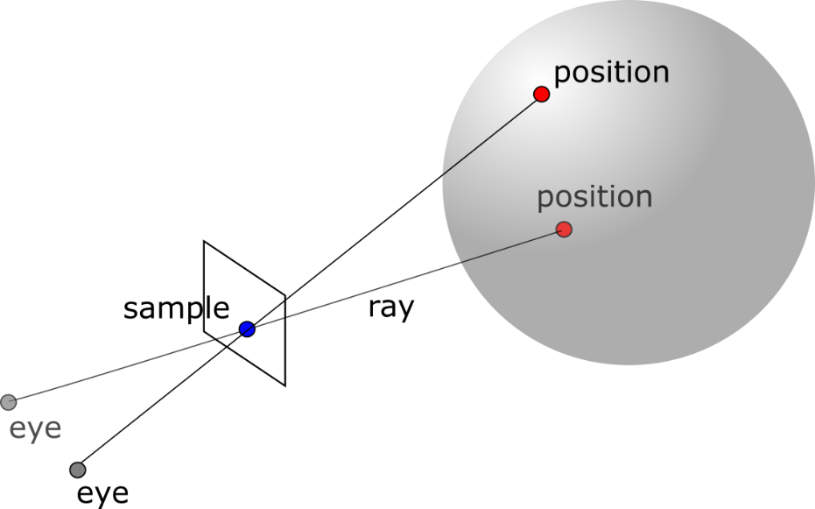
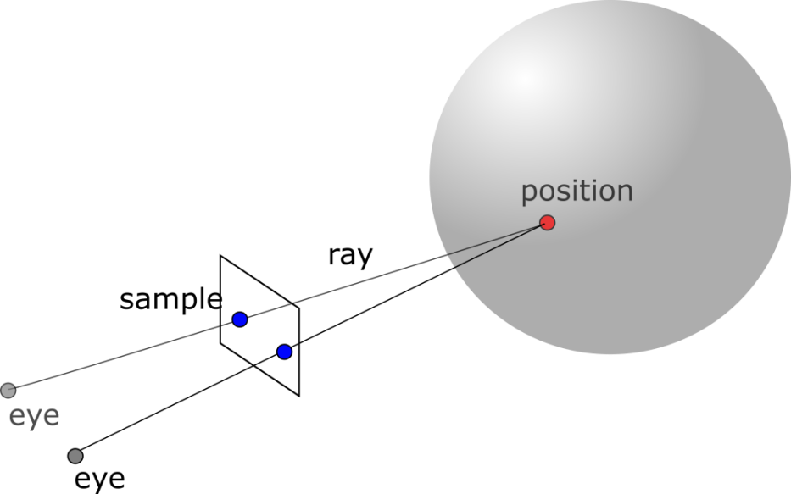
Stable samples
Supersampling
Stable ray tracing
Notes:
Explain figure…
Generically done via sample reprojection

Slide 5
Related work
  Sample reprojection [Badt 1988, Walter et al. 1999, 2002; Zhu et al. 2005]
  Mostly for efficiency reasons
  Stores shading result
Sample reprojection for temporal stability [Adelson and Hodges 1995, Martin et al. 2002]
  One sample per pixel only
  Need post processing to remove residual temporal instability
Temporal stability: Temporal supersampling [Karis 2014; Patney et al. 2016]
  Post processing filter
  Increases blurriness
Notes:
Generically stable samples are based on sample reprojection in screen space

Slide 6
Interactive stable ray tracing
The final goal is temporal stability, retaining sharpness
We allow a non integral number of samples per pixel
Sample density estimation
Making it efficient for modern GPU pipelines
Application: caching of global illumination
Notes:
As in Martin, temporal stability
We change from them allowing…
We handle the hole filling problem differently
Modern GPU

Slide 7
Interactive stable ray tracing

Slide 8
A generic stable ray tracing algorithm
8
Notes:
What are the essential steps of a stable ray tracing pipeline?
Reproject from one frame to the next
Distribution of samples can be completely random
Verification: still in front of the camera or not?
Hole filling: fill holes in the pixel that miss data
Reconstruction: final color is computed

Slide 9
For an efficient implementation
Our implementation:
Notes:
Reprojection and reconstruction
Unification

Slide 10
Our reprojection
Pixel k, Frame n
Pixel m, Frame n+1
Notes:
Screen space data structure mirrored
We allow only one sample per subpixel
Also, we have bitmasks, split into two

Slide 11
Analysis, first to estimate density
User-defined target density (1 spp, 2 spp, etc.)
Density estimation radius
Notes:
Analysis -> Analize the resulting sample distribution, compute a density, and adjust

Slide 12
Analysis, to add and remove samples
Sample removal
Sample addition
Notes:
Samples are added or removed by dividing the pixel into four strata
Remove from the strata with most pixel
Add to the strata with least pixelFor performance reasons, no depth here

Slide 13
Verification, with a cached sample
Frame n+1
Frame n
Still visible, keep in cache
Cached sample
Notes:
Cached sample, cast a ray, if still visible, store in the cache

Slide 14
Verification, with an occluded sample
Frame n+1
Frame n
If last sample, store closest hit
Store as occluded
Notes:
Sometimes sample are occluded, we still keep them in the cache, hoping that they may reappear
Sometimes samples may pop up if they are the last remaining one left (hole filling on the go)

Slide 15
Reconstruction
3x3 gaussian filter
It is possible to apply post processing such as temporal integration / antialiasing [Patney et al. 2016]
Notes:
Simple reconstruction filter
Temporal integration

Slide 16
Caching global illumination
Our samples are suitable to store the result of indirect illumination
In our implementation: unidirectional PT, Exponential moving average
Notes:
Store result of GI
Unidirectional path tracing
Accumulate data with exponential moving average
Large possiblity for exploration here

Slide 17
Results

Slide 18
Questions
Reconstruction quality
  What is the impact on reconstruction quality?
Temporal stability
  Do we improve temporal stability at iso performance?
Sharpness improvement
  Do we achieve better sharpness compared to temporal integration / antialiasing?
Performance impact
  What is the performance impact?

Slide 19
Quality impact mostly on low spp
SS = Supersampling, SRT = Stable ray tracing
SS, 1 spp
SRT, 1 spp
SS, 2 spp
SRT, 2 spp
SS, 4 spp
SRT, 4 spp
SS, 32 spp
Notes:
Comparison of quality against regular sampling
Mention thickened edges

Slide 20
Temporal stability, hairball
Video
Notes:
1st and second we have 4 spp, with and without TAA.
3rd and 4th we have srt, with and without temporal integration
5th reference
1st and third, Without temporal post processing iflters: improved temporal stability
2nd and 4th, with temporal stability: not as stable but less blurry.
We can see it

Slide 21
Impact on sharpness
Sharpness: CPBD-based metric (higher is sharper)
Supersampling, 4 spp
Sharpness: 0.8142
Stable ray tracing, 2 spp
Sharpness: 0.8056
Supersampling, 32 spp
Sharpness: 0.8054
Supersampling, 4 spp
+ temporal antialiasing
Sharpness: 0.6610
Stable ray tracing, 2 spp
+ temporal integration
Sharpness: 0.7783
Notes:
Mention sharpness measure ‘
First row: comparision without post filters
Second row: comparison with post filters

Slide 22
Comparing with previous work
Video
Notes:
Martin et al. is the closest work in stable ray tracing
Also, as we saw before against main competitor, we improve upon temporal stabilty

Slide 23
A test with global illumination
Video
Notes:
Sponza, 1st and second: srt left and ss right, plus version with temporal integration
TAA good at hiding noise, but also blurs a lot

Slide 24
Global illumination, sharpness
Supersampling, 2 spp
Sharpness: 0.7924
Stable ray tracing, 1 spp
Sharpness: 0.7085
Supersampling, 32 spp
Sharpness: 0.6771
Supersampling, 2 spp
+ temporal antialiasing
Sharpness: 0.5348
Stable ray tracing, 1 spp
+ temporal integration
Sharpness: 0.6060
Notes:
Also here similar results, SRT is sharper
SS is sharper here because of noise

Slide 25
Performance results
Technique | Reprojection | Analysis | Verification/ Shading | Reconstruction | Total
Stable ray tracing, d_{target}= 1 spp | 1.05 ms | 0.28 ms | 18.91 ms | 0.72 ms | 20.94 ms
Supersampling, 1 spp | - | - | 13.35 ms | 0.21 ms | 13.56 ms
Supersampling, 2 spp | - | - | 20.94 ms | 0.38 ms | 21.32 ms
Technique | Reprojection | Analysis | Verification/ Shading | Reconstruction | Total
Stable ray tracing, d_{target}= 2 spp | 1.23 ms | 0.38 ms | 28.88 ms | 0.82 ms | 31.31 ms
Supersampling, 3 spp | - | - | 28.36 ms | 0.54 ms | 28.90 ms
Supersampling, 4 spp | - | - | 35.86 ms | 0.71 ms | 36.57 ms
Notes:
Average performance for hairball scene
Slower, talk about load balancing issues
1.4 to 1.5 slower

Slide 26
A new practical technique for stable shading
Based on sample reprojection, with inexpensive analysis phase
Balances temporal stability and image sharpness
Sharp, fairly temporally stable result
Allows us to cache global illumination effects
Notes:
Practical and generic
Sample reprojection
Temporal stability and image sharpness
Better sharpness, temporally stable
Global illumination

Slide 27
References
[Adelson and Hodges 1995] Stephen J. Adelson and Larry F. Hodges. 1995. Generating exact ray-traced animation frames by reprojection. IEEE Computer Graphics and Applications 15, 3 (1995), 43–52.
[Badt 1988] Sig Badt, Jr. 1988. Two algorithms for taking advantage of temporal coherence in ray tracing.The Visual Computer 4, 3 (1988), 123–132.
[Bala et al. 2003] Kavita Bala, BruceWalter, and Donald P. Greenberg. 2003. Combining edges and points for interactive high-quality rendering. ACM Transactions on Graphics (Proc. of SIGGRAPH 03) 22, 3 (July 2003), 631–640.
[Herzog et al. 2010] Robert Herzog, Elmar Eisemann, Karol Myszkowski, and Hans-Peter Seidel. 2010. Spatio-temporal upsampling on the GPU. In Proceedings of Interactive 3D Graphics and Games (I3D ’10). ACM, 91–98.
[Karis 2014] Brian Karis. 2014. High-quality temporal supersampling. In Advances in Real-Time Rendering in Games, Part I. Number 10 in ACM SIGGRAPH 2014 Courses. http://advances.realtimerendering.com/s2014/
[Martin et al. 2002] William Martin, Peter Shirley, Steven Parker, William Thompson, and Erik Reinhard. 2002. Temporally coherent interactive ray tracing. Journal of Graphics Tools 7, 2 (2002), 41–48.
[Nehab et al. 2007] Diego Nehab, Pedro V. Sander, Jason Lawrence, Natalya Tatarchuk, and John R. Isidoro. 2007. Accelerating real-time shading with reverse reprojection caching. In Proceedings of Graphics Hardware (GH 2007).
[Patney et al. 2016] Anjul Patney, Marco Salvi, Joohwan Kim, Anton Kaplanyan, Chris Wyman, Nir Benty, David Luebke, and Aaron Lefohn. 2016. Towards foveated rendering for gaze tracked virtual reality. ACM Transactions on Graphics (Proceedings of SIGGRAPH Asia 2016) 35, 6 (November 2016), 179:1–179:12.
[Scherzer et al. 2007] Daniel Scherzer, Stefan Jeschke, and Michael Wimmer. 2007. Pixel-correct shadowmaps with temporal reprojection and shadow test confidence. In Rendering Techniques 2007 (Proceedings of EGSR 2007). Eurographics Association, 45–50.
[Velazquez-Armendariz et al. 2006] Edgar Velazquez-Armendariz, Eugene Lee, Kavita Bala, and Bruce Walter. 2006. Implementing the render cache and the edge-and-point image on graphics hardware. In Proceedings of Graphics Interface 2006 (GI ’06). Canadian Information Processing Society, 211–217.
[Walter et al. 1999] Bruce Walter, George Dre.akis, and Steven Parker. 1999. Interactive rendering using the render cache. In Rendering techniques ’99 (Proceedings of EGWR 1999). Springer, 19–30.
[Yang et al. 2009] Lei Yang, Diego Nehab, Pedro V. Sander, Pitchaya Si.hi-amorn, Jason Lawrence, and Hugues Hoppe. 2009. Amortized supersampling. ACM Transactions on Graphics (Proceedings of SIGGRAPH Asia 2009) 28, 5 (December 2009), 135:1–135:12.
[Zhu et al. 2005] Tenghui Zhu, Rui Wang, and David Luebke. 2005. A GPU accelerated render cache. In Proceedings of Pacific Graphics 2005 (short paper).

Slide 28
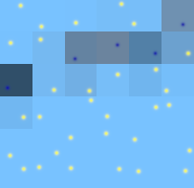
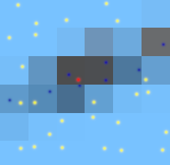
Limitation, edge thickening
Caused by change in distributions of samples
Legend: Background sample, Hair sample, Occluded sample
Frame 0, No thickening
Frame 1, Thickened edge
Notes:
Example explain why edge thicken
Point at area that remains uncovered
Better way of estimating density is necessary

Slide 29
Quality impact mostly on low spp
SS, 1 spp
SRT, 1 spp
SS, 2 spp
SRT, 2 spp
SS, 4 spp
SRT, 4 spp
SS, 32 spp
Notes:
Mention broken edges
Largely okay for higher sample counts

Slide 30
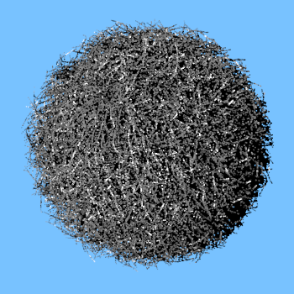
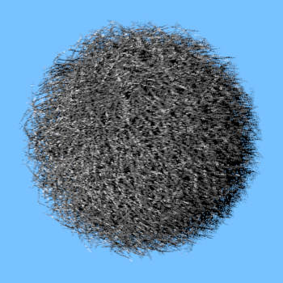
No averaging improves sharpness
Stable ray tracing, 1 spp
sharpness: 0.8182
[Martin et al. 2002]
sharpness: 0.6957
Notes:
Sharpness in martin is lower due to post filter

