Slide 1
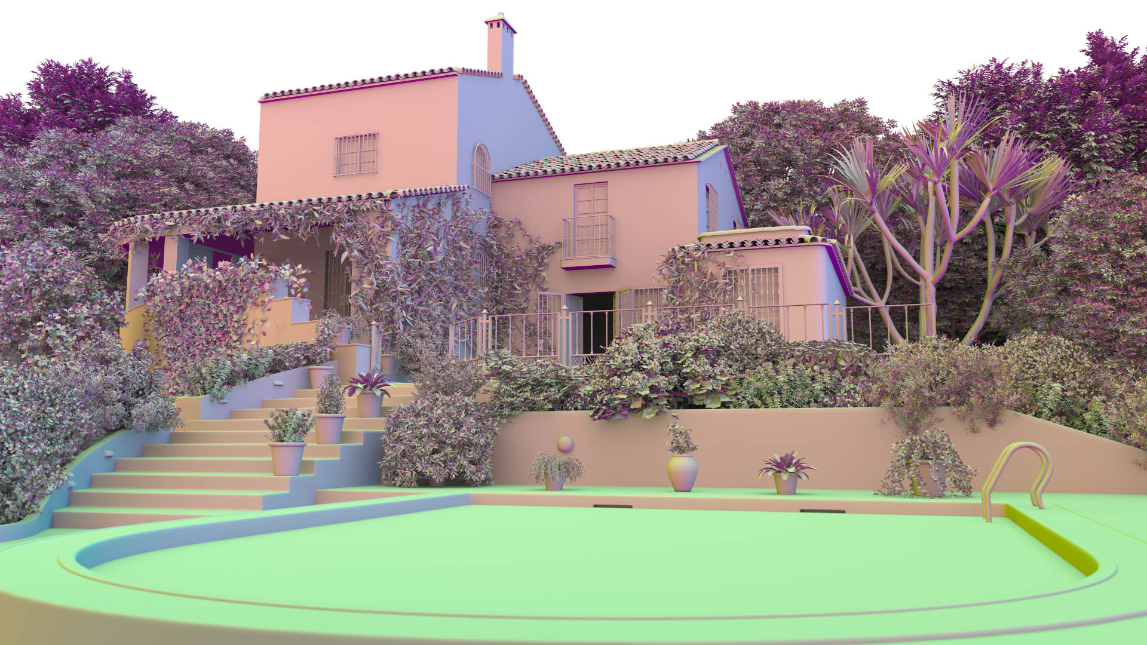
Accelerated Single Ray Tracing for Wide Vector Units
Valentin Fuetterling°*, Carsten Lojewski°, Franz-Josef Pfreundt°, Bernd Hamann^ and Achim Ebert*
° * ^

Slide 2
Introduction – Ray Tracing
Ray
Set of triangles
Find first intersection
Acceleration
Bounding Volume Hierarchy (BVH)
Requires traversal
BVH

Slide 3
Motivation
Accelerating single ray traversal on data-parallel hardware
Why single rays?
Ease of use
Consistent performance
Immediate results

Slide 4
Current Single Ray Traversal
Dissection

Slide 5
State-Of-The-Art
Multi-branching BVH
Data parallelism
Vector instructions (SIMD)
Less traversal iteration
More coherent memory access
Binary BVH
BVH4
[Dammertz et al. 2008; Ernst and Greiner 2008;
Wald et al. 2008]

Slide 6
Building Blocks
Ray Setup
Inner Node Iteration
Bounding Box Intersection
1
0
3
2
Node Ordering
0
1
2
3
0
2
Stack Operation
1
Leaf Node
Triangle Intersection
Stack Compaction

Slide 7
Node Ordering: Heuristics
Ideal traversal order
Minimal traversal iterations
Unknown
Distance heuristic
Intersection distance
Sign heuristic
Pre-compute order
0_{x}
1_{x}
0_{x}

Slide 8
Data-parallel Limitations?
Inner Node
Bounding Box Intersection
Node Ordering
Variable number of active nodes N
Treat N < 3 as special cases for efficiency
Branchy code
Stack Operation

Slide 9
Wive
Accelerated Single Ray Tracing for Wide Vector Units

Slide 10
Contributions
WiVe: Single Ray Traversal Algorithm
Encoding for sign-based ordering heuristic
Full data-parallel traversal for multi-branch BVHs
Constant-time (i.e. branch-less) inner node iteration
Inner Node
Bounding Box Intersection
Node Ordering
Stack Operation

Slide 11
WiVe Key Ideas
Encode fixed traversal orders into nodes
One order per ray signs combination (8)
Order defined by permute vector
Map node ordering to a single permute vector operation
Map stack operation to a single vector compress operation
0
1
2
3
4
5
6
7
1
0
6
7
3
2
5
4
0
1
2
3
4
5
6
7
0
2
6
7

Slide 12
WiVe Algorithm
Initially nodes are in memory order
Permute nodes (A)
Intersection test (B)
Compress (C)
Store to stack (D)
0
1
2
3
4
5
6
7
A
1
0
6
7
3
2
5
4
B
1
0
6
7
3
2
5
4
C
4
1
0
2
4
2
0
D
1

Slide 13
WiVe Node Order
a)
X
Y
Y
6
7
Binary treelet with split axis labels (a)
Leaves form BVH8 node cluster
Split hierarchy determines permute vectors
BVH8 node cluster in spatial domain (b)
Ray with +x and -y signs (octant is 10b = 2)
If signs[split axis] negative: Swap default order
Y
X
0
1
Y
Y
b)
2
3
4
5
7
1
0
3
5
Permute_vector[2] =
1
0
6
7
3
2
5
4
2
6
4
Y
X

Slide 14
WiVe Configurations (BVH8-half)
odd
8b
BVH branching-factor equals half the vector width
E.g BVH8 with 16-wide vector instructions
t_{min} and t_{max} values interleaved in register
Child offset and t_{min} interleaved on stack
$${ t}_{max}^{0}$$
$${ −t}_{min}^{0}$$
$${ t}_{max}^{1}$$
$${ −t}_{min}^{1}$$
$${ t}_{max}^{7}$$
$${ −t}_{min}^{7}$$
even
0
1
2
3
4
5
6
7
A
1
0
6
7
3
2
5
4
B
n
1
0
6
7
3
2
5
4
$${ t}_{min}^{}$$
C
4
1
0
2
4
2
n
8b
$${ t}_{min}^{}$$
0
D
1
n
$${ t}_{min}^{}$$

Slide 15
WiVe Configurations (BVH8-full)
4b
BVH branching-factor equals full vector width
E.g. BVH8 with 8-wide vector instructions
t_{min} and t_{max} values in separate registers
Child offset and t_{min} on separate stacks
$${ t}_{max}^{0}$$
$${ t}_{max}^{1}$$
$${ t}_{max}^{7}$$
$${ t}_{min}^{0}$$
$${ t}_{min}^{1}$$
$${ t}_{min}^{7}$$
0
1
2
3
4
5
6
7
A
1
0
6
7
3
2
5
4
B
1
0
6
7
3
2
5
4
C
4
n
$${ t}_{min}^{}$$
1
0
2
4
2
4b
n
$${ t}_{min}^{}$$
0
n
$${ t}_{min}^{}$$
D
1
n
$${ t}_{min}^{}$$

Slide 16
EvaLUation
WiVe

Slide 17
Experimental Setup
Compare WiVe to Embree 2.15.0 single ray
Integrated into Embree Protoray benchmark
WiVe BVH derived from Embree BVH, same topology
BVH uses SAH-based binning (no spatial splits)
Path tracing with 8 bounces
Two implementations of WiVe
BVH8-half for AVX-512 (16-wide)
BVH8-full for AVX2 (8-wide)

Slide 18
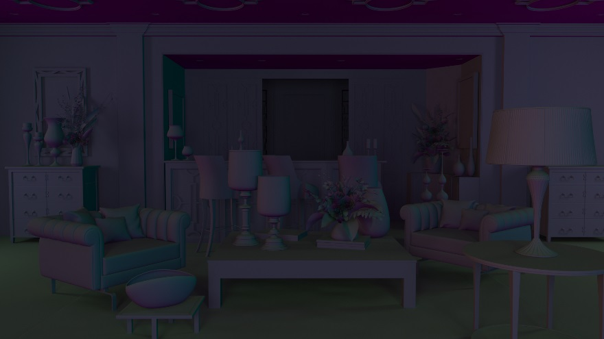
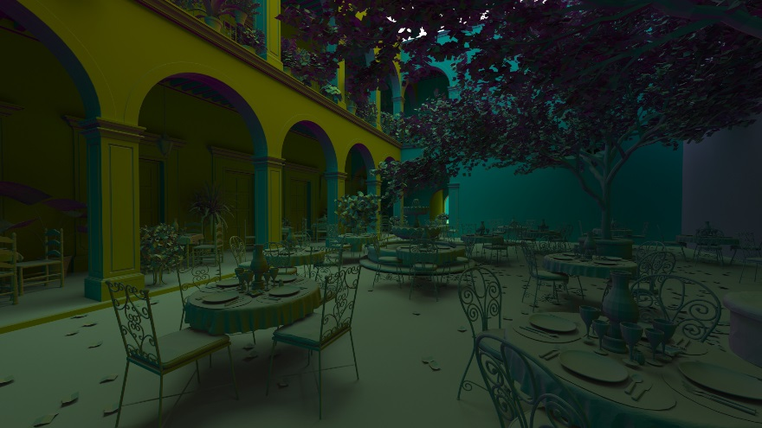
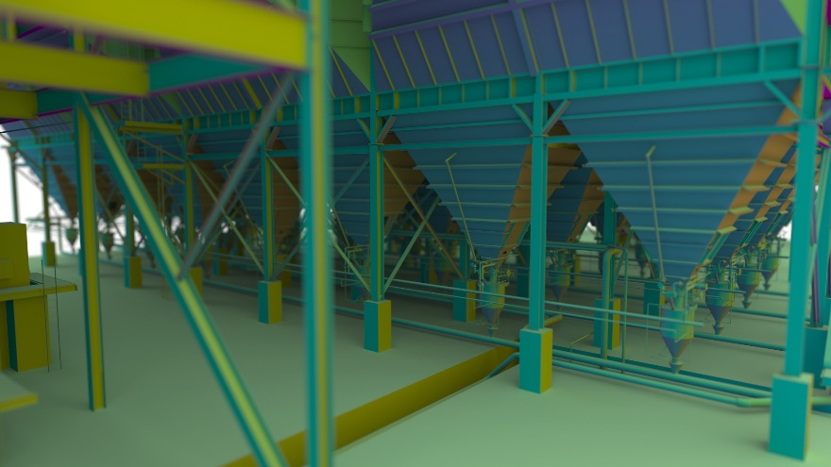
Input / Output
White environment light
Diffuse shading
Normal colors
3840 x 2160 resolution
Mazda (5.7M)
Art Deco (10.5M)
San Miguel (10.7M)
Villa (37.5M)
Powerplant (12.8M)

Slide 19
Results – Order Heuristic
Sign-based vs. distance-based heuristic
Per-ray average indicators
Very close, slight bias towards distance
Worst case is San Miguel with 6-7% discrepancy

Slide 20
Results – Performance (BVH8-half)
AVX-512 implementation
Native permute and compress instructions
Measured on Intel® Xeon Phi™ 7250 @ 1.4GHz (Knight’s Landing)
Timings include full (off-screen) rendering

Slide 21
Results – Performance (BVH8-full)
AVX2 implementation
Native permute instruction, compress emulated with permute + shift + look-up table (1kb)
Measured on dual-socket Intel® Xeon™ E5 2680v3 @ 2.5GH (Haswell)

Slide 22
Conlusion & Outlook
Introduced the WiVe algorithm
Fully vectorized SIMD single ray traversal
Branch-free traversal iteration for multi-branching BVHs
Fastest on CPUs
Combine WiVe with compression
Investigate WiVe on GPUs
Trade throughput for latency

Slide 23
Thank you!
Email: valentin.fuetterling@itwm.fraunhofer.de
Blog: http://rapt.technology

