Slide 1
Dual Streaming for Hardware-Accelerated Ray Tracing
Konstantin Shkurko Tim Grant Daniel Kopta Ian Mallett Cem Yuksel Erik Brunvand
University of Utah
HPG ’17 7.29.17
Notes:
Good afternoon everyone. My name is Konstantin Shkurko and I am part of the hardware ray tracing group at the university of Utah. Our group has been working on dedicated ray tracing hardware for a number of years and I’ll present our recent work. Dual streaming for hardware accelerated ray tracing.
Ray tracing accesses memory randomly and quickly becomes burdened by the modern DRAM. Specialized hardware architectures offer an opportunity to co-design hardware with software and gain synergistic effects.

Slide 2
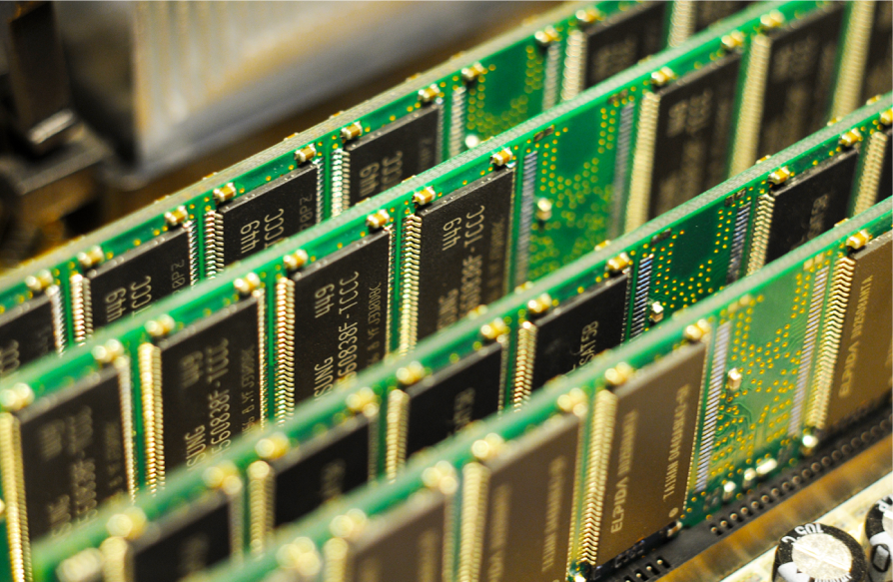
DRAM
Notes:
Despite it’s name, dynamic random access memory, is really designed to access data in large chunks sequentially.
The reason for this behavior is an internal structure called the row buffer. One can think of it as a hidden cache. Using it efficiently reduces access latency and energy.

Slide 3
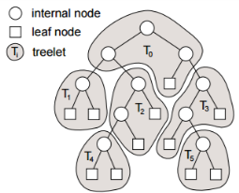
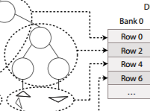
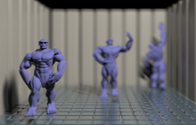
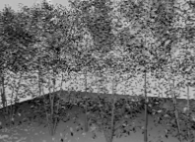
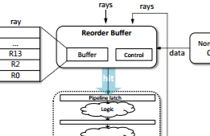
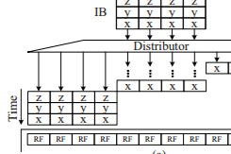
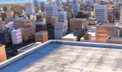
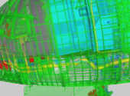
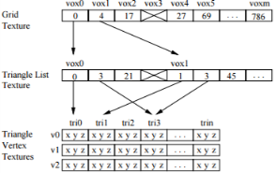
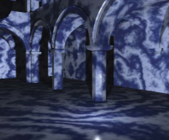
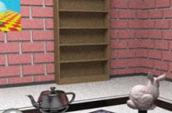
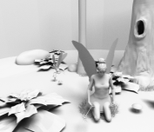
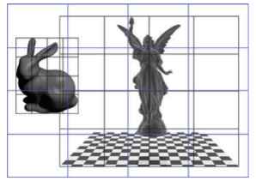
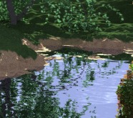
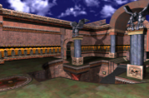
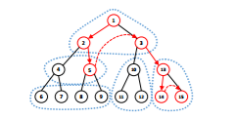
Previous Work
[Aila & Karras 2010]
[Kopta et. al. 2015]
[Woop et. al. 2006]
[Boulos et. al. 2007]
[Navratil et. al. 2007]
[Wald et. al. 2014]
[Lee et. al. 2015]
[Kim et. al. 2010]
[Eisenacher et. al. 2013]
[Moon et. al. 2010]
[Bigler et. al. 2006]
[Purcell et. al. 2002]
[Spjut et. al. 2009]
[Keely 2014]
[Gribble & Ramani 2008]
[Kopta et. al. 2010]
[Bikker 2012]
[Pharr et. al. 2010]
[Schmittler et. al. 2002]
[Liktor & Vaidyanathan 2016]
[Nah et. al. 2014]
Notes:
We are not the first to recognize that memory behavior for ray tracing is an issue and there is a large body of work improving it. Loosely there are 2 categories
1. Improving data reuse by improving memory access patterns. Methods like grouping or sorting rays.
2. Improving bandwidth by improving how much data is fetched. Methods like subdividing or compressing scene data.

Slide 4
Dual Streaming
Notes:
Dual streaming builds on previous work and converts scene and ray data into predictable sequential streams. These streams feed the intersection hardware.

Slide 5
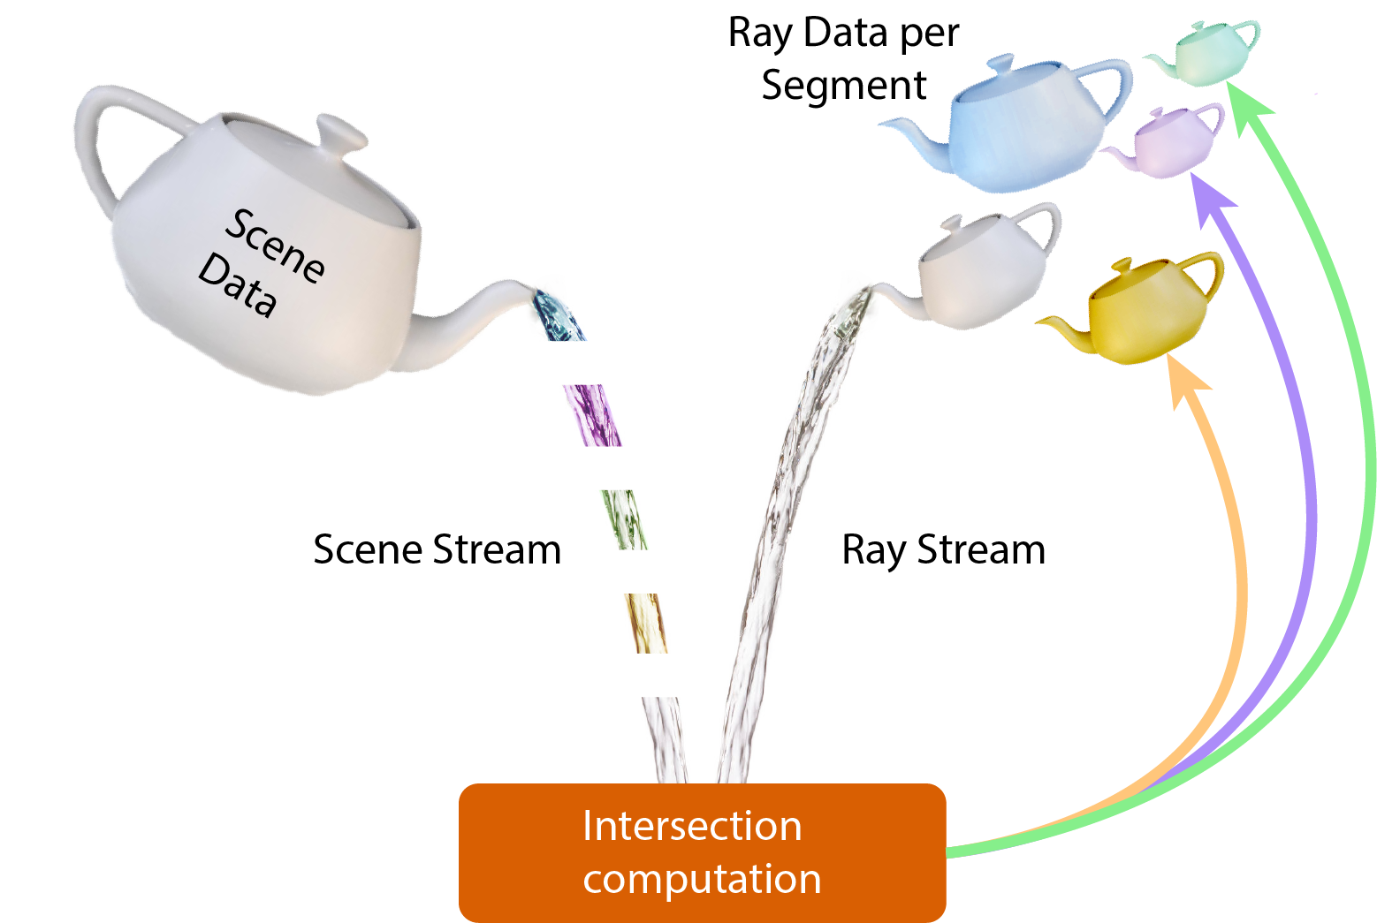
Dual Streaming
Notes:
Technically the picture is a bit more complicated because the scene data is transmitted in chunks, and the intersection pipeline generates more rays for the system.

Slide 6
Contributions
First fully streamed formulation of ray tracing
scene, ray streams
predictive memory access
new traversal order
scene traffic at absolute minimum
Hardware architecture
Notes:
Our main contribution is the reformulation of ray tracing for the first time in a fully streamed manner. The two streams, one for scene and ray data, access memory in a way that is predictable for perfect prefetching and exploits DRAM behavior. The new traversal order loads scene data at most once per ray wavefront. Ray wavefront being all rays at the same depth.
Besides regularizing the memory traffic for scene data, we reduce it to its absolute minimum.
We also co-designed a hardware architecture implementing dual streaming. We believe our work only scratches the surface of the predictable traversal order and opens up a lot of exciting opportunities for future research.

Slide 7
Predictive Traversal Order
Notes:
Predictive traversal order we introduce maximizes scene data reuse and converts DRAM access patterns to be sequential. Consider a scene BVH, shown here.

Slide 8
Predictive Traversal Order
Notes:
We subdivide it into segments. While we rely on BVH treelets, other acceleration structures can also work. Note that both node and triangle data are stored within each segment.
All rays start traversal at the root segment, depicted here in red.

Slide 9
Predictive Traversal Order
Notes:
We store the rays in a queue assigned to the red segment. As we process those rays, they will traverse other segments.

Slide 10
Predictive Traversal Order
Notes:
Rays are added into appropriate queues when they cross segment boundaries.
Imagine a ray that starts at the root segment shown in red. Traditional ray tracing would pass this ray through a few segments in depth-first order: from red to yellow to red to green. However, with dual streaming we fetch the red segment once. We then iterates through other segments one at a time in a completely predicted manner, so yellow green blue.
But because the ray can visit two child segments yellow and green, we have to add it into both of their queues.

Slide 11
Predictive Traversal Order
Rays can be duplicated
No traversal stack stored
Notes:
A subtle benefit of this ray duplication is we no longer need to store a traversal stack. This dramatically lowers storage needs for the ray state.

Slide 12
Stream Layout in DRAM
Notes:
We store each ray queue as a linked list of ray buckets. This forms the ray stream.
Scene segments form the scene stream

Slide 13
Stream Layout in DRAM
Notes:
Both streams are sized to fit nicely within DRAM rows. In this case, each scene segment uses 8 rows, and each row stores 4 ray buckets. When prefetching data from either stream, we load the entire segment or ray bucket. This loads data from the row buffer sequentially, dramatically decreasing access latency and energy.
I’d like to reiterate, data layout alone is not enough, one must also consider access patterns and the number of accesses.
Our predictive traversal order ensures data reuse. Our data layout and prefetching ensure efficient use of DRAM.

Slide 14
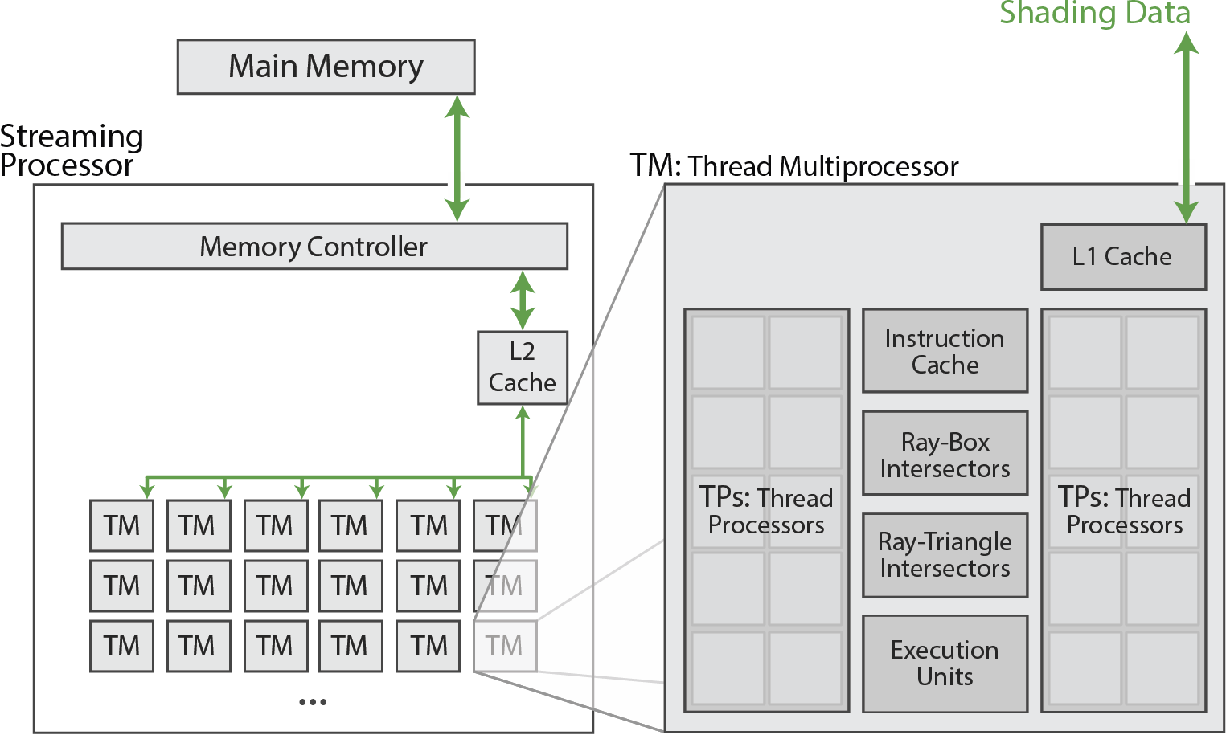
Hardware Architecture
Notes:
We designed the dual streaming traversal algorithm specifically to exploit the known DRAM behavior and created custom memory subsystem to accelerate this traversal.
The architecture shares a lot of common traits with many parallel architectures like shared resources, many threads organized hierarchically and operation in SPMD mode.
The small L2 data cache is used only for shading data, NOT stream data. What makes dual streaming architecture unique is that it allows to use a sequence of buffers rather than caches for stream data. I will briefly highlight the hardware units dual streaming adds.

Slide 15
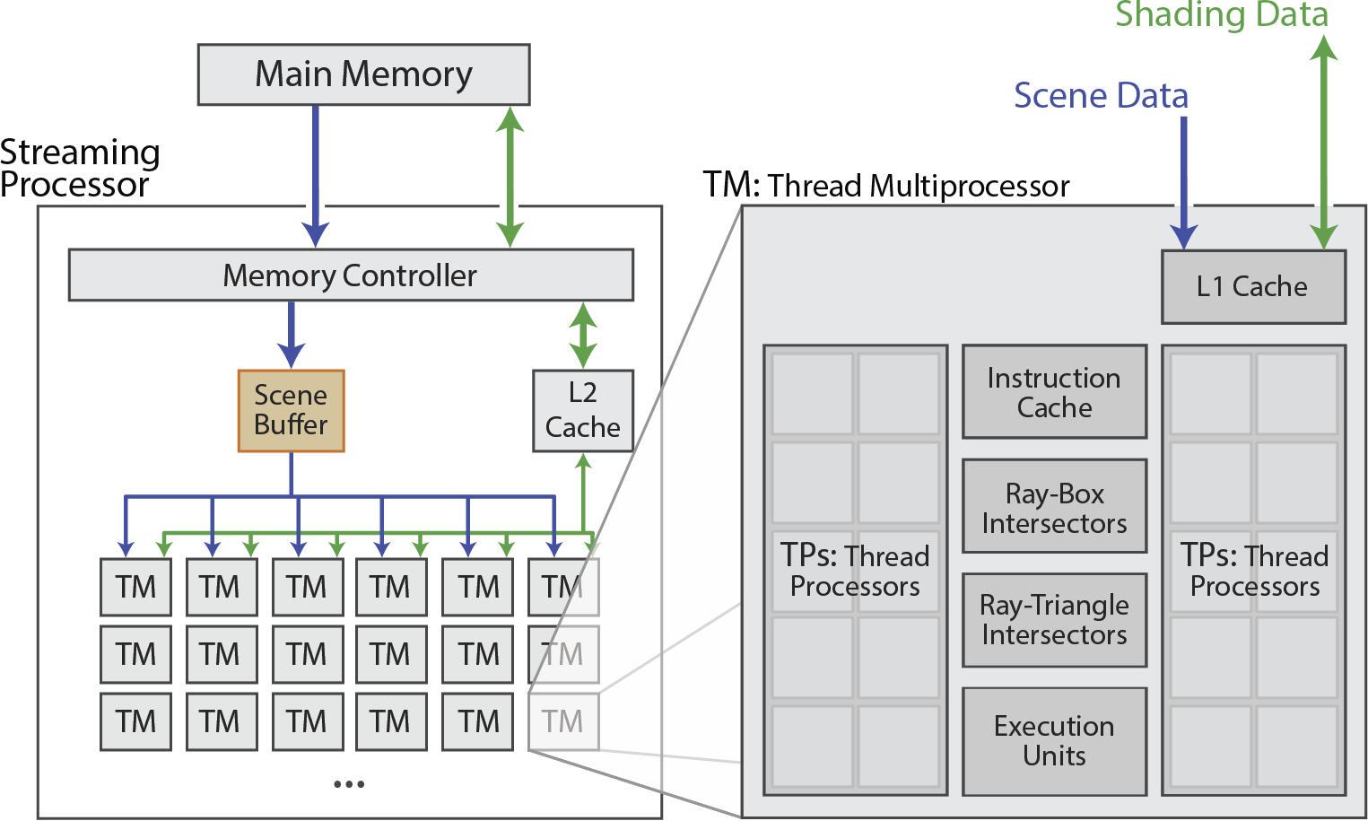
Hardware Architecture
Notes:
The scene buffer is a global unit that basically replaces a traditional L2 data cache. It fully stores a number of scene segments within. When a scene segment is scheduled, it is prefetched from DRAM into the scene buffer ahead of traversal. During traversal, each TP requests scene data from the L1 cache. After a cache miss, the L1 cache fetches data from the scene buffer, which does not reach out to DRAM itself.

Slide 16
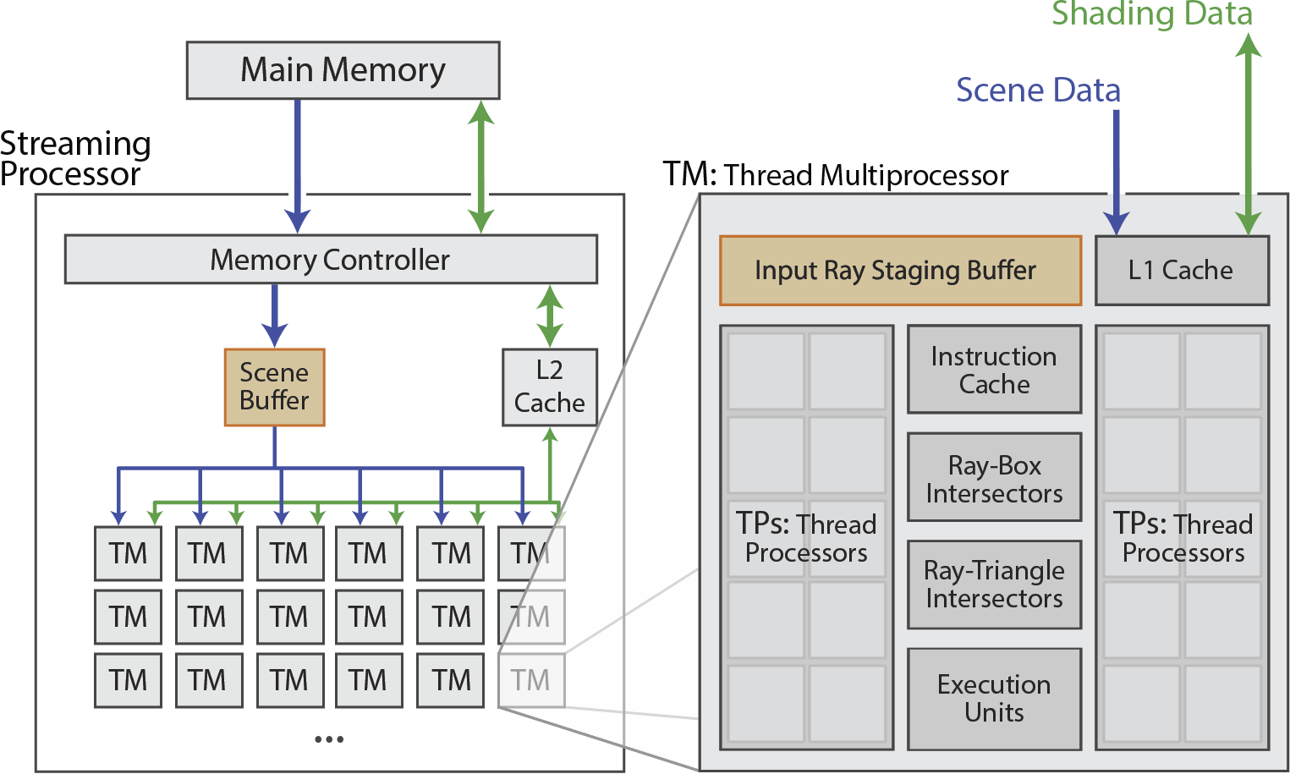
Hardware Architecture
Notes:
To accommodate the ray stream, our thread multiprocessors include a special staging buffer. The input ray staging buffer stores 2 ray buckets: one for processing and another for prefetching. Threads request rays from it. Note this unit is also not a cache.

Slide 17
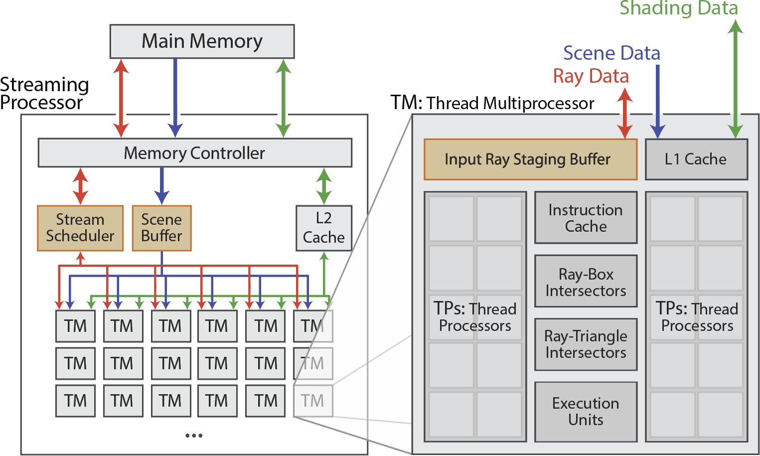
Hardware Architecture
Notes:
The stream scheduler manages the workload for the chip. It prefetches ray buckets into ray staging buffers, and writes rays out from TMs into the main memory.

Slide 18
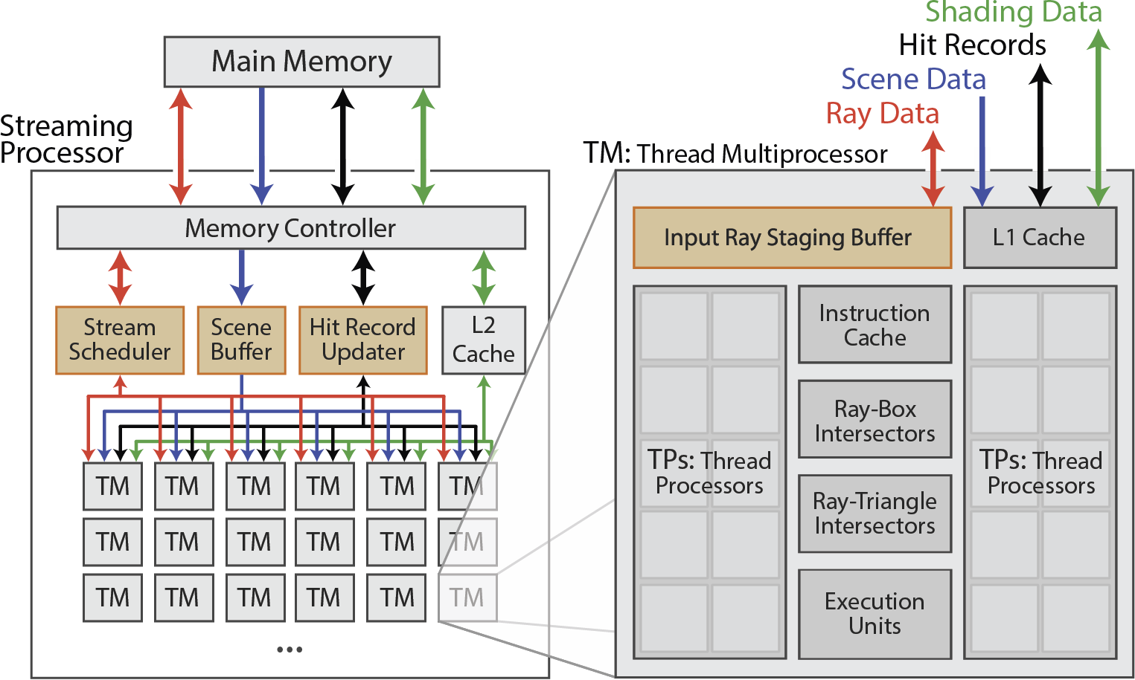
Hardware Architecture
Notes:
Finally, dual streaming introduces another global unit: the hit record updater. It updates hit records atomically because rays can be duplicated.

Slide 19
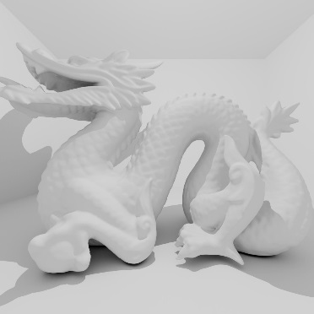
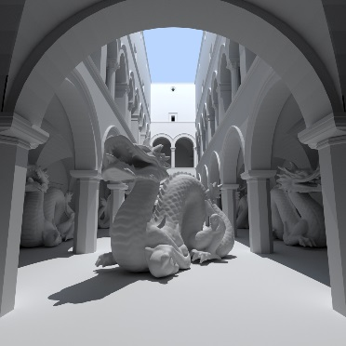
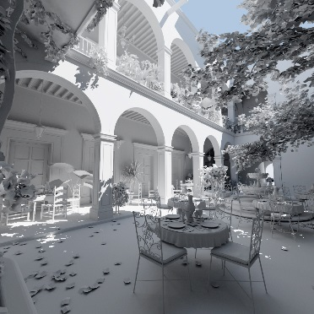
Results: Scenes
Dragon
870 K
Dragon Box
870 K
Dragon Sponza
6.6 M
San Miguel
10.5 M
Benchmark
Notes:
We evaluate the performance of our architectures using path tracing up to depth 5 to generate incoherent rays. We use 1024x1024 pixel resolution and all surfaces are Lambertian.
We tested 3 sets of scenes at different sizes. Benchmark scenes represent typical real-time scenarios. San Miguel uses no instancing.

Slide 20
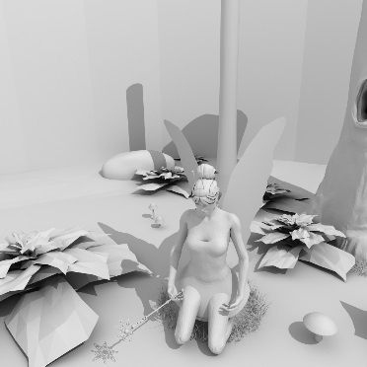
Results: Scenes
Dragon
870 K
Dragon Box
870 K
Dragon Sponza
6.6 M
San Miguel
10.5 M
Benchmark
Small
Fairy Forest
174 K
Crytek Sponza
262 K
Notes:
Small scenes are tiny and will fit into on-chip caches. They were selected to evaluate the overhead of dual streaming.

Slide 21
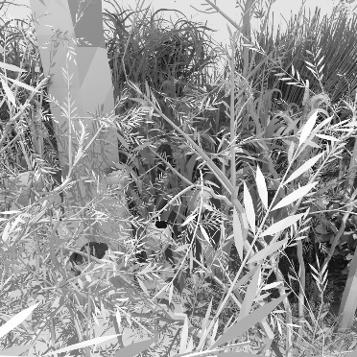
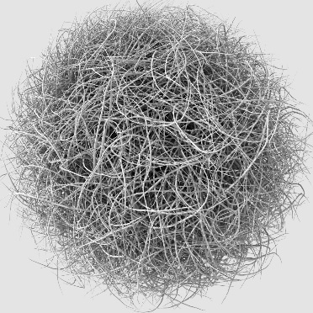
Results: Scenes
Dragon
870 K
Dragon Box
870 K
Dragon Sponza
6.6 M
San Miguel
10.5 M
Benchmark
Small
High Depth Complexity
Fairy Forest
174 K
Crytek Sponza
262 K
Vegetation
1.1 M
Hairball
2.9 M
Notes:
Scenes with high depth complexity can benefit significantly from early ray termination, which is not present in the current implementation of dual streaming.

Slide 22
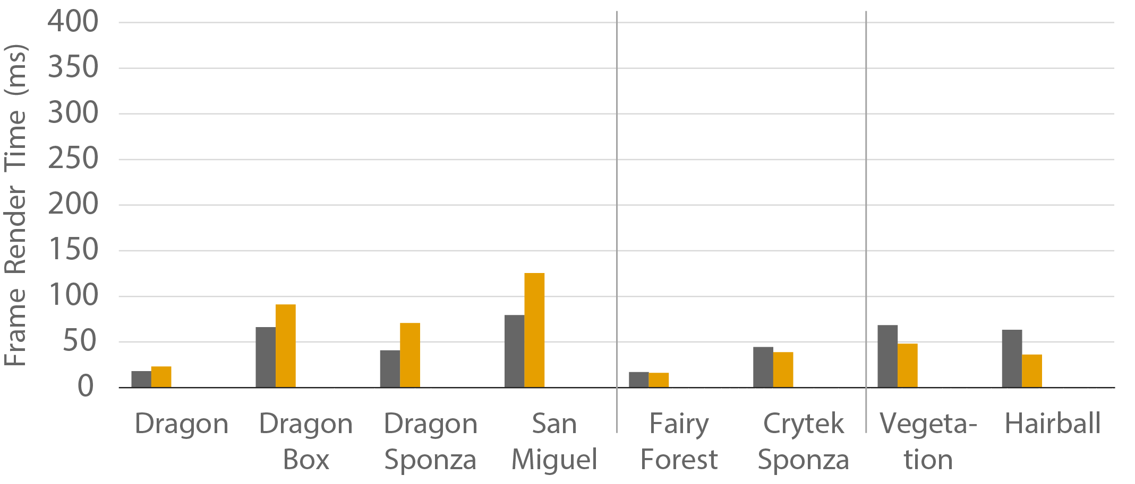
Results: Render Time
Strata no early termination
Benchmark
Small
High Depth
Complexity
Notes:
First, let’s consider the frame render time. We compare dual streaming to our previous ray tracing architecture named strata, because it is focused on optimizing DRAM access patterns for scene data. However, strata uses traditional ray traversal order, unlike dual streaming. Both processors are set up equivalently.
Dual streaming outperforms strata in benchmark scenes, with a wider gap for larger scenes, like San Miguel. The rendering times are similar between dual streaming and strata for small scenes. For scenes with high depth complexity, our current implementation of dual streaming performs worse because it lacks early ray termination and relies on more ray intersection tests and higher ray duplication rate.

Slide 23
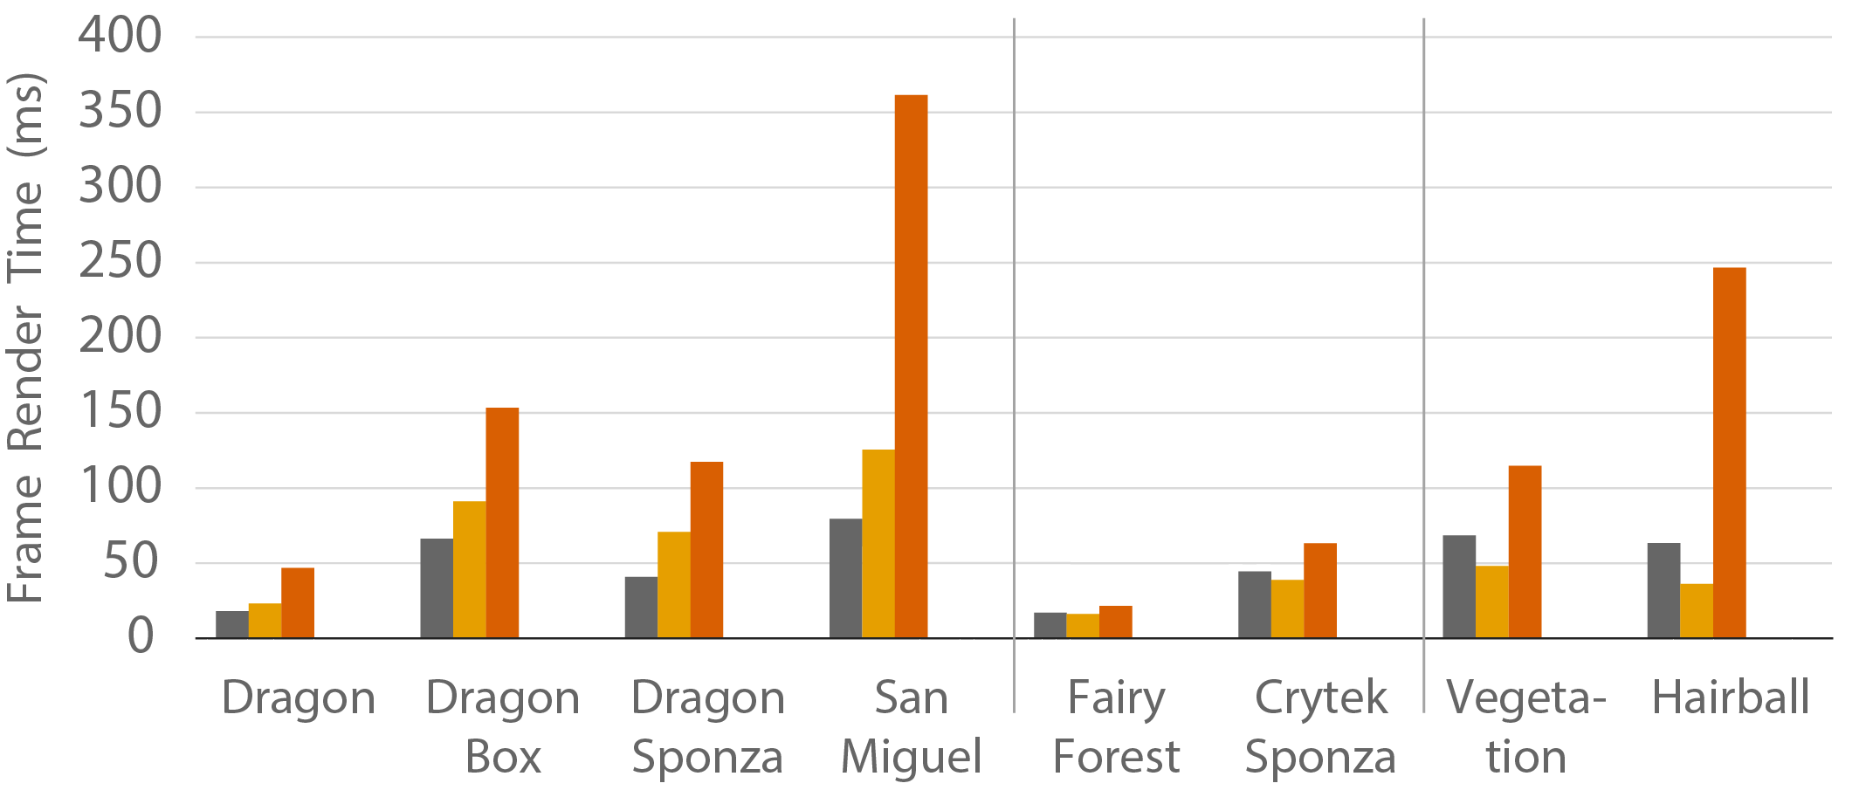
Results: Render Time
Strata no early termination
Benchmark
Small
High Depth
Complexity
Notes:
To evaluate the effect that early ray termination has on performance, we also compare strata with early termination disabled. It performs significantly worse in all metrics for all scenes.

Slide 24
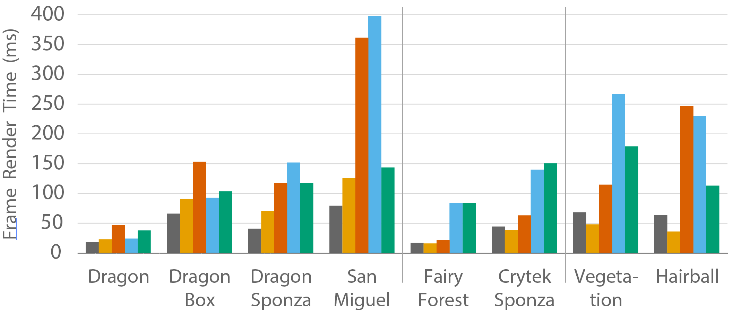
Results: Render Time
Benchmark
Small
High Depth
Complexity
Notes:
We also compared to OptiX and Embree running on real hardware. Please consider these numbers as a point of reference rather than apples to apples comparison.
We used contemporary hardware configuration for these tests. Dual Streaming and Strata were set up equivalently, while OptiX and Embree ran on recent hardware.

Slide 25
Results: Configurations
 | Dual Streaming | STRaTA | OptiX | Embree
Processor | custom | custom | NVIDIA GTX Titan | Intel i7-5960X
# cores | 2048 | 2048 | 2688 | 8 (16)
frequency | 1 GHz | 1 GHz | 0.9 GHz | 4.6 GHz
on-chip memory | 7.7 MB | 9.2 MB | 5.9 MB | 22.5 MB
DRAM bandwidth | 512 GB/s | 512 GB/s | 288 GB/s | 75 GB/s
Notes:
Similar core counts and frequency to GPU.
The on chip memory includes all buffers, caches and register files.
More up to date BW.

Slide 26
Results: Frame Energy
Notes:
Besides rendering time, it is important to consider energy taken per frame. In our simulations, DRAM used about half, compute 3% at most and the rest was used by the on-chip memory system. Because DRAM takes such a significant portion, we look at it specifically.

Slide 27
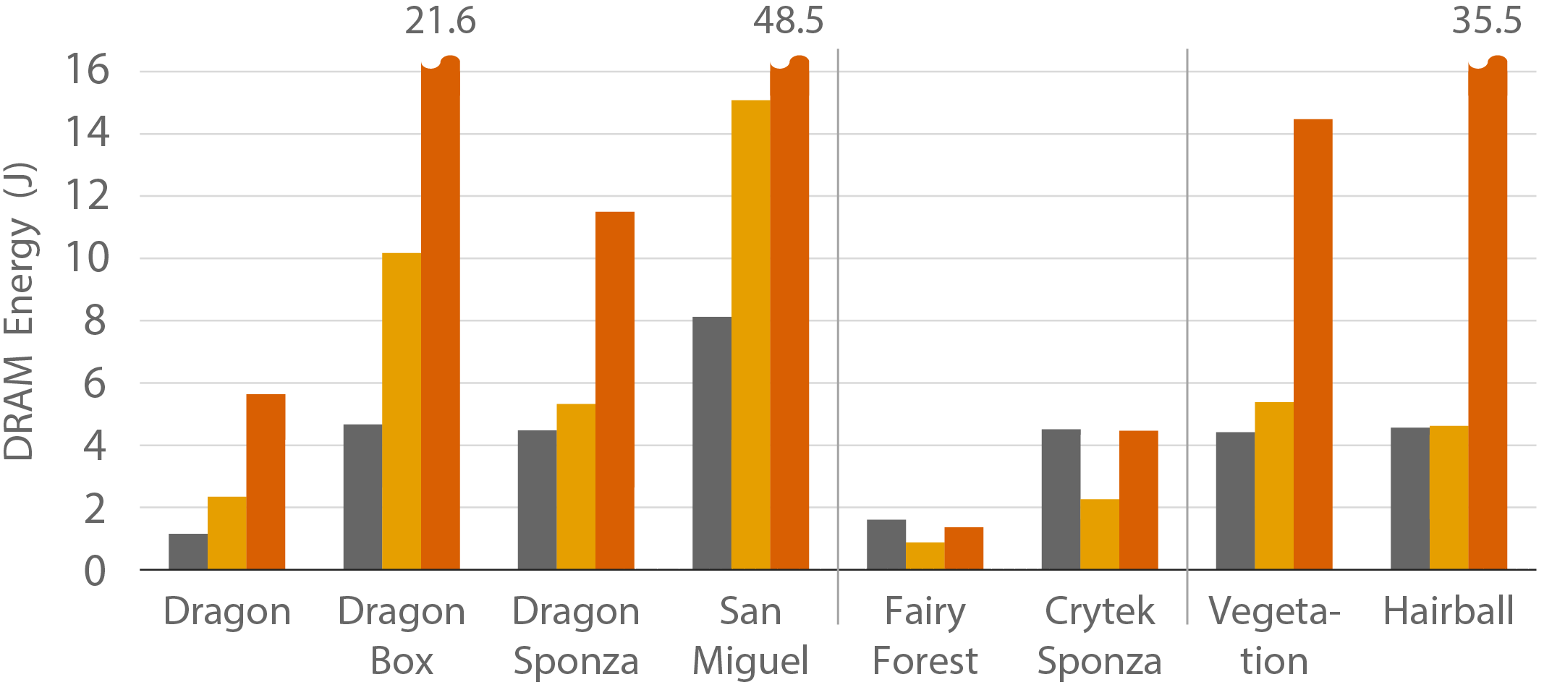
Results: DRAM Energy
Benchmark
Small
High Depth
Complexity
Notes:
Once again, dual streaming performs better in the benchmark scenes.
The small scenes use more DRAM energy. This is because dual streaming introduces extra DRAM traffic from the ray stream, while Strata keeps its rays on chip.
Even though performance for scenes of high depth complexity is somewhat worse than strata, dram energy is still reduced.
Notice that strata without early termination requires considerably more DRAM energy in all but small scenes. This can be attributed to a significant increase in memory traffic (2x than strata)

Slide 28
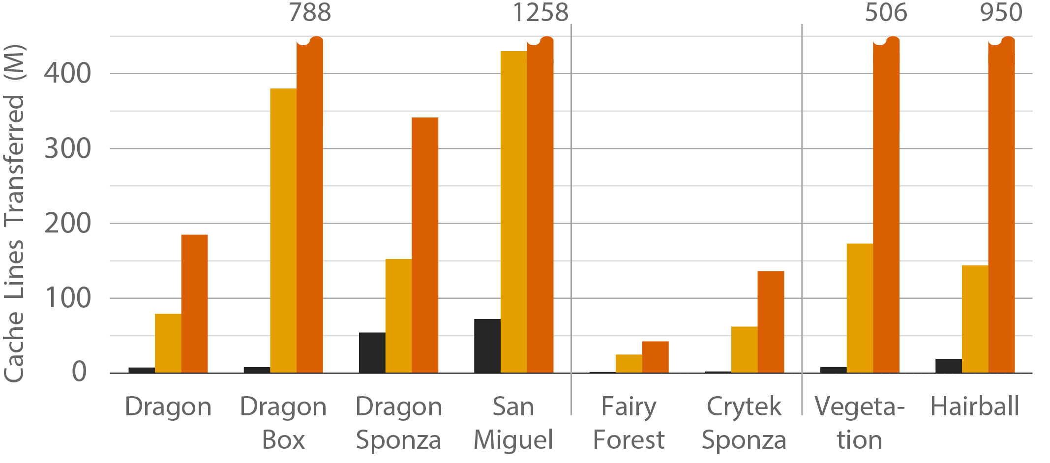
Results: Scene Traffic
Benchmark
Small
High Depth
Complexity
Notes:
We measure total traffic as the number of cache lines transferred between DRAM and the processor. First, let’s consider scene traffic only. It is clear that dual streaming reduces scene traffic significantly for all scenes, even the small scenes.

Slide 29
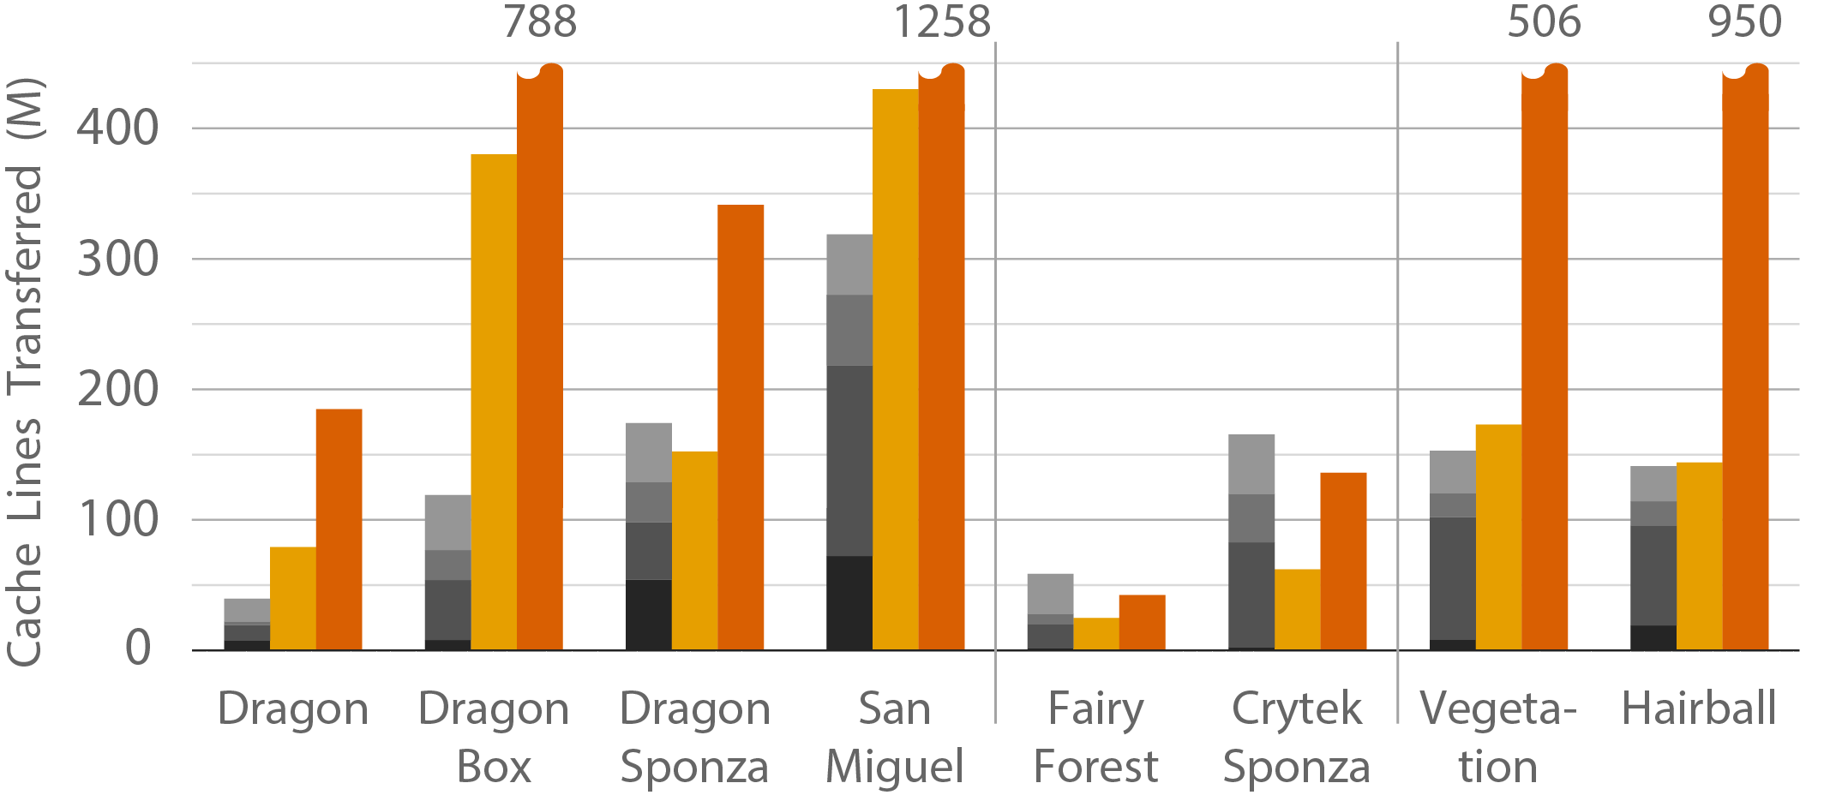
Results: All Traffic
Benchmark
Small
High Depth
Complexity
Notes:
However, dual streaming trades some of that traffic savings for the ray stream, hit record and shading data. The ray stream makes up a large portion of the total traffic. This is because of ray duplication and lack of early ray termination in the current implementation. Reducing this creates an interesting opportunity for future work.

Slide 30
Results: All Traffic
Benchmark
Small
High Depth
Complexity
Notes:
Note Dragon Sponza scene. Even though dual streaming improves performance and reduces DRAM energy, it transfers more data from DRAM. This result is not intuitive: more transfers can lead to lower energy and latency IF we can use DRAM row buffer efficiently.
Please see the paper for more in depth evaluation of dual streaming.

Slide 31
Future Work
Early ray termination
Notes:
The new ray traversal order gives us a lot of benefits but also exposes new and interesting challenges. They represent fertile ground for future research. See the paper for a more in depth discussion. I will mention only a few here.
Implementing early ray termination is non-trivial because rays can be duplicated. Our paper evaluates a couple of approaches but they were only marginally effective. Likely further changes to the algorithm and hardware are required.

Slide 32
Future Work
Early ray termination
Dynamic traversal order
Notes:
Performance could be improved significantly by adjusting the order of scheduling segments. One could use dynamic statistics to update this ordering on the fly. This could dramatically increase the effectiveness of early termination schemes.

Slide 33
Future Work
Early ray termination
Dynamic traversal order
Treelet assignment
Notes:
For our evaluation we used treelets built to minimize SAH. However, alternative build schemes could help. For example would shallower or deeper treelets reduce ray duplication?

Slide 34
Future Work
Early ray termination
Dynamic traversal order
Treelet assignment
Data compression
Notes:
Finally compressing both streams. Decreasing ray stream can reduce its impact on total traffic significantly, and improve performance. Compressing scene data will likely reduce ray traffic. It would reduce the total number of segments and thus reduce ray duplication.

Slide 35
Conclusion
First fully streamed formulation of ray tracing
scene, ray streams
predictive memory access
new traversal order
scene traffic at absolute minimum
Hardware architecture
Notes:
So in conclusion, we reformulate ray tracing for the first time in a fully streamed fashion. The two streams, one for scene and ray data, access memory in a way that is predictive for perfect prefetching and exploits DRAM behavior.
Besides regularizing the memory traffic for scene data, the new traversal order drives it to its absolute minimum.
We also co-designed a hardware architecture implementing dual streaming. We believe our work only scratches the surface of the predictable traversal order and opens up a lot of exciting opportunities for future research.

Slide 36
Acknowledgments
Josef Spjut
Elena Vasiou
Frank Meinl
Marko Dabrovic
Samuli Laine
Guillermo Leal Llaguno
Cem Yuksel
Anonymous reviewers
This work is supported in part by the National Science Foundation under Grant No. 1409129.
Notes:
We would like to acknowledge many folks for providing feedback and scenes for our work. And of course NSF for supporting it.

Slide 37
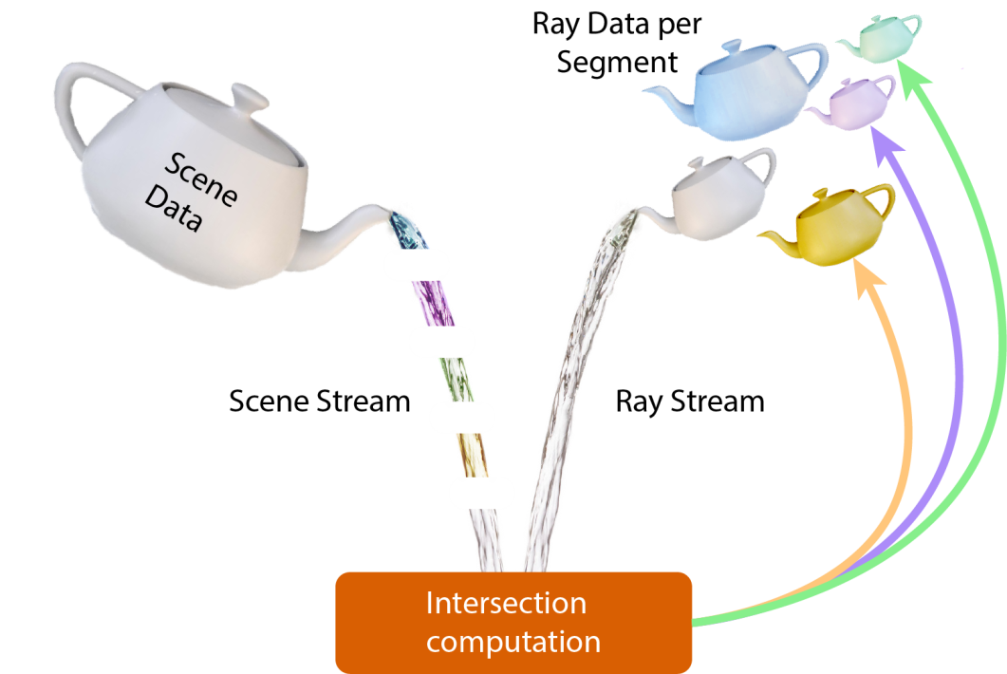
Thank you!

