Slide 1
Vectorized Production Path Tracing
Mark Lee
Brian Green
Feng Xie
Eric Tabellion
DreamWorks Animation
Notes:
Today I’m going to describe the some of the approaches we took, when faced with the opportunity to write a brand new renderer from scratch.
That renderer is named MoonRay.

Slide 2
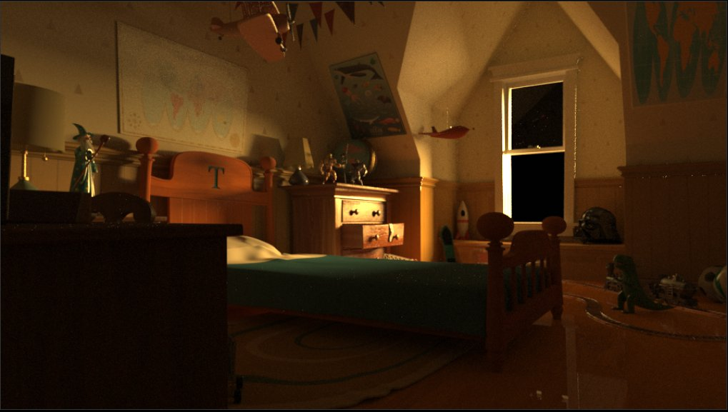
Hello MoonRay
Notes:
MoonRay is a brand new production renderer developed in house, to replace our previous micro-polygon based renderer called MoonLight.
At it’s core, it’s a modern physically based Monte Carlo path tracer, which runs on CPU.
Some of the interesting architectural aspects of MoonRay are its approach to performance and scalability.
Vectorization is a big part of this, and is primarily what I’ll be talking about in this presentation.

Slide 3
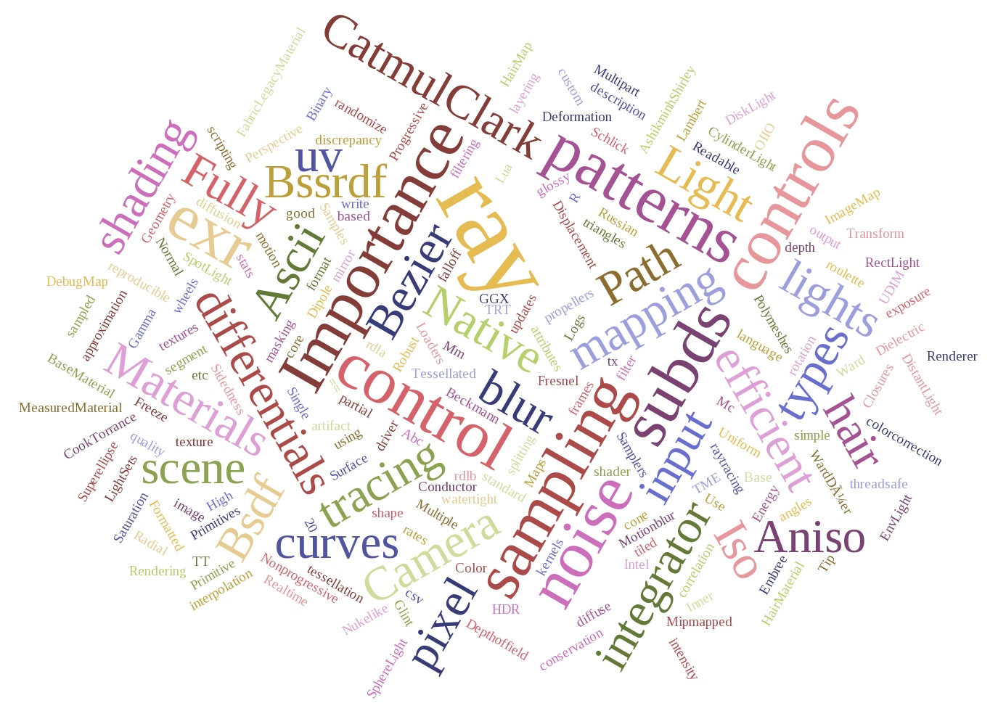
Notes:
Even though MoonRay is still relatively young, it supports a wide range of features, enough to put it to work on its first major production.
It’s built on a unidirectional path tracing kernel, in which we make heavy use of multiple importance sampling, next event estimation, and path splitting with russian roulette, among other techniques.

Slide 4
Hello MoonRay
Notes:
It also supports many high end features required for full scale film production, such as AOVS, light path expressions, subsurface scattering, hair, volumes, instancing, and a wealth of production ready physically plausible shaders.

Slide 5
MoonRay Overview
Single executable with internal scalar and vectorized code paths
Both code paths produce identical output images
Notes:
1. MoonRay is a single executable which contains both scalar and vectorized implementations of major portions of the rendering phase. We use a command line flag to switch between these 2 modes.
2. It’s important to note that both modes produce identical output images. The scalar code path is not simply a way to bootstrap the vectorized mode, it actually represents the fastest scalar renderer we were capable of writing. In this paper we use it as a baseline to compare the vectorized mode to.

Slide 6
Data Oriented Design
Nothing new, AAA game studios have always done this
Approach the problem from the point of view of the hardware
… which means caring greatly about data access patterns
Lower level data structures are flat and uncomplicated
Notes:
Before diving into the vectorized mode, let’s look at some ideas with apply equally to both modes, the first is Data oriented design.
In the quest for faster rendering, we have borrowed some practices from the gamedev world, where speed is of paramount importance.
In particular we’ve approached the path tracing problem from a data-oriented design perspective.
Whereas an object oriented approach might focus on how to decompose a problem in terms of higher level abstractions, DOD focuses on how the problem can be efficiently mapped to the underlying hardware.
With the seemingly constant increases in core counts, but relatively slow increases in memory latency and bandwidth, it means we have to pay close attention to how data flows through the system.
An example of how this has impacted MoonRay are we’ve made deliberate decisions to process sequential batches of data where possible since modern CPUs are very good at automatically prefetching sequential data.
Layers of abstraction make this task more complex, so many of the low level data structures are flat and simple.

Slide 7
How would it change your approach to coding if main memory access was 10x slower?
Notes:
Here is an interesting thought experiment, ask yourself how you would code differently if all main memory accesses were 10x slower.
This is actually quite a reasonable mindset for writing high performance code on modern CPUs.

Slide 8
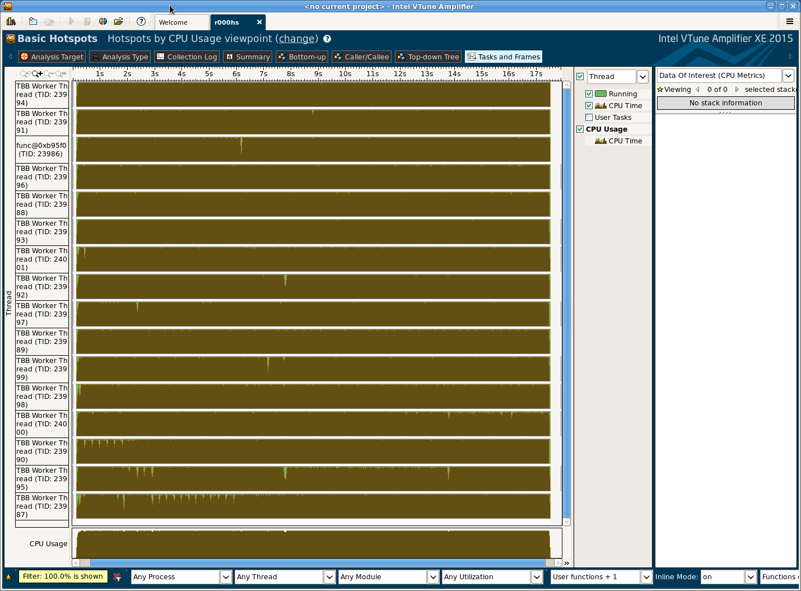
Threading
Notes:
To ensure that MoonRay scales well, we removed all locking and thread synchronization from within the rendering phase, with a couple of small exceptions.
The decision to avoiding locking was impactful - for example, during the render phase it ruled out allocating memory from the global heap, or running any deferred procedurals.
In return though, we observe near linear scaling all the way up to 100s of cores.

Slide 9
Keep all vector lanes of all cores busy all the time with meaningful work!
Notes:
So the scalar code path in MoonRay represents our best attempt at making a very performant scalar path tracer.
In implementing this code path, much of the low hanging optimization fruit was picked.
Still a non-trivial area of the CPU die was seeing very little use in our code, that was the area devoted to SIMD operations.
An early mantra became “Keep all vector lanes of all cores busy all the time with meaningful work”.
This isn’t actually achievable in practice, but served as a goal to strive toward.

Slide 10
Keep all vector lanes busy….
How can we use the vector hardware effectively?
How can we gather batches of work effectively?
How can we minimize control flow divergence in vector code?
How can we access memory effectively?
Notes:
Many questions arise from this goal…

Slide 11
Will the performance gains outweigh the additional work?
Notes:
And this is the biggest question of all - will the performance gains outweigh the additional work?

Slide 12
c
c
c
c
=
c
=
a
+
b
c
=
a
+
b
a
a
a
a
c
=
a
+
b
+
c
=
a
+
b
b
b
b
b
AOS Format
SOA Format
Notes:
Let’s start off with a quick overview of how MoonRay uses the vector hardware.
Essentially, we want to map each scalar computation to its own dedicated vector lane.
The data is on the left is laid out in what’s known AOS, or arrays of structures, format.
To effectively make use of SIMD hardware, we need to transform these AOS data structures to SOA, or structures or arrays format, as shown on the right.

Slide 13
AOS to SOA Conversion
Notes:
So how do we do this efficiently?

Slide 14
D
C
B
A
Notes:
Let’s say we have 4 AOS data structures in memory which we want to process in a vectorized fashion...

Slide 15
D
C
B
A
Notes:
We allocate temporary arena memory for the final SOA block, then copy the AOS structures in, in the desired sort order.
Since all the AOS data locations are known ahead of time, each can be pre-fetched in advance.

Slide 16
D
C
B
A
SOA Packet
Memory Transposition
Notes:
Once the AOS structures are copied over, we perform an in-place matrix transpose using SIMD unpack, permute and shuffle instructions.
This was a simple case, but larger data structures can also be transformed using this approach by breaking them down into smaller blocks according to the targeted vector lane width.
Now the data is ready to be ingested by ISPC.

Slide 17
ISPC
ISPC = Intel SPMD Program Compiler
Can target multiple vector architectures, e.g. SSE, AVX, AVX512
Automatic masking
C like syntax
Notes:
Standard C++ isn’t well suited to to writing vectorized code so we embraced a language from Intel called ISPC.
So what is ISPC?
1. ISPC stands for “Intel SPMD Program Compiler”, with the SPMD standing for single program multiple data. That’s is, you write scalar looking code, and it works on multiple lanes automatically.
2. ISPC can target various SIMD instruction sets.
3. It also supports automatic masking when branches are encountered.
4. The code itself is familiar looking, since its syntax is very C like. This has been important in allowing the shading team jump in and start writing vectorized shaders without a large ramp up time.

Slide 18
Queuing
Strategy - use “queues” to build up large coherent batches of work
Queues entries typically consist of a 32-bit index and a 32-bit “sort key”
Each queue has an associated handler to process entries
Notes:
The scalar code path spawns rays in a depth first fashion, one at a time.
To make effective use the SIMD hardware, we want to work in batches.
To achieve this, we chose to re-express depth first path tracing as a breadth first traversal.
1. The strategy is to use queues as a buffer area, in which we build up sizeable chunks of work, to ensure all vector lanes are filled.
2. Most queues in the system are very compact, with each entry consisting of a reference to ray state, and a 32-bit sort key
3. Each queue has an associated handler, which we invoke when the queue fills up.

Slide 19
When a queue becomes full,
the thread which filled it flushes it
Notes:
So how do we determine when to flush a queue?
The rule is simply “when a queue becomes full, the thread which filled it flushes it”
This approach means no central scheduler is needed, and doesn’t create any dependencies between threads.
An autonomous scheduling naturally falls out.

Slide 20
Scalar Path Tracing
Notes:
Here is a breakdown of the typical scalar depth first we all know and love.

Slide 21
Scalar Path Tracing
Generate primary rays
Notes:
First we generate one or more primary rays for each pixel and fire them into the scene.

Slide 22
Scalar Path Tracing
Generate primary rays
Trace primary ray
Notes:
Each primary ray is intersected with scene BVH to determine if we’ve hit any geometry.

Slide 23
Scalar Path Tracing
Generate primary rays
Trace primary ray
Shader graph eval at hit point
Texture eval at hit point
Integration at hit point
Spawn and trace secondary rays
Spawn and trace occlusion rays
Accumulate radiance
Notes:
This next block encapsulates the recursive aspects of path tracing.
The hit point is shaded, which includes looking up any required textures.
This results in a shader closure which compactly describes the surface appearance at the hit point,
This shader closure is sent into the integrator to be lit.
To capture indirect light, each ray may spawn one or more additional rays in a depth first fashion.
This process continues until the ray termination criteria are met.

Slide 24
Scalar Path Tracing
Generate primary rays
Trace primary ray
Shader graph eval at hit point
Texture eval at hit point
Integration at hit point
Spawn and trace secondary rays
Spawn and trace occlusion rays
Accumulate radiance
Frame Buffer
Notes:
And finally the accumulated radiance for that ray tree is added into the frame buffer.

Slide 25
Vectorized Path Tracing
Notes:
Now I am going to describe how we’ve mapped the scalar, depth-first, path tracing algorithm into the corresponding breadth-first vectorized version.

Slide 26
Vectorized Path Tracing
Generate primary rays
Primary Ray Queue
Notes:
We start off by generating primary rays.
Instead of directly intersecting these rays with the scene geometry, we add them to a primary ray queue.

Slide 27
Vectorized Path Tracing
Generate primary rays
Primary Ray Queue
Primary Ray Queue Handler
Notes:
When the number of queued primary rays hits its pre-configured queue size limit, we pass them onto the associated queue handler.
The handler sends the rays into embree for ray / geometry intersection.

Slide 28
Vectorized Path Tracing
Generate primary rays
Primary Ray Queue
Primary Ray Queue Handler
Shade Queue (shared)
Notes:
Intersecting each ray with scene geometry returns hit point information, as well as surface shader information.
We pre-allocate a separate queue per material instance.
This enables us to minimize control flow divergence since all entries in a shade queue are guaranteed to execute the same shader code, which will be invoked with the same shader parameters.
Like other queues in the system, a shader queue is only flushed after it fills up.

Slide 29
Vectorized Path Tracing
Generate primary rays
Primary Ray Queue
Primary Ray Queue Handler
Shade Queue (shared)
Radiance Queue
Notes:
Another possibility is that a primary ray doesn’t actually intersect any scene geometry at all.
In that case we test if it hit any lights and add the light contribution to the radiance queue.

Slide 30
Vectorized Path Tracing
Generate primary rays
Primary Ray Queue
Primary Ray Queue Handler
Shade Queue (shared)
Radiance Queue
Radiance Queue Handler
Frame Buffer
Notes:
There is a potential scaling problem, however, when dealing with tens or hundreds of threads, all potentially trying to write radiance samples into a shared frame buffer.
This is true despite not locking and only using atomic operations to update radiances.
To alleviate this, we first sort radiance queue entries by the pixel they belong to, and accumulate them locally before attempting the atomic update.
So the reason radiance queues exist at all in our architecture is purely for scalability reasons.

Slide 31
Vectorized Path Tracing
Generate primary rays
Primary Ray Queue
Primary Ray Queue Handler
Shade Queue Handler
Shade Queue (shared)
Radix sort queue entries
Vectorized shader graph eval
Vectorized texture eval
Vectorized integration
Radiance Queue
Radiance Queue Handler
Frame Buffer
Notes:
So let’s see what happens when a shade queue fills and needs to be flushed.
The central idea behind having one handler which performs all shading, texturing, and integration work, is that AOS to SOA conversion is not free, and so we want to only perform it once per ray segment.
This is the point in the pipeline where were switch over to fully vectorized execution.

Slide 32
Shade Queue Handler
Radix sort queue entries
Vectorized shader graph eval
Vectorized texture eval
Vectorized integration
Notes:
This is the zoomed in view of the shade queue handler.

Slide 33
Shade Queue Handler
Radix sort queue entries
Transform AOS entries to SOA
Vectorized shader graph eval
Vectorized texture eval
Vectorized integration
Transform SOA entries back to AOS
Notes:
Now that it’s expanded, there are 2 other blocks we can add to fill in some extra details.
The yellow blocks represent vectorized code, namely shading, texturing, and integration, which are sandwiched between a pair of green blocks.
These green blocks are responsible for transforming the data back and forth between AOS and SOA.

Slide 34
Shade Queue Handler
Entry sort criteria
UDIM tile
Mip-level
Uv coordinates
Radix sort queue entries
Transform AOS entries to SOA
Vectorized shader graph eval
Vectorized texture eval
Vectorized integration
Transform SOA entries back to AOS
Notes:
The inputs to the handler are the batch of entries which need to be shaded.
Before shading we first sort the entries to make texture lookups more coherent.
The box on the right shows the simplified set of the criteria we sort by.
The aim is to get as much reuse as possible out of each texture tile once loaded, before moving onto the next.

Slide 35
Shade Queue Handler
Radix sort queue entries
Transform AOS entries to SOA
Vectorized shader graph eval
Vectorized texture eval
Vectorized integration
Transform SOA entries back to AOS
Notes:
Once our entries are sorted, we’re ready to transform them into SOA format for consumption by the ISPC kernels.

Slide 36
Shade Queue Handler
Radix sort queue entries
Transform AOS entries to SOA
100% ISPC code
Optional JIT compilation via LLVM
Returns a shader closure in SOA format
Vectorized shader graph eval
Vectorized texture eval
Vectorized integration
Transform SOA entries back to AOS
Notes:
All SOA data is sent through an ISPC shading network to generate corresponding SOA shader closures.

Slide 37
Shade Queue Handler
Radix sort queue entries
Transform AOS entries to SOA
Custom OIIO vectorized texture sampler
Custom set-associative cache built on top of main OIIO tile cache
Vectorized shader graph eval
Vectorized texture eval
Vectorized integration
Transform SOA entries back to AOS
Notes:
This shading network will typically contain texture nodes also.
We make use of OpenImageIO for loading texture tiles, but to maintain vectorized execution in this part of the pipeline, we implemented our own custom texture sampler on top.
Please see the paper for more details about our OpenImageIO customizations.

Slide 38
Shade Queue Handler
Radix sort queue entries
Transform AOS entries to SOA
Vectorized shader graph eval
Ability to add to arbitrary queues
Supports arbitrary ray spawning
Vectorized texture eval
Vectorized integration
Transform SOA entries back to AOS
Notes:
The entire integrator, including code related to light and bsdf sampling runs in ISPC also.
The outputs, although in SOA format, don’t need to correspond one to one with the inputs, which allows us to spawn rays arbitrarily.

Slide 39
Shade Queue Handler
Radix sort queue entries
Transform AOS entries to SOA
Vectorized shader graph eval
Vectorized texture eval
Vectorized integration
Transform SOA entries back to AOS
Notes:
The entries which are returned from the integrator are still in SOA format, so we must convert them back to AOS format for subsequent queuing.
You may ask why the need to convert these back to AOS. We do this so that entries can be freely resorted during the next wavefront.

Slide 40
Vectorized Path Tracing
Generate primary rays
Primary Ray Queue
Primary Ray Queue Handler
Shade Queue Handler
Shade Queue (shared)
Radix sort queue entries
Vectorized shader graph eval
Vectorized texture eval
Vectorized integration
Radiance Queue
Radiance Queue Handler
Frame Buffer
Notes:
So let’s zoom back out to the macro scale again.

Slide 41
Vectorized Path Tracing
Generate primary rays
Primary Ray Queue
Primary Ray Queue Handler
Shade Queue Handler
Shade Queue (shared)
Radix sort queue entries
Vectorized shader graph eval
Vectorized texture eval
Vectorized integration
Radiance Queue
Radiance Queue Handler
Frame Buffer
Notes:
The first type of output which the integrator can generate are radiance values, one example of this is light from emissive surfaces.

Slide 42
Vectorized Path Tracing
Generate primary rays
Primary Ray Queue
Primary Ray Queue Handler
Shade Queue Handler
Shade Queue (shared)
Radix sort queue entries
Vectorized shader graph eval
Incoherent Ray Queue
Vectorized texture eval
Vectorized integration
Radiance Queue
Radiance Queue Handler
Frame Buffer
Notes:
The integrator can arbitrarily spawn rays, which are typically more incoherent than primary rays, so we put them into a separate incoherent ray queue.
Implementation wise, the primary ray queue and the incoherent ray queue are actually hooked up to the same handler.
We’ve made a distinction between these queues however since we don’t want to pollute the naturally coherent primary ray queue with any incoherent rays.
Speaking of ray queues, we did extensive testing with ray sorting also, details of which can be found in the paper.

Slide 43
Vectorized Path Tracing
Generate primary rays
Primary Ray Queue
Primary Ray Queue Handler
Shade Queue Handler
Shade Queue (shared)
Radix sort queue entries
Vectorized shader graph eval
Incoherent Ray Queue
Vectorized texture eval
Vectorized integration
Incoherent Ray Queue Handler
Radiance Queue
Radiance Queue Handler
Frame Buffer
Notes:
When the incoherent ray queue fills, we invoke the incoherent ray queue handler, which hands these rays to embree.

Slide 44
Vectorized Path Tracing
Generate primary rays
Primary Ray Queue
Primary Ray Queue Handler
Shade Queue Handler
Shade Queue (shared)
Radix sort queue entries
Vectorized shader graph eval
Incoherent Ray Queue
Vectorized texture eval
Vectorized integration
Incoherent Ray Queue Handler
Radiance Queue
Radiance Queue Handler
Frame Buffer
Notes:
And just like the primary ray queue handler, it generates results which either are sent to the appropriate shade queue or to the radiance queue.
The top red arrow is how we mimic depth first recursion in a breadth first context.

Slide 45
Vectorized Path Tracing
Generate primary rays
Primary Ray Queue
Primary Ray Queue Handler
Shade Queue Handler
Shade Queue (shared)
Radix sort queue entries
Vectorized shader graph eval
Incoherent Ray Queue
Vectorized texture eval
Vectorized integration
Occlusion Ray Queue
Incoherent Ray Queue Handler
Radiance Queue
Radiance Queue Handler
Frame Buffer
Notes:
The final type of output generated from the integrator are occlusion rays to lights.
There are no dependencies on these rays, they are strictly fire-and-forget.
Entries in this queue contain the ray and the amount of radiance to add to the frame buffer in the case that the light isn’t occluded.

Slide 46
Vectorized Path Tracing
Generate primary rays
Primary Ray Queue
Primary Ray Queue Handler
Shade Queue Handler
Shade Queue (shared)
Radix sort queue entries
Vectorized shader graph eval
Incoherent Ray Queue
Vectorized texture eval
Vectorized integration
Occlusion Ray Queue
Incoherent Ray Queue Handler
Radiance Queue
Occlusion Ray Queue Handler
Radiance Queue Handler
Frame Buffer
Notes:
This queue, like all other queues, will get flushed at some future point in time, and all the light contributions will be accounted for.

Slide 47
Vectorized Path Tracing
Generate primary rays
Primary Ray Queue
Primary Ray Queue Handler
Shade Queue Handler
Shade Queue (shared)
Radix sort queue entries
Vectorized shader graph eval
Incoherent Ray Queue
Vectorized texture eval
Vectorized integration
Occlusion Ray Queue
Incoherent Ray Queue Handler
Radiance Queue
Occlusion Ray Queue Handler
Radiance Queue Handler
Frame Buffer
Notes:
Rays which pass the occulusion tests are added to the radiance queue.

Slide 48
Vectorized Path Tracing
Generate primary rays
Primary Ray Queue
Primary Ray Queue Handler
Shade Queue Handler
Shade Queue (shared)
Radix sort queue entries
Vectorized shader graph eval
Incoherent Ray Queue
Vectorized texture eval
Vectorized integration
Occlusion Ray Queue
Incoherent Ray Queue Handler
Radiance Queue
Occlusion Ray Queue Handler
Radiance Queue Handler
Frame Buffer
Notes:
And that’s it, that’s the way data flows in and out of queues and handlers in the system.

Slide 49
Will the performance gains outweigh the additional work?
Notes:
Let’s return to the key question - will the performance gains outweigh the additional work.
To answer this we need to ask ourselves what type of speed up we can reasonably expect from attempting to vectorize a path tracer.
A naive estimate would be to divide the total rendering phase time by the number of vector lanes that the hardware supports.
For example, if running scalar takes 100 seconds, we might predict a figure of 25 seconds when running vectorized on SSE, since it’s 4 lanes wide.
This answer turns out to be woefully optimistic for a number of reasons.

Slide 50
Time
Scalar
Vectorized
Notes:
This graph will highlight some of the factors at play, and put perspective on the type of speedup we can reasonably expect.
We’ll compare scalar path tracing execution on the left vs vectorized execution on the right, time is along the Y axis.

Slide 51
Time
3rd party libraries
3rd party libraries
Scalar
Vectorized
Notes:
In general time spent in 3rd party libraries isn’t going to change too much between scalar and vectorized executions.
This is true, even if the library makes heavy use of vectorization internally.
For example, we use embree to handle all ray/geometry intersection duties in both the scalar and vectorized code paths.
Embree is already well vectorized internally, regardless of which mode we’re running in.
Ray intersection itself can take a sizeable percentage of the frame, and that is time in which we’re not going to see a significant speedup.

Slide 52
Time
Unsuitable for vectorization
Unsuitable for vectorization
3rd party libraries
3rd party libraries
Scalar
Vectorized
Notes:
The next category where we won’t see any speedup is code which is hard to vectorize, or is inherently scalar.
For example, currently in MoonRay, after we intersect geometry, we do the proceeding differential geometry computations with scalar code.

Slide 53
Scalar
Code
Time
Unsuitable for vectorization
Unsuitable for vectorization
3rd party libraries
3rd party libraries
Scalar
Vectorized
Notes:
All that remains in the scalar code path is code which is ripe for vectorization.
These block sizes are hypothetical BTW, and not based on real world profiles.
The combined height of all the blocks on the left gives the total time to render a scene in the scalar case.

Slide 54
Scalar
Code
Vectorized
Code
Time
Unsuitable for vectorization
Unsuitable for vectorization
3rd party libraries
3rd party libraries
Scalar
Vectorized
Notes:
That portion of the code can be nicely vectorized, and we should see some substantial gains here.
So far so good...

Slide 55
Scalar
Code
Queuing
Overhead
Vectorized
Code
Time
Unsuitable for vectorization
Unsuitable for vectorization
3rd party libraries
3rd party libraries
Scalar
Vectorized
Notes:
But we also have to account for extra work which is required by the vectorization machinery, work which doesn’t exist on the scalar side.
For example, any time spent queuing is pure overhead since this work doesn’t have to be done at all in the scalar code path.

Slide 56
Sorting
Overhead
Scalar
Code
Queuing
Overhead
Vectorized
Code
Time
Unsuitable for vectorization
Unsuitable for vectorization
3rd party libraries
3rd party libraries
Scalar
Vectorized
Notes:
The same goes for sorting queue entries.
This is required to keep inputs to vectorized kernels relatively coherent, which is important to minimize both CPU cache misses, and control flow divergence.

Slide 57
AOS/SOA
Overhead
Sorting
Overhead
Scalar
Code
Queuing
Overhead
Vectorized
Code
Time
Unsuitable for vectorization
Unsuitable for vectorization
3rd party libraries
3rd party libraries
Scalar
Vectorized
Notes:
Oh, and there’s also the AOS to SOA conversions to slow us down further.
So obviously it’s only worth vectorizating if the total render time can be significantly reduced.

Slide 58
Results
Notes:
Now let’s look at some real world scene profiles to see how they compare with the previous hypothetical graph.
We’ve targeted the AVX2 instruction set for all of these tests, allowing us to process groups of 8 rays simultaneously.

Slide 59
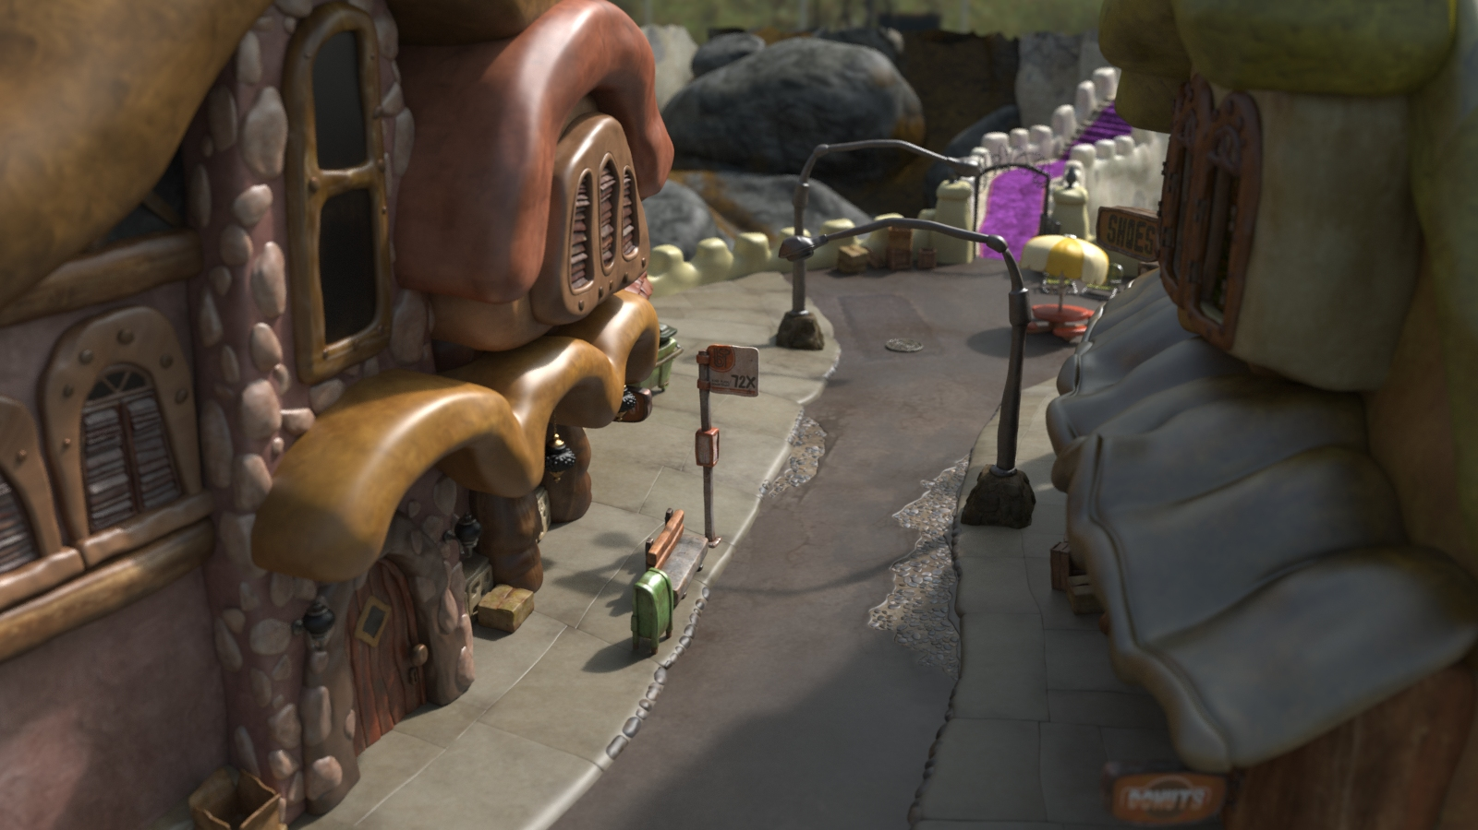
Notes:
This is a render of Bergen Town from the movie Trolls.

Slide 60
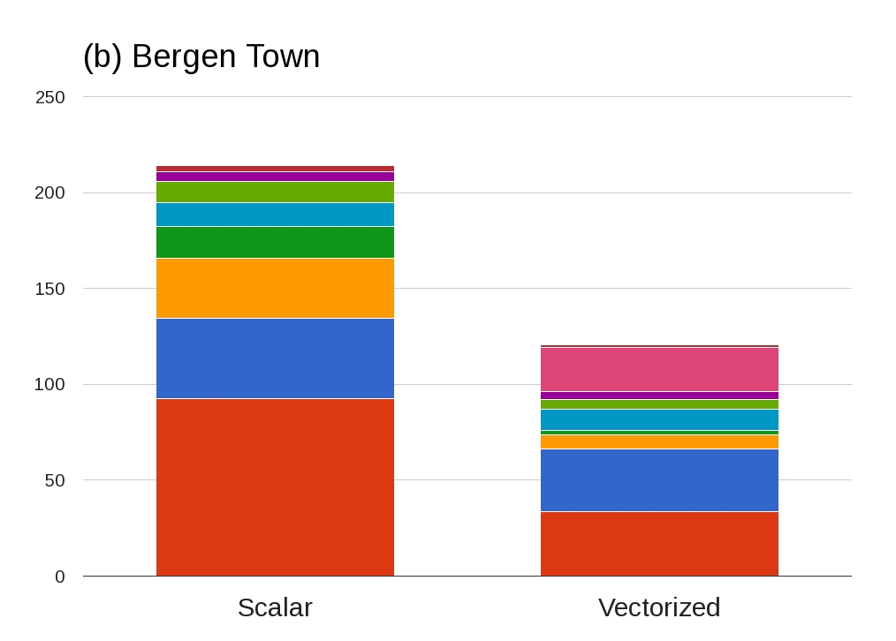
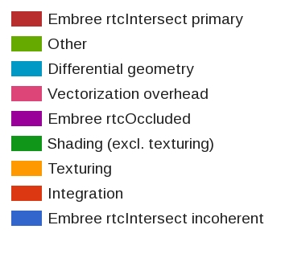
Shading
Texturing
Intersect incoherent
Vect overhead
Integration
Notes:
The charts for this scene show that integration time dominates here.
Such scenes are a good case for the vectorized code path, since any scenes where we spend a good portion of time doing integration, shading, and/or texturing stand to see the most benefit.
Even though the vectorization overhead, the pink block in the top middle, stands out, we still observe a 77% overall speedup for this scene.

Slide 61
Bergen Town Vectorization Speedups
Ray intersection subsystem speedup | 1.20x
Shading subsystem speedup | 6.19x
Texturing subsystem speedup | 4.24x
Integration subsystem speedup | 2.75x
Overall speedup | 1.77x
Notes:
Here are the subsystem specific speedups.
The shading speedup in particular stands out here.
Although the shaders themselves are relatively simple, it’s nice to see over a 6x speedup for this scene.

Slide 62
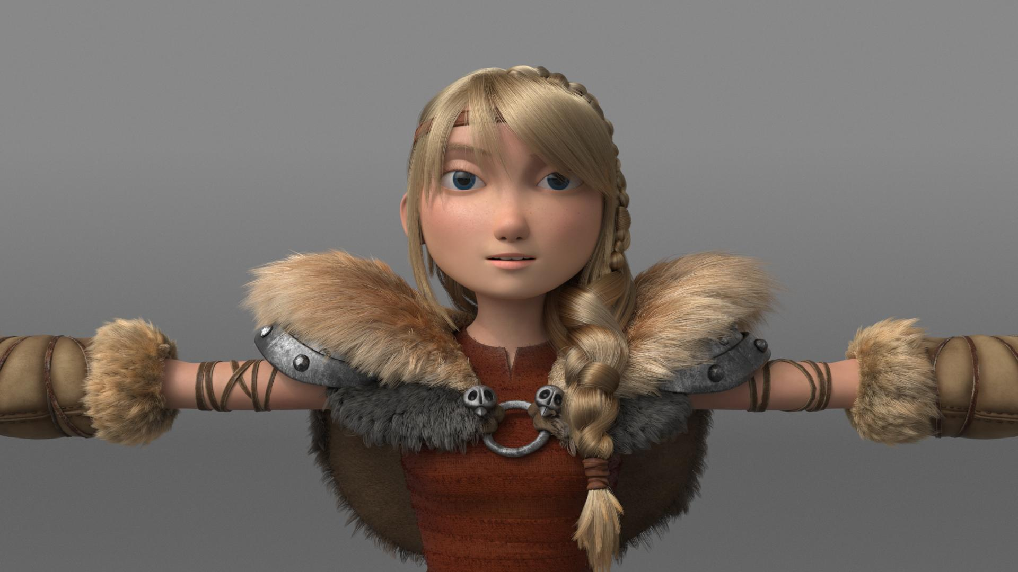
Notes:
Next is the character Astrid from the film How to Train your Dragon II.

Slide 63
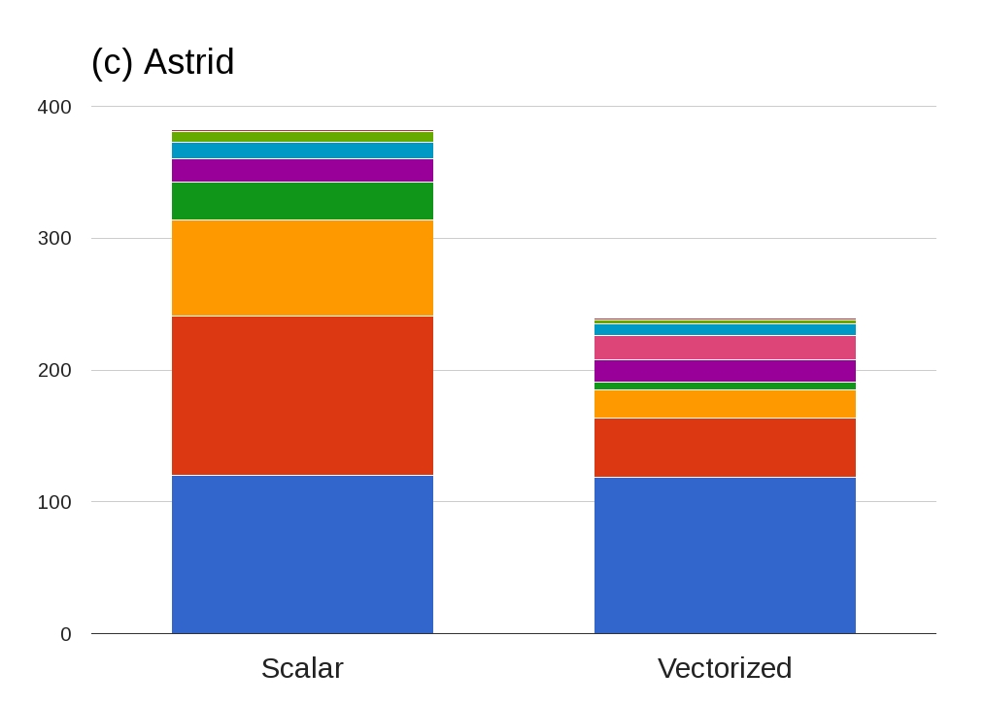
Shading
Texturing
Integration
Intersect incoherent
Notes:
There is a lot of fur and hair in this scene, and the biggest block of time, at the bottom in blue, is spent inside of embree.
This corresponds with the 3rd party library time we noted earlier, time which we don’t see any speedup.
Still we observe significant gains in shading, texturing, and integration, resulting in a 60% gain overall.

Slide 64
Astrid Vectorization Speedups
Ray intersection subsystem speedup | 1.00x
Shading subsystem speedup | 4.54x
Texturing subsystem speedup | 3.43x
Integration subsystem speedup | 2.68x
Overall speedup | 1.60x
Notes:
And the subsystem specific speedups...

Slide 65
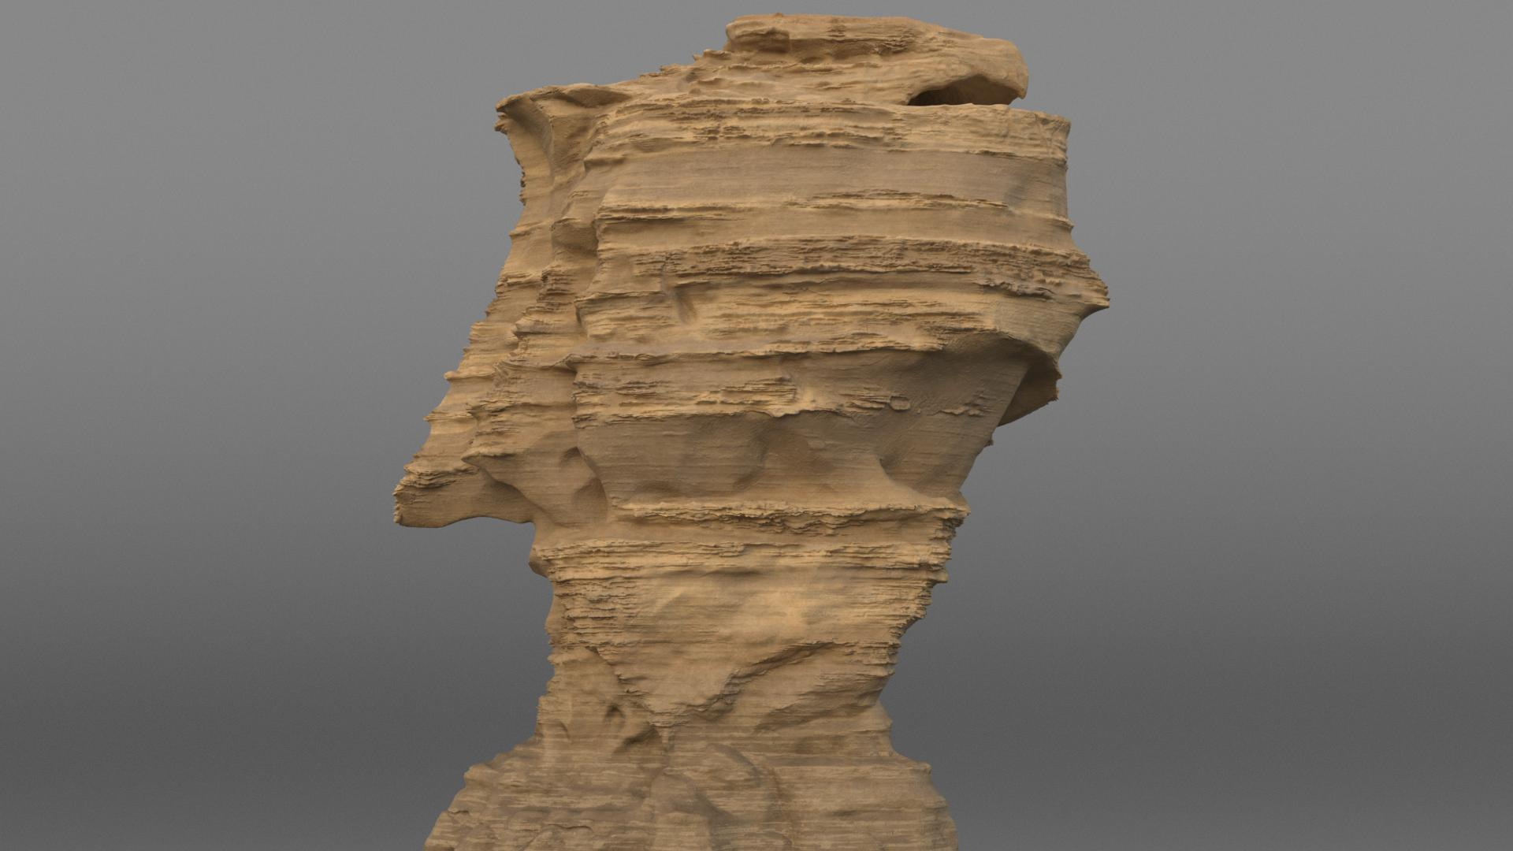
Notes:
I did want to show this particular asset, however, since it’s an example of where texturing, shading, and integration all dominate.

Slide 66
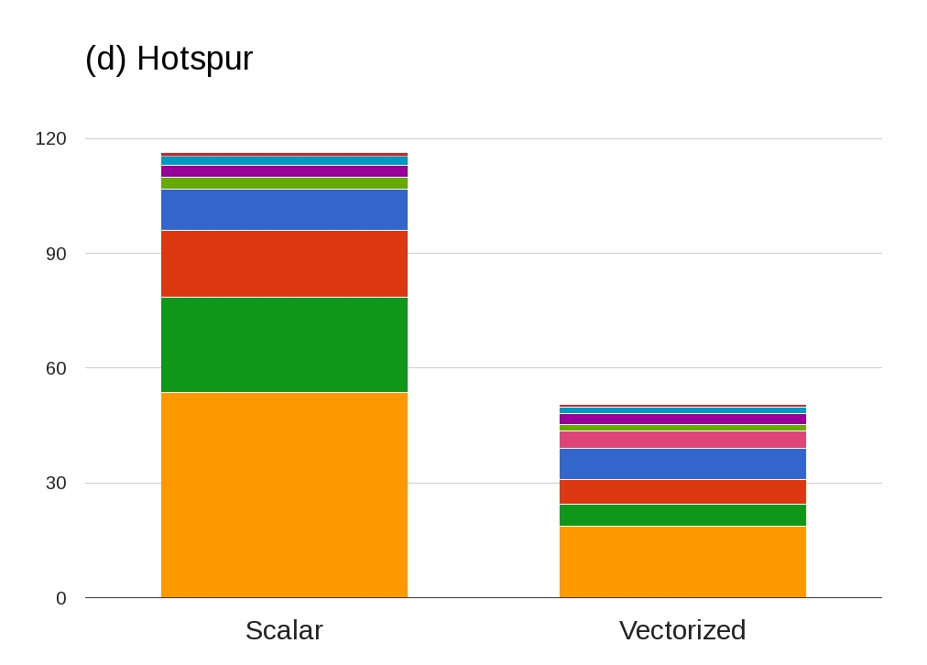
Intersect incoherent
Integration
Shading
Texturing
Notes:
This is a best case scenario for us, and the results line up with the expectations, giving us a 2.3x overall speedup in this case.

Slide 67
Hotspur Vectorization Speedups
Ray intersection subsystem speedup | 1.14x
Shading subsystem speedup | 4.20x
Texturing subsystem speedup | 2.90x
Integration subsystem speedup | 2.72x
Overall speedup | 2.31x
Notes:
Unfortunately we aren’t able to show some of the more complex scenes coming out of production just yet.
The data is looking promising however, with one of the more complex indoor scenes, which contains hundreds of lights, showing a 2x speedup.

Slide 68
Conclusion
Significant speedups over scalar mode in all scenes tested
Vectorization speedup is scene dependent
Future looking architecture
Linear scaling with increased core counts
Non-trivial speedups with increased vector lane counts
Suitable for GPU hardware
Notes:
And so to conclude…
1. So far in every case we’ve profiled, we’ve observed significant speedups in vectorized mode compared to scalar mode.
2. The speed up itself is quite scene dependent. Those scenes which spend a large percentage of time inside of shading, texturing or integration code show the largest gains. The is encouraging as we ingest larger and larger scenes, since ray intersection costs scale logrithmically with geometry complexity, but in general, shading, texturing, and integration scale linearly with content, and so are key areas we want to speedup.
3. Finally, we feel that this type of architecture is very well positioned to take advantage of future hardware going forward.
We scale linearly over increased cores. We don’t scale linearly over increased lane widths, but do observe non-trivial speedups.
See the paper for more details.
The architecture of MoonRay has more in common with modern GPU style path tracers than existing CPU path tracers, so we expect it to port over quite smoothly.

Slide 69
Good Luck MoonRay!
Notes:
I’d like to end by wishing the best of luck to MoonRay on her maiden production.

Slide 70
Questions?
Acknowledgements: We’d like to thank the MoonRay and MoonShine teams at DWA, and the open source community
mark.lee@dreamworks.com
Full paper is available at: research.dreamworks.com

