Slide 1
Mach-RT: A Many Chip Architecture for Ray Tracing
Elena Vasiou, Konstantin Shkurko, Erik Brunvand, Cem Yuksel
University of Utah
Notes:
Hello everyone, my name is Elena Vasiou and I will be presenting our work titled: Mach-RT A many chip architecture for Ray Tracing

Slide 2
More Chips! Handle it!
Higher framerates
Lower energy
Notes:
In this work we show how it is possible to connect multiple chips to a single DRAM on a board and use this multi chip method to improve memory performance. We create an architecture that is able to hide memory latency and scale with a large number of threads.
While this might seem like a crazy idea, we are able to achieve higher framerates AND lower energy compared to equivalently large single chip approaches.

Slide 3
Ray Tracing Performance
No predictable memory access pattern
Is unlike Raster which is able to leverage streaming
Large energy and time overheads due to irregular DRAM accesses
Notes:
Traditionally, Ray Tracing does not provide a predictable memory access pattern.
Unlike Rasterization, which is able to hide memory latency on the GPU through accessing data in a perfectly predictable manner,
The irregular DRAM accesses resulting from scene traversal lead to large energy and time overheads that hurt performance and prevent Ray Tracing from reaching its theoretical performance potential.

Slide 4
Previous Work
Notes:
To improve the memory behavior and increase performance, previous work has focused on

Slide 5
Previous Work
Coalescing memory access
[Aila & Laine 2009], [Gribble & Ramani 2008], [Spjut et al. 2009]
Notes:
Coalescing memory accesses for scene data

Slide 6
Previous Work
Coalescing memory access
[Aila & Laine 2009], [Gribble & Ramani 2008], [Spjut et al. 2009]
Batching and packets for scheduling
[Myungbae 2017], [Boulos et al. 2007]
Notes:
Utilizing batching and ray packets during scheduling

Slide 7
Previous Work
Coalescing memory access
[Aila & Laine 2009], [Gribble & Ramani 2008], [Spjut et al. 2009]
Batching and packets for scheduling
[Myungbae 2017], [Boulos et al. 2007]
Ordered ray generation and sorting
[Eisenacher et al. 2013], [Purcell et al. 2002]
Notes:
Ordered ray generation and sorting

Slide 8
Previous Work
Better data layout
[Hapala et al. 2013], [Viitanen et al. 2017], [Meister & Bittner 2018]
Notes:
Or manipulating the BVH structure

Slide 9
Previous Work
Better data layout
[Hapala et al. 2013], [Viitanen et al. 2017], [Meister & Bittner 2018]
Compression
[Keely 2014], [Ylitie et al. 2017], [Benthin et al. 2018]
Notes:
Among many others, compression is highly successful in reducing the amount of data transported from DRAM.
However even with the most aggressive compression schemes scene and ray traffic can be overwhelming if data accesses are not handled efficiently

Slide 10
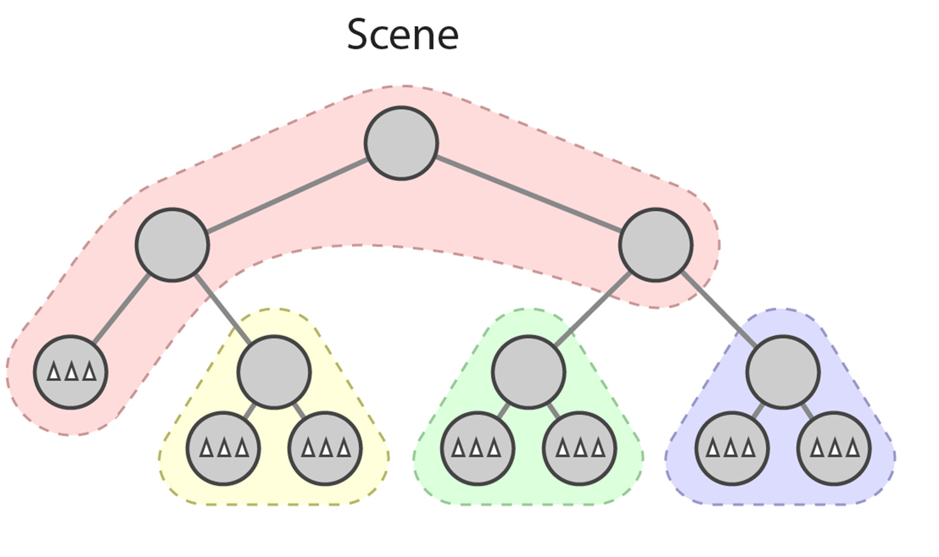
Dual Streaming
Notes:
Our group’s prior work, Dual Streaming, was developed to bring scene traffic to its absolute minimum and thus remove the constrains imposed on ray tracing by the irregular memory accesses. It achieved that by reordering the traversal order.
Imagine a ray that starts at the root segment shown in red. In traditional ray tree traversal, this ray, would pass through a few segments in depth-first order: from red to yellow, back to red and then green, fetching nodes from the red segment multiple times.

Slide 11
Traversal Order
Notes:
However, with dual streaming rays are stored in queues assigned to each segment. We then iterate through all segments one at a time in a completely predicted manner, by adding rays to their individual ray queues.
So ray processing in this case, would happen from red to yellow, to green then blue.

Slide 12
Drawbacks
Ray Duplication
Early Termination
Notes:
However, this style of traversal introduced two significant issues.
First, because a ray can visit two or more child segments, it has to be added into all of their queues. This implies that a single ray can be enqueued to multiple segments thus artificially increasing the required workload by duplicating rays.
In turn, we cannot discard any hits from a ray until we know all duplicates have been processed, leading to reduced ability to test hit points and terminate early.

Slide 13
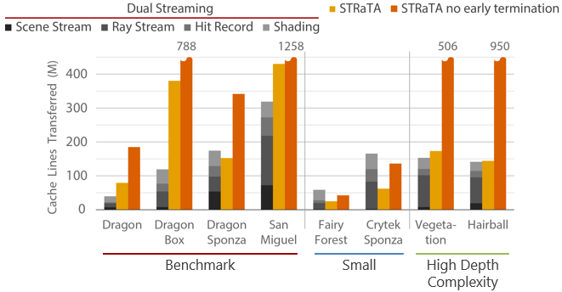
Memory Traffic
[Shkurko et. al. 2017]
Notes:
And so, while scene traffic is reduced to its absolute minimum, Dual Streaming introduced ray traffic to and from DRAM, a significant element that takes up a large percentage of total memory traffic.

Slide 14
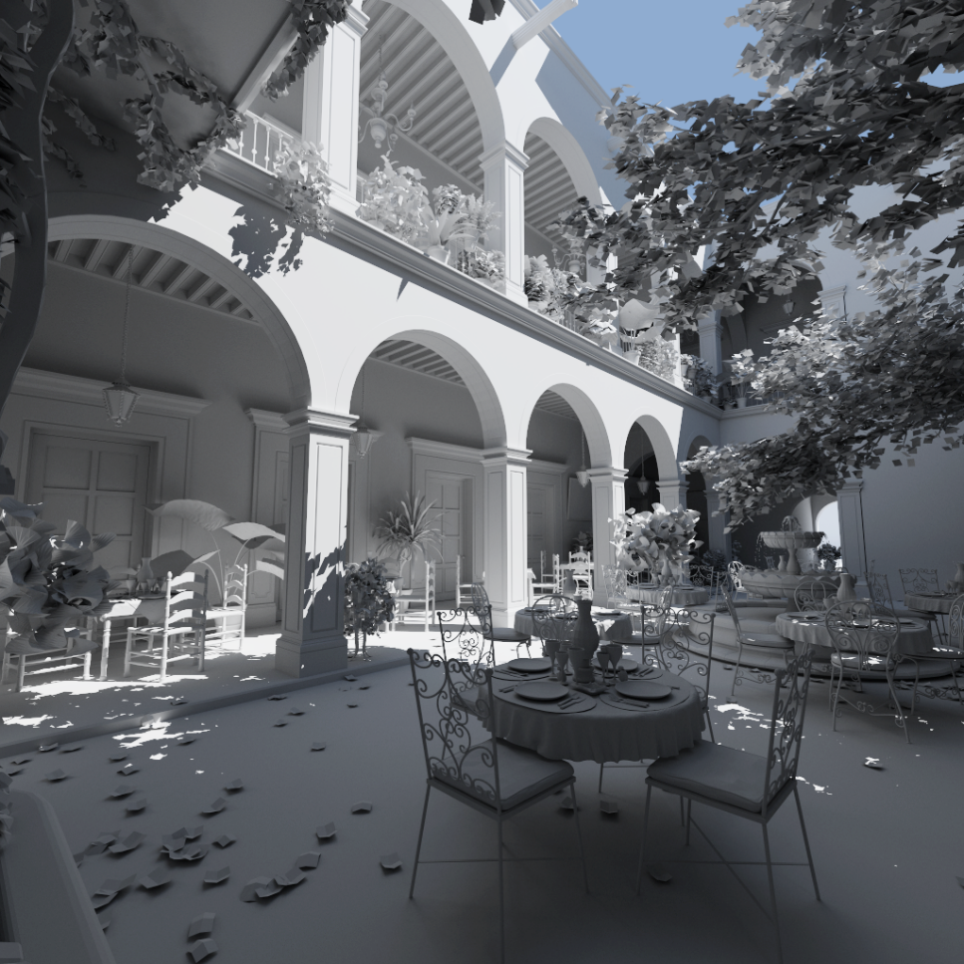
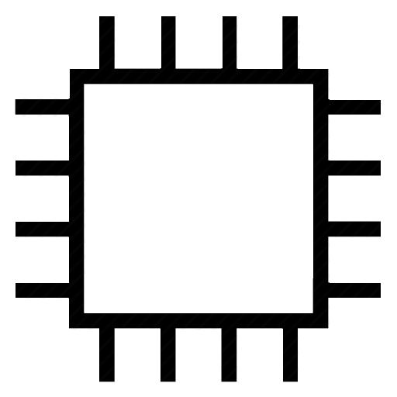
Single Large Chip
Notes:
With each frame needing a few millions of rays at today’s resolutions, to accommodate keeping all rays on chip and thus removing the effects of the ray stream, one would need to image a chip with very large on chip memory modules.
The cost of accessing such large memories would be evident in increased energy costs per access, access latency, as well as eventual manufacturability of the chip.
This is an overall bad idea.

Slide 15
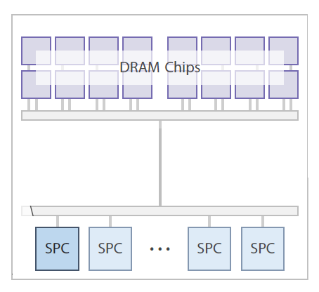
Board of Chips
Notes:
We propose splitting all that memory across multiple instances of a chip, all connected to a single DRAM.
This way, each Streaming Processor (SPC), contains a smaller, more manageable amount of memory, but a large sum in total, accommodating the large number of rays required.

Slide 16
Board of Chips
Notes:
While we are assuming minimum possible scene traffic per chip, the presence of multiple chips can still stress the memory system, so we implement an off chip L3 cache that interfaces all communications between the SPCs and DRAM. This also allows us to use a single memory controller, thus keeping the hierarchy simple.

Slide 17
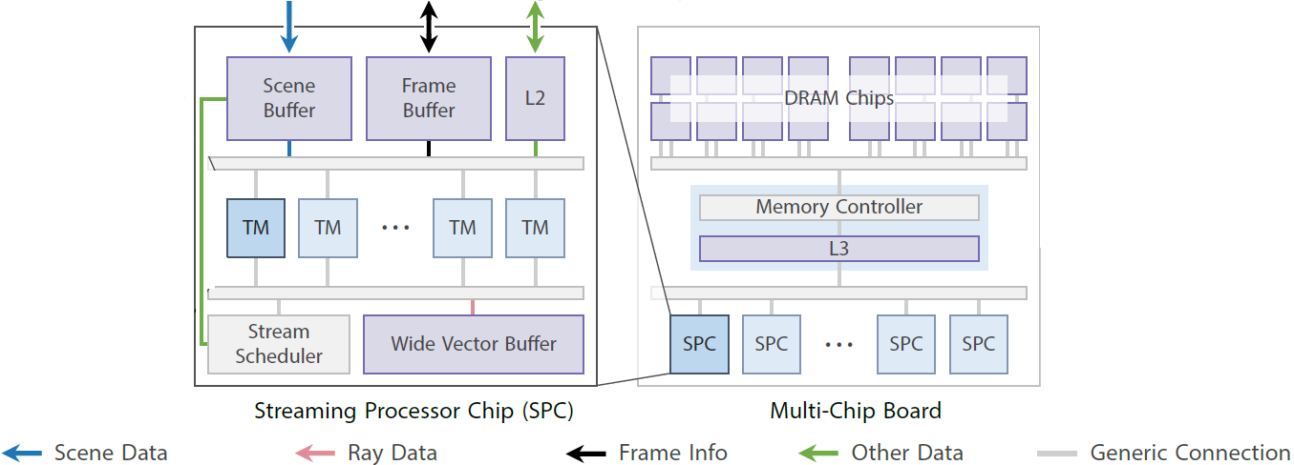
SPC
Notes:
Each SPC on the board contains their own Stream scheduler, independent scene buffer for data segment storage and an L2 cache used for shading
The Frame Buffer stores all hit records, data necessary to generate new rays and colors for all pixels assigned to the chip
The Wide Vector Buffer is responsible for storing all ray information.
All compute units are housed within Thread Multiprocessors or TMs

Slide 18
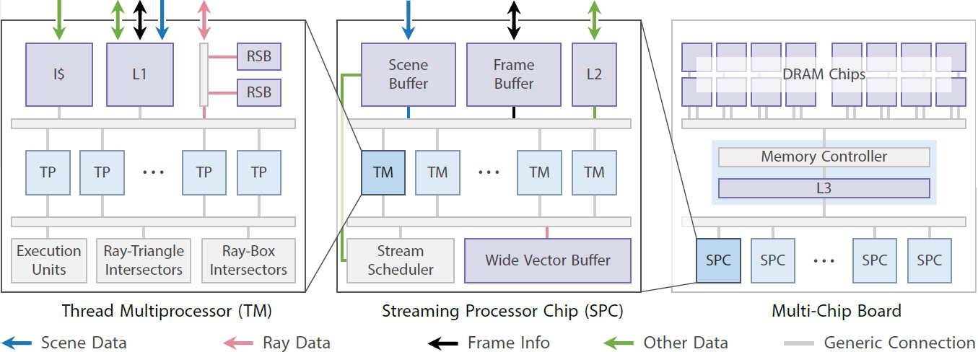
Board Final
Notes:
TMs contain a number of Thread Processors. TPs are grouped to allow for the shared utilization of energy and area expensive units.
Each TM has their own dedicated ray triangle and ray box intersection pipelines, which are the only ray tracing specific units in the entire system.
Ray Buffers, an L1 cache and an Instruction cache make up final units within each multiprocessor

Slide 19
Pixel Distribution
Interleaved pixel assignment
1
2
3
4
1
2
3
1
2
3
4
1
2
3
4
1
2
3
4
1
2
3
4
1
2
3
4
1
2
3
4
1
2
3
4
1
Notes:
Pixels in a frame are assigned to chips in an interleaved fashion such that each chip renders a smaller resolution of the entire image, that is composed fully at the end of the process.
The example configuration represents the pixel work load per chip if we had 4 chips rendering a 6x6 pixel image.
While this is the assignment pattern we chose to test, our system is completely programmable and so others such as traditionally tiled approaches are possible.

Slide 20
Improvements
Because of on chip rays:
Eliminate ray traffic to DRAM
Notes:
This configuration of large on chip ray memories allows us to completely eliminate ray traffic from main memory

Slide 21
Improvements
Because of on chip rays:
Eliminate ray traffic to DRAM
Ray duplication effect reduced
Notes:
It also gives us the opportunity to reduce the data requirements for storage per ray.
We keep a unique copy of ray attributes such as origin and direction, and associate each ray with a 4Byte index. When a ray encounters multiple exit points, only the index gets propagated to multiple queues.
were previously each ray was 32Bytes in size, all of which was duplicated across segment ray queues.

Slide 22
Improvements
Because of on chip rays:
Eliminate ray traffic to DRAM
Ray duplication effect reduced
Early Ray Termination
Notes:
The presence of rays on chip also simplifies early ray termination calculations. Since pixels are independently assigned to each chip, individual hit records are always available for update.
This allows us to check the current closest hit for each ray before beginning traversal through a segment.

Slide 23
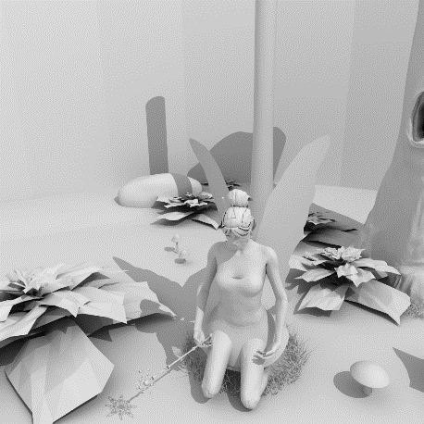
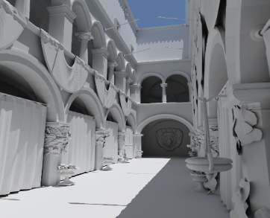
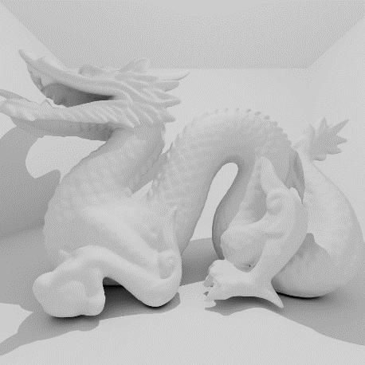
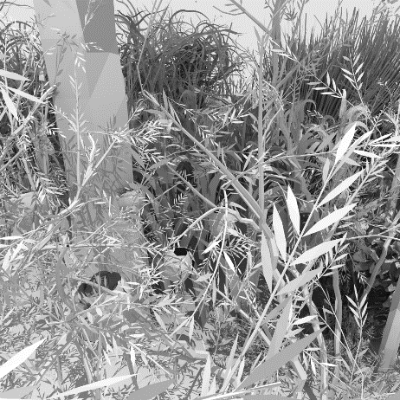
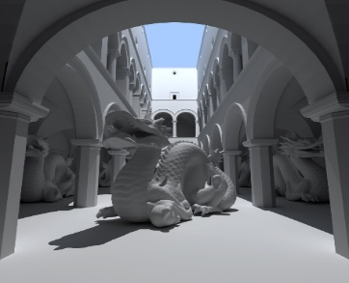
Results
Fairy Forest
174K
Crytek Sponza
262K
Dragon Box
870K
Vegetation
1.1M
Dragon Sponza
6.6M
San Miguel
10.5M
Notes:
We use path tracing with up to depth 5 to explore full incoherent ray behavior. All images are rendered full at a 1024x1024 pixel resolution with Lambertian materials.
The benchmarked scenes represent different levels of rendering effort with triangle count and depth complexity.

Slide 24
Hardware Simulation
Cycle accurate simulator
Render to frame completion
Large simulation times
Milliseconds of simulated behavior
Notes:
We evaluate the performance of our multiple chip system on a cycle accurate simulator that renders an entire frame to completion to capture the full behavior of the ray tracing program.
Due to the level of detail required to simulate each frame, simulation times can take anything from a few hours, days or weeks to complete, even though the simulated behavior is that of a few milliseconds.

Slide 25
System Configuration
 | MACH_RT
Frequency | 2.0GHz
Threads | 512/chip
DRAM bandwidth | 512GB/s
L3 cache | 64MB
On chip Memory | 114MB
Notes:
Our architecture is configured with specifications of concurrent hardware, but looking to approach future system capabilities.
Each chip is provisioned with 512 cores, running at 2.0GHz frequency. We use GDDR5 DRAM with a total for 512GB/s available bandwidth and a simple SRAM off chip L3 cache with 64Megabytes of capacity.
To render a frame at our chosen resolution, we need to provision enough on chip memory to store all ray data, and all information necessary for generating new rays, as well as pixel color assignments. This requires over 100Megabytes of on chip buffers.
While this total on chip memory might seem large, the amount is split evenly between all chips, meaning the more chips connected on a board, the less memory exists on each chip.

Slide 26
Single Large Chip
Notes:
To test our theory that eliminating the ray stream will improve performance, we investigate the effects of an unrealistically large chip of our Mach RT, against a large version of the previously developed Dual Streaming Architecture.

Slide 27
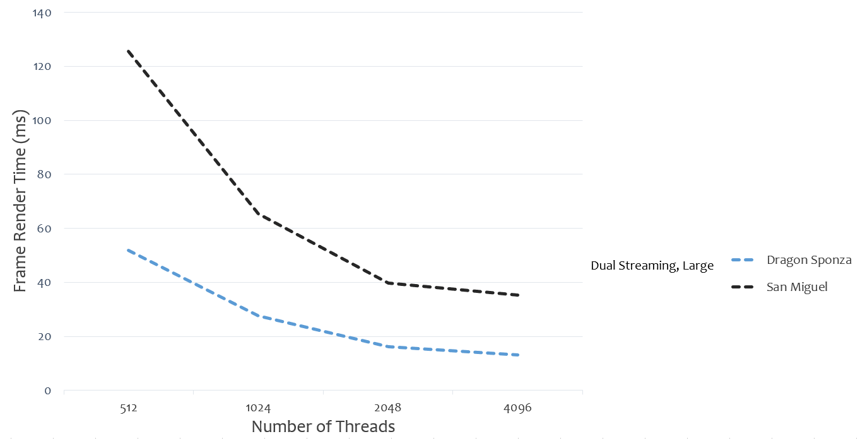
Single Large Chip: Render Time
Notes:
In this graph we see the time in miliseconds to render a frame with a single large chip of the original dual streaming configuration (seen in the dotted line) for our 2 largest scenes, dragon sponza and san miguel. Unsurprisingly, as more threads are added, up to 4 thousand, the render time drops.

Slide 28
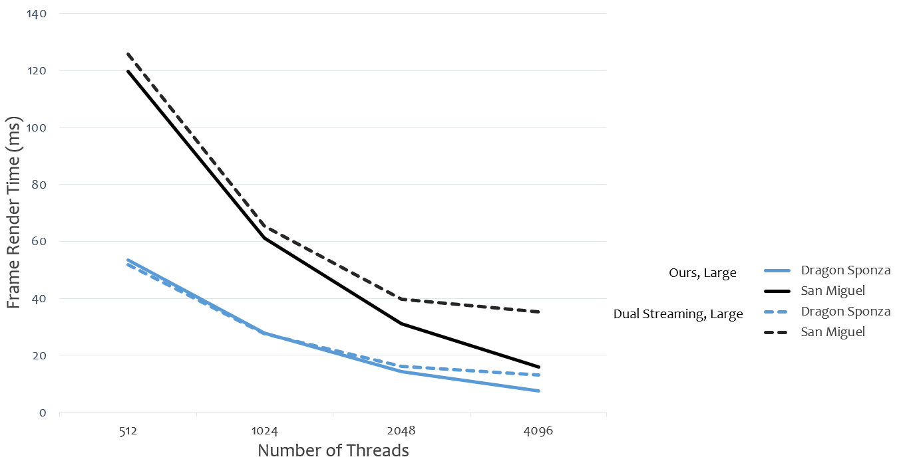
Single Large Chip: Render Time
Notes:
When compared to the render times of our method, seen as the solid lines, we observe that clearly having all rays available at a closer proximity to the cores helps improve frame rates.

Slide 29
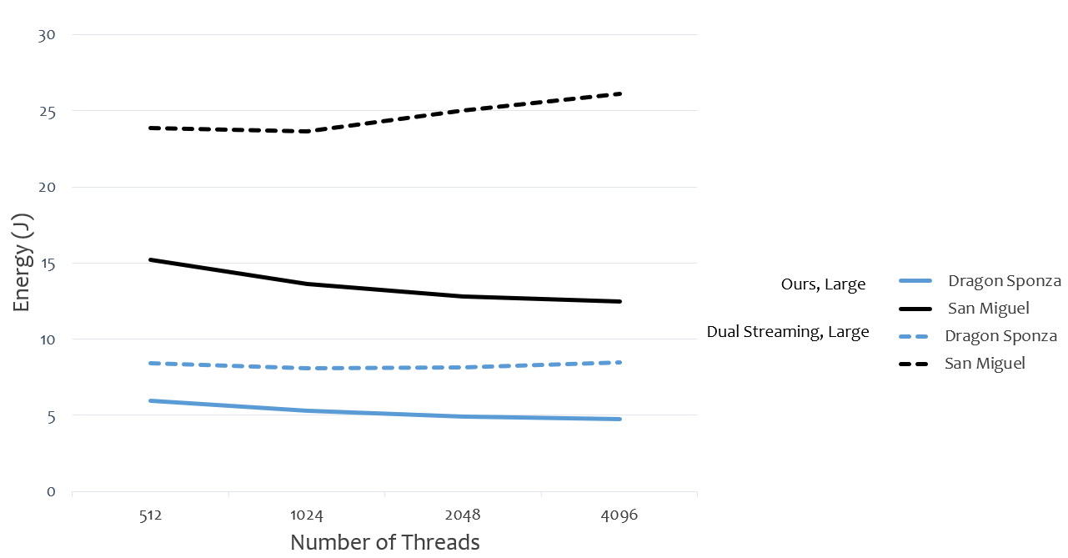
Single Large Chip: Energy
Notes:
The energy profile is vastly better for our approach, since we no longer have to rely on DRAM accesses , which are quite energy consuming, to receive ray data.
Please note that these represent single unrealistically large chips.

Slide 30
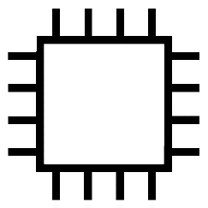
Multiple Chips
1
1
2
2
1
1
2
2
3
3
4
4
3
3
4
4
Ours
Dual Streaming
[Skhurko et al. 2017]
STRaTA
[Kopta et al. 2013]
Notes:
Let’s examine how the performance changes when multiple chips are introduced. In this case we test against large versions of the Dual Streaming and STRaTA architectures for ray tracing acceleration.
In all cases, we kept the scaling of the architectures as fair as possible while maintaining the unique strengths of each one. For more details on the exact configurations please refer to the paper
#10 min mark!!!

Slide 31
STRaTA
Energy and Bandwidth efficient
Limited on chip ray queues
Reconfigurable pipelines
Notes:
STRaTA is a dedicated architecture previously developed to reduce energy and bandwidth requirements for ray tracing.
It utilized a form of on chip ray storage with a compressed traversal stack. Its reconfigurable intersection pipelines allowed the system to switch efficiently between box and triangle intersections based on the bvh node type.

Slide 32
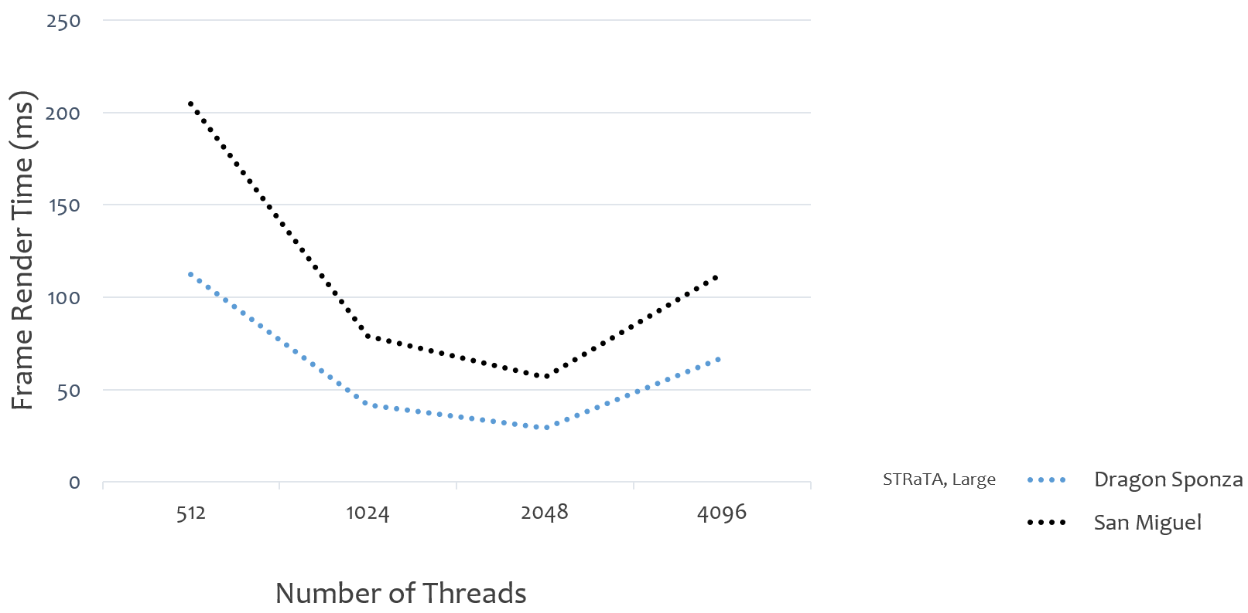
Multiple Chips: Render Time
Notes:
The frame render time decreases for STRaTA up until a 2 thousand thread configuration. Afterwards, render times increase dramatically, due to the constant requests for data to memory.

Slide 33
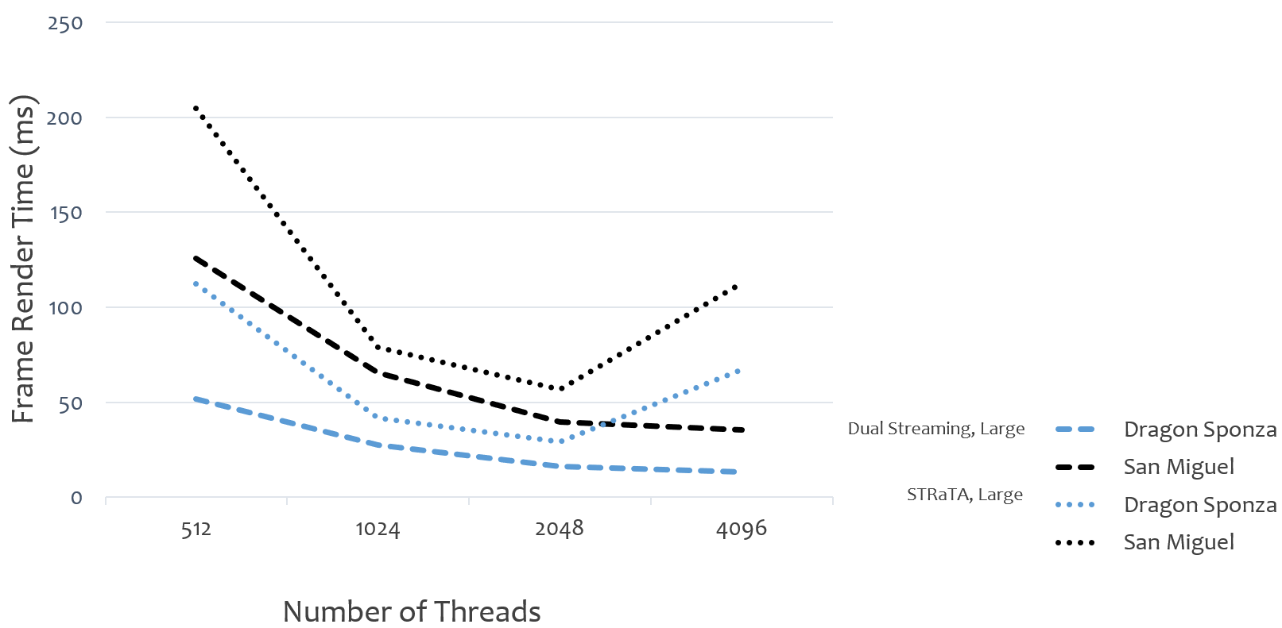
Multiple Chips: Render Time
Mach-RT chips
Notes:
The original dual streaming method fares better overall. With render times, overlayed in the dashed lines, consistently dropping throughout all configurations.

Slide 34
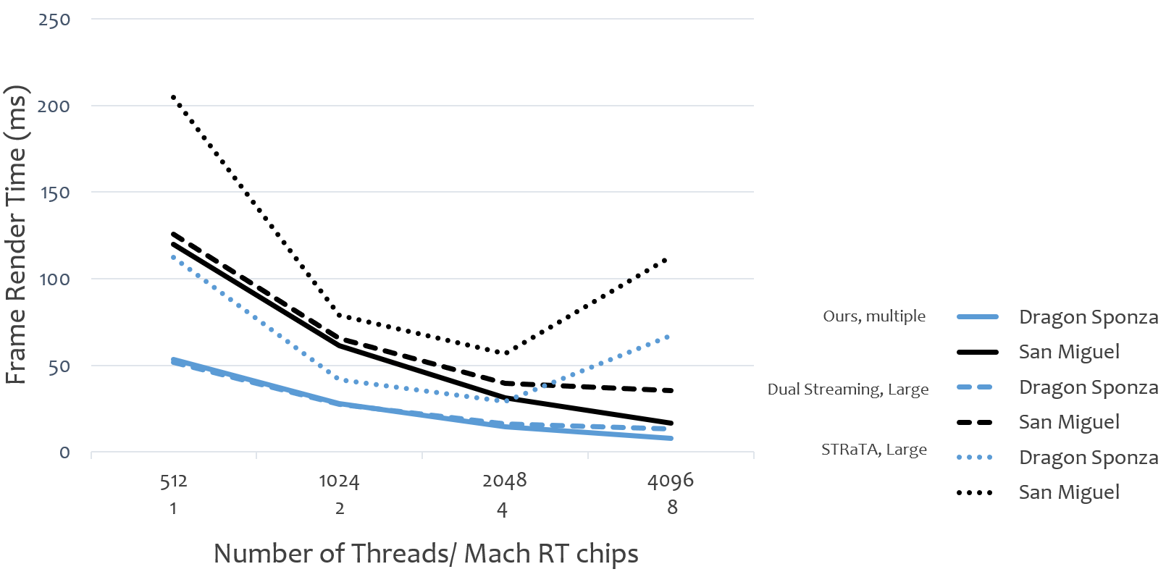
Multiple Chips: Render Time
Notes:
In this case, the x axis shows architecture sizes in number of chips for our method and number of threads for the large chips of previous approaches. The solid line represents the pefromance of our proposed method.
When compared to our architecture, Mach-RT times are initially similar to the dual streaming chip. However, renders times improve at a higher rate the more chips are added, up to the examined 8.

Slide 35
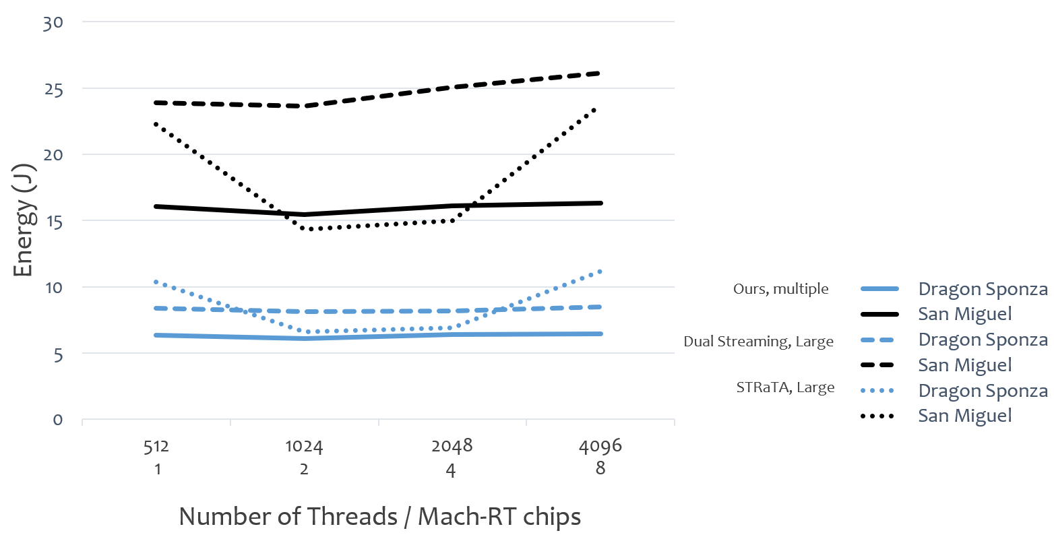
Multiple Chips: Energy
Notes:
Unsurprisingly, our architecture maintains a lower and more or less constant profile to the other architectures.
These include contributions from the off chip L3 cache that is designed to serve overlapping scene requests from the multiple chips, thus reducing the overall pressure on DRAM. The on chip buffers certainly also contribute to the total but not enough to outweigh the benefits from contacting main memory.

Slide 36
Cache Lines Transferred
Notes:
To examine further the memory behavior, we look at the number of cache lines transferred from DRAM at 8 chips (or 4thousand thread equivalent) for all scenes.
The previously developed methods need to request both scene and ray data continuously with the original Dual Streaming being generally more efficient than STRaTA
Note the irregularity in data transfers in the Dragon Box scene. Though it is small with respect to triangle count, it is completely enclosed so no rays escape and are traced to the full path

Slide 37
Cache Lines Transferred
Notes:
When comparing to our method, as you can see, Mach RT transfers orders of magnitude less data than the other approaches since it only needs to fetch scene segments once per chip in order to trace each wavefront

Slide 38
Comparisons to DXR
Notes:
We wanted to ground our results to a real-world scenario and so also compared to the newly released NVIDIA Turing architecture that supports hardware ray tracing with a path tracer implemented with the DXR API.
For this comparison we scaled our architecture to 6 chips for a total of 3 thousand threads, running at 1.8GHz frequency to match the commercial hardware.
In this case, lower on the graph means better render time. For all tested scenes our architecture outperformed the tested RTX2080

Slide 39
16 Chips
Reduced gains
Work starvation
Large impact of scene fetches
Notes:
To test the limits of how many chips we can connect together we also investigated the effect of connecting 16 chips to a board.
While we still observe performance increases, the gains are reduced with respect to how many processors are added especially for the larger more complex scenes.
This slow down is attributed to the fact that at larger chips counts there are fewer rays per chip at our current resolution, leading to work starvation.
Additionally, at the current set up, the impact of fetching each scene segment becomes more significant per ray as there are fewer of them present to amortize the cost of scene data transfer.

Slide 40
Conclusion
Multiple chip architecture for ray tracing
Is doable by using Dual Streaming
No ray traffic to DRAM
Notes:
In conclusion, we have proposed a new multiple chip architecture that allows us to stream scene data once per chip and keep memory accesses to a minimum by eliminating ray traffic to DRAM through the utilization of on chip buffers.
While this work makes heavy use of large on chip memories, it provides an imaginative solution to eliminating large ray streams until memory technology improves.
#15 mins!

Slide 41
Q&A
Thank you!
Notes:
Thank you and I will now take questions

Slide 42
Future Work
Chip layout
Other off chip memories (HMC)
Scene and ray compression
Notes:
The idea of connecting multiple chips to a single DRAM opens up possibilities for some interesting future directions.
Those include examining chip layouts other than the linear-all-connected-to-dram, such as a more hierarchical tree approach.
We have used a simple SRAM L3 to connect all chips to a DRAM, but bringing the memory modules closer to the processors by using more experimental memory systems can impact performace.
Despite the fact that we are using scene data very efficiently, memory bandwidth can still be a concern, so integrating a scene and possibly ray compression scheme would further decrease overall memory traffic to all chips.

Slide 43
Questions to Rehearse
What happens if run out of ray memory
(dram spill over)
Shading
Comparisons with DXR are unfair
How about multiple DRAMS

Slide 44
Cache Lines Transferred
Notes:
To examine further the memory behavior, we look at the number of cache lines transferred from DRAM at 8 chips (or 4thousand thread equivalent) for all scenes.
our architecture only needs to fetch scene segments once per chip in order to trace each wavefront so respective data transfers are minimal.
The outlier being San Miguel which is a scene with lots of intricate geometry, although the amount of data transfers is still moderate.

