Slide 1
Effective Static Bin Patterns for Sort-Middle Rendering
Bernhard Kerbl, Michael Kenzel, Dieter Schmalstieg and Markus Steinberger
Graz University of Technology

Slide 2
Consider the following...
One day, you are tasked with looking into micro- polygon rendering with complex fragment shading
Before full development, your supervisor demands performance estimates
Maximum triangle load, FPS, etc.
So you get to work...

Slide 3
Many pixel-sized triangles I
Generate triangles just big enough to cover single pixels
Simulate expensive shading with fixed number of operations
Put triangles side by side for convenience
Tentative goal: Approx. 7,000 triangles rendered @ 120 FPS

Slide 4
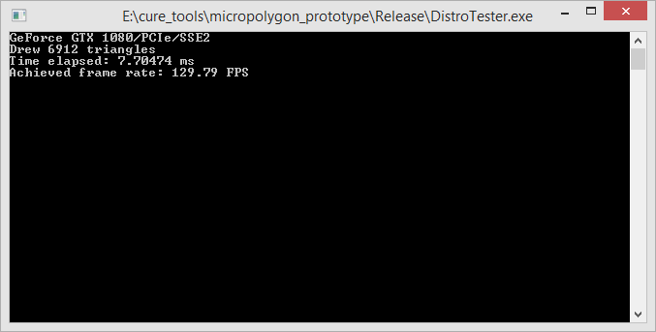
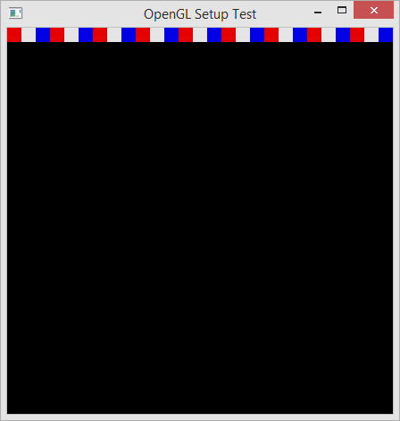
Many pixel-sized triangles II
Put tiles next to each other (256 triangles per tile, 16x16) 130 FPS ✓

Slide 5
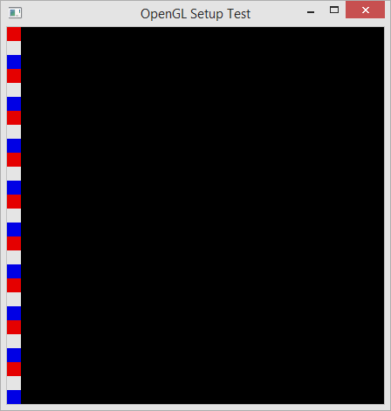
Many pixel-sized triangles III
Horizontal or vertical, performance remains clearly above 120 FPS

Slide 6
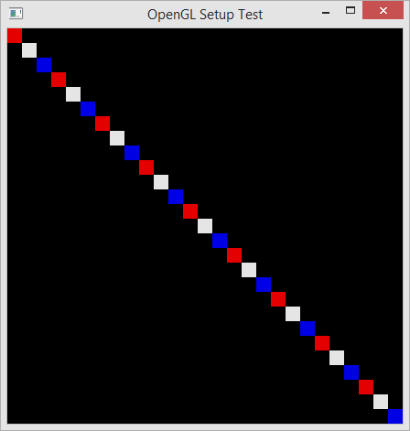
Many pixel-sized triangles IV
Diagonal line, because it fills the window nicely... Hold on, 40 FPS?

Slide 7
Fragment Load Balancing on GPUs
Rendering pipeline geared towards sort-middle rendering
Assigns clip-space triangles to (rectangular) bins for shading
Fixed assignment rules, one-to-many processor/bin mapping
Static 2D binning (or “tiling”)
1
2
3
4

Slide 8
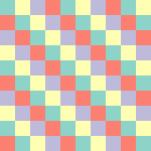
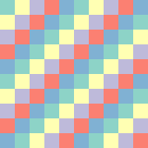
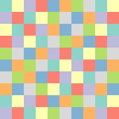
Common Binning Patterns
NVIDIA
AMD & Intel
GTX 560 Ti
GTX 580/680
GTX 780 Ti
GTX Titan Xp
GTX 1060
AMD 6770M
AMD R9 270X
Intel HD 530
Intel HD 4000

Slide 9
Rasterizers, Compute Units, GPCs
Level/naming of balanced resources differ between vendors
NVIDIA: Graphics Processing Clusters (GPC)
AMD: Compute Units
…
Focus on noticeable effect on shading performance (measurable)
We will henceforth refer to corresponding units as “rasterizers”

Slide 10
2D Binning Parameters
Bin size in pixels
Rasterizer capability (uniform/varying)
Number of rasterizers employed
Arrangement scheme (pattern)

Slide 11
2D Binning Parameters
Bin size in pixels, fixed size assumed
Rasterizer capability (uniform/varying), uniform assumed
Number of rasterizers employed, should be independent
Arrangement scheme (pattern)

Slide 12
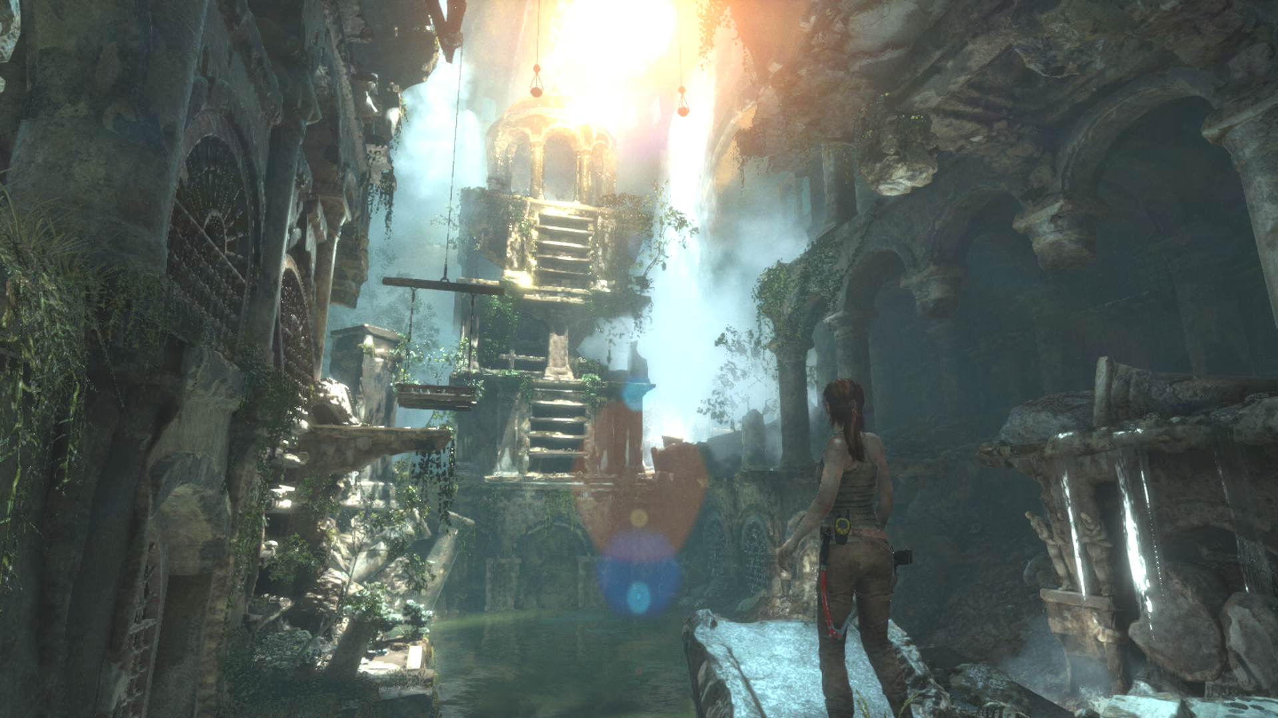

Slide 13
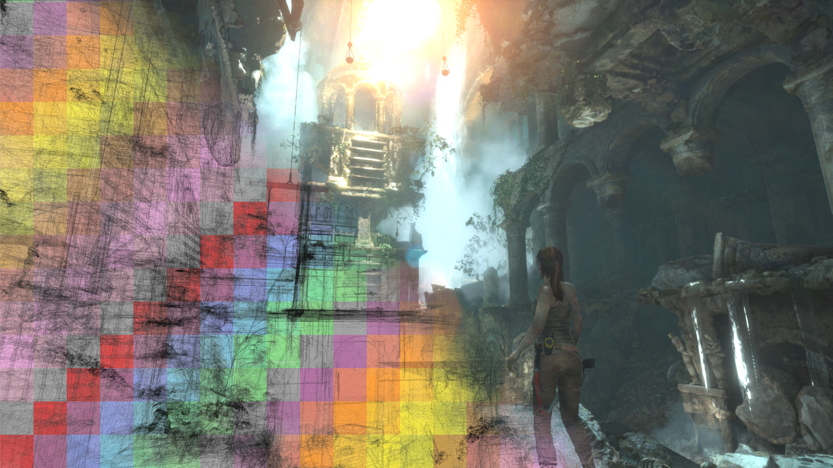

Slide 14
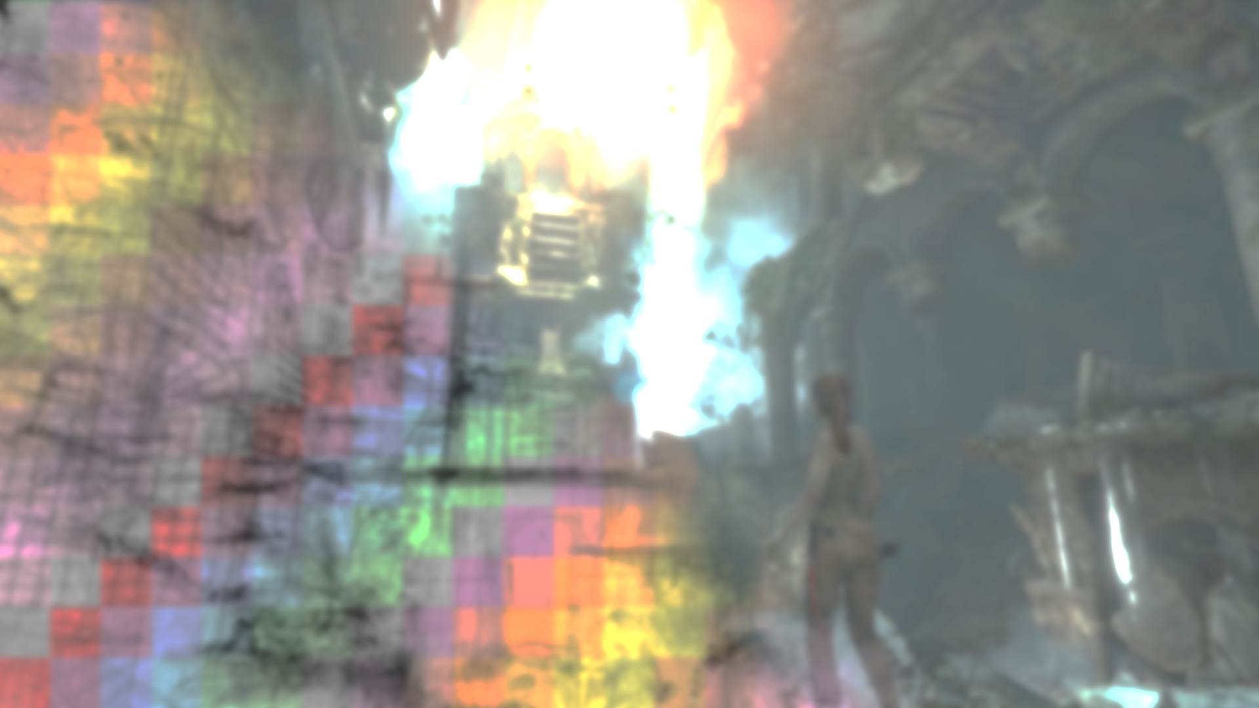
Considered Criteria
Based on realistic geometry data loads
Pattern space utilization
Clustering of geometry
Orientation of rendered objects

Slide 15
Space Utilization
Thought experiment: vertical pixel column pattern
All $N$ rasterizers are assigned a separate image column of width $w$
If $(N−1)×w$ > viewport width, at least one rasterizer is idle

Slide 16
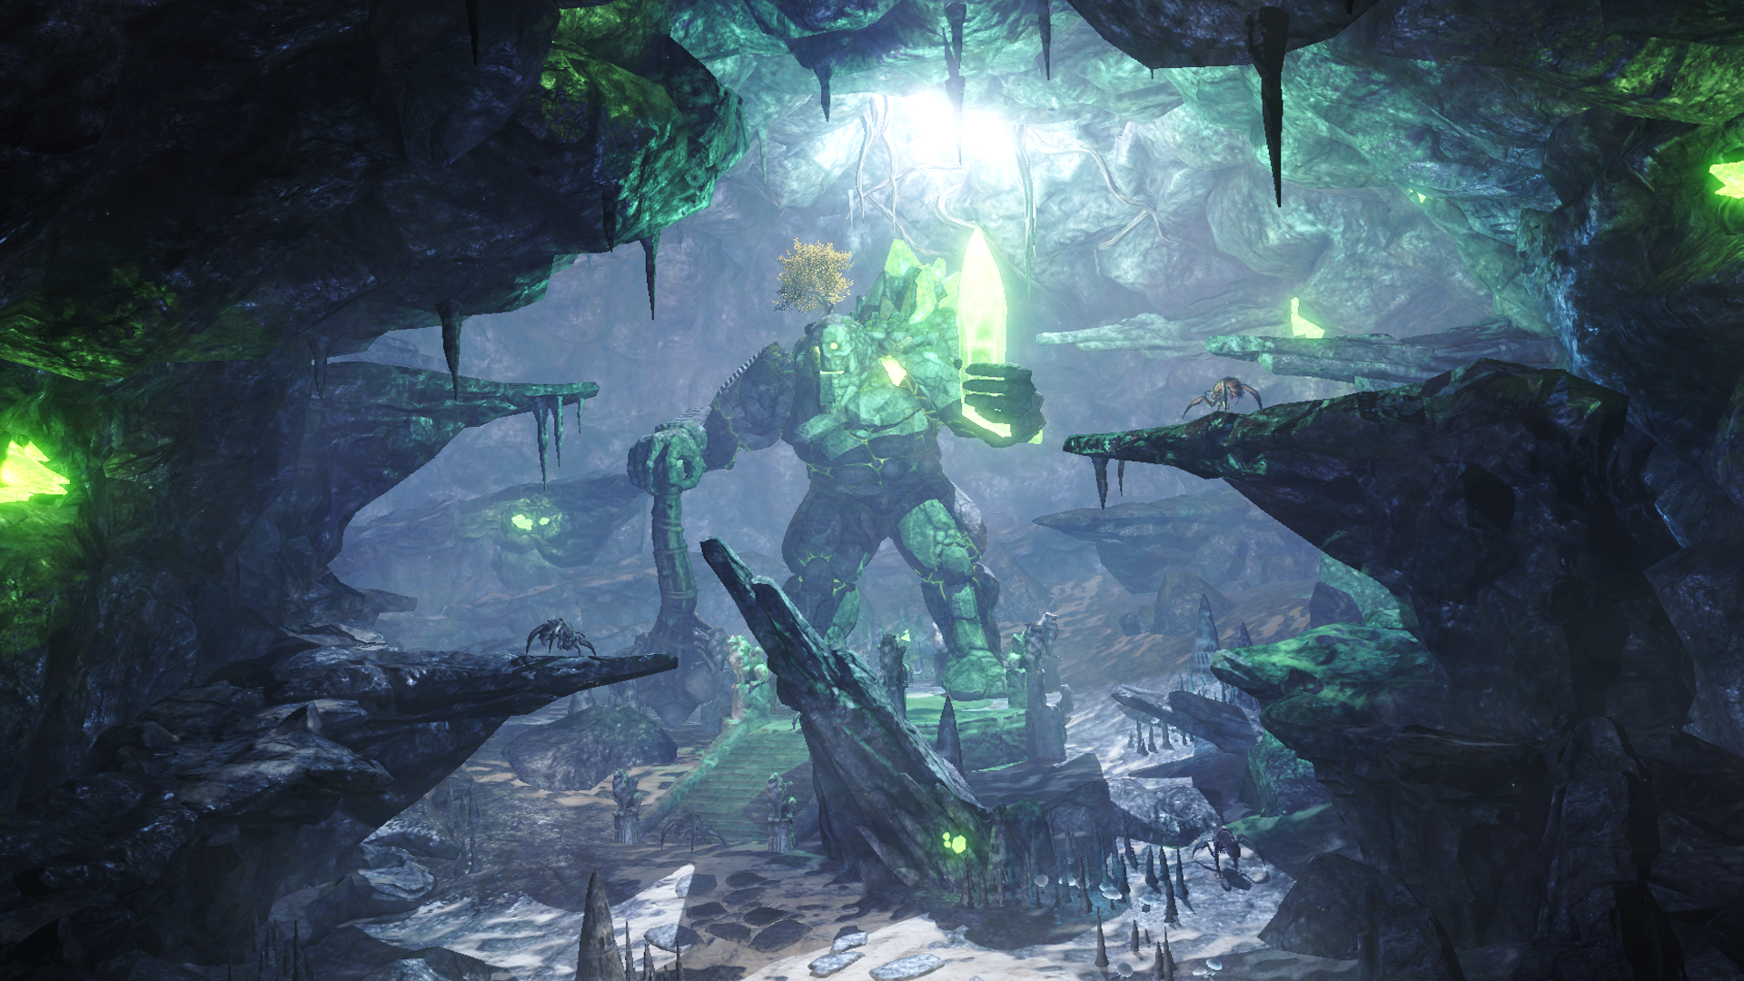

Slide 17
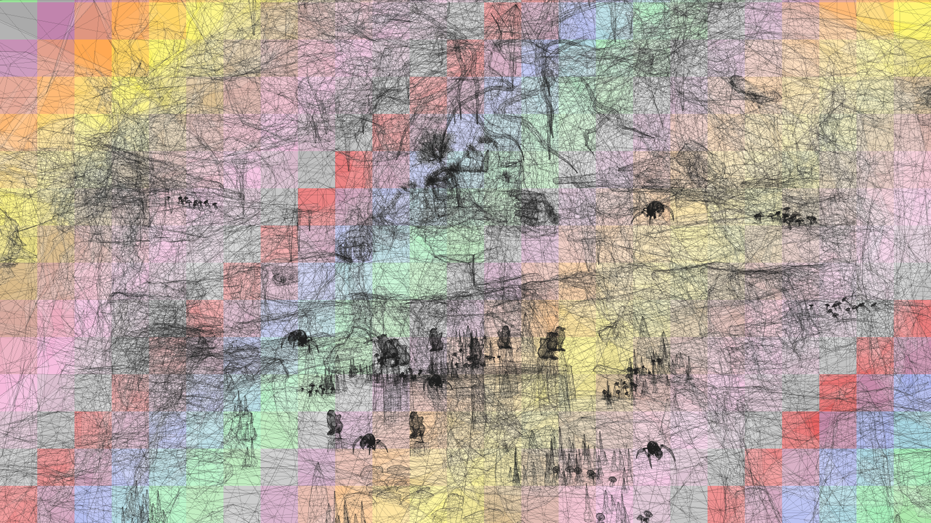

Slide 18
Geometry clustering
Large portions of total geometry confined to localized clusters
Assigning rasterizer to bins in close proximity prevents balancing
Experimentally confirmed in our paper for test suite of 200 scenes
The greater the distance between bins for a rasterizer, the better

Slide 19
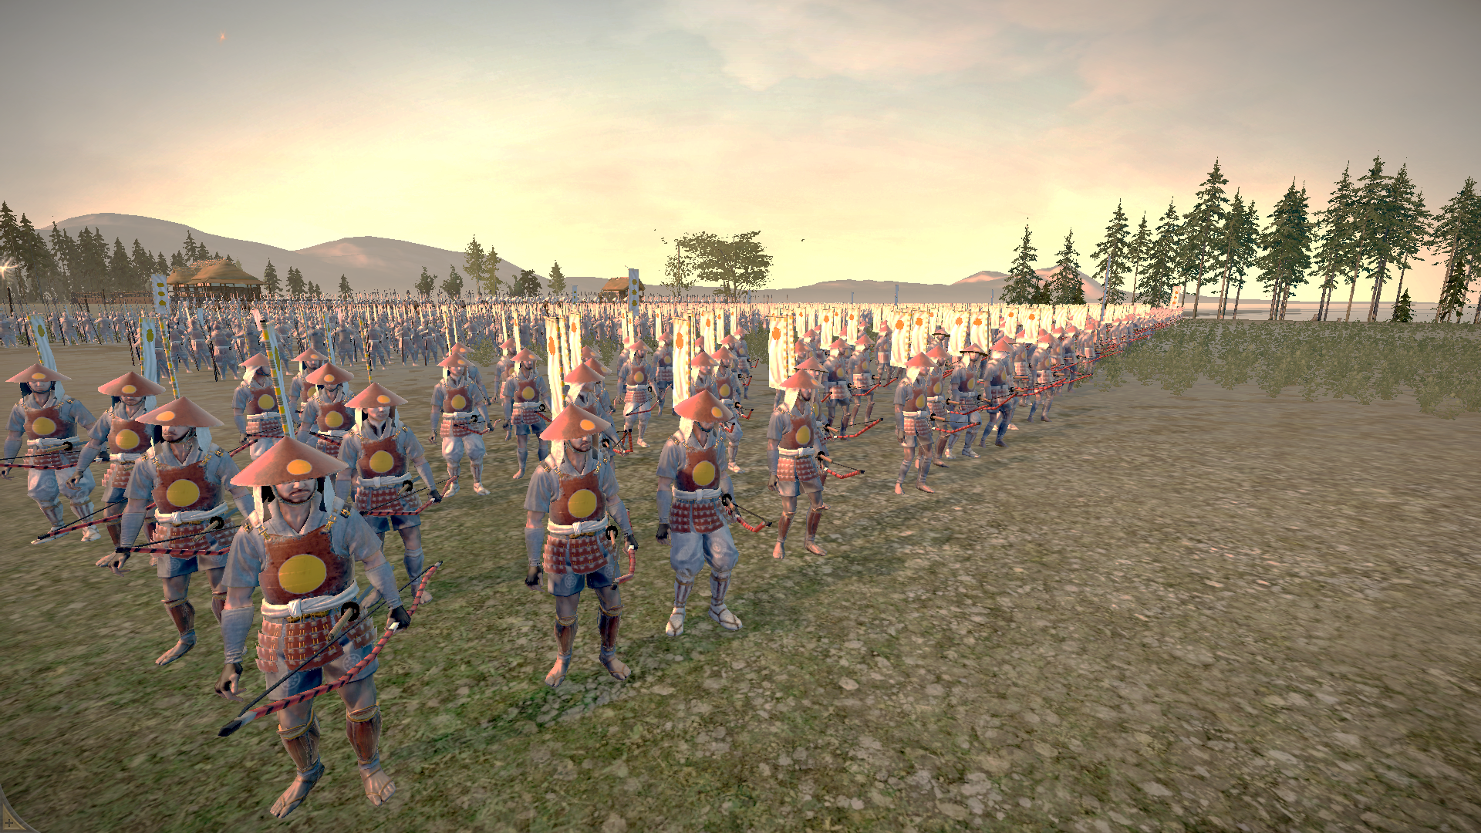

Slide 20
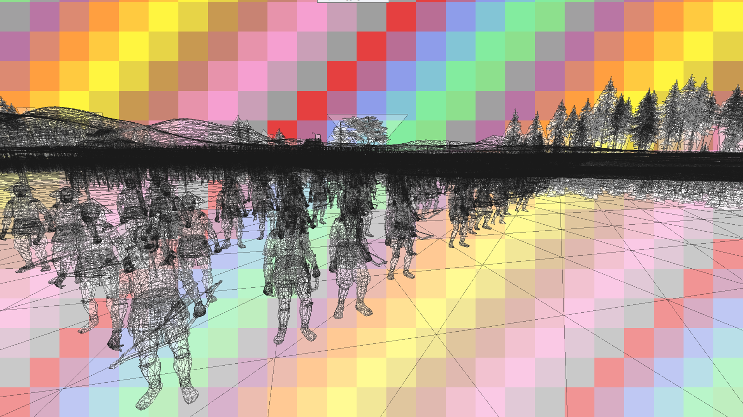

Slide 21
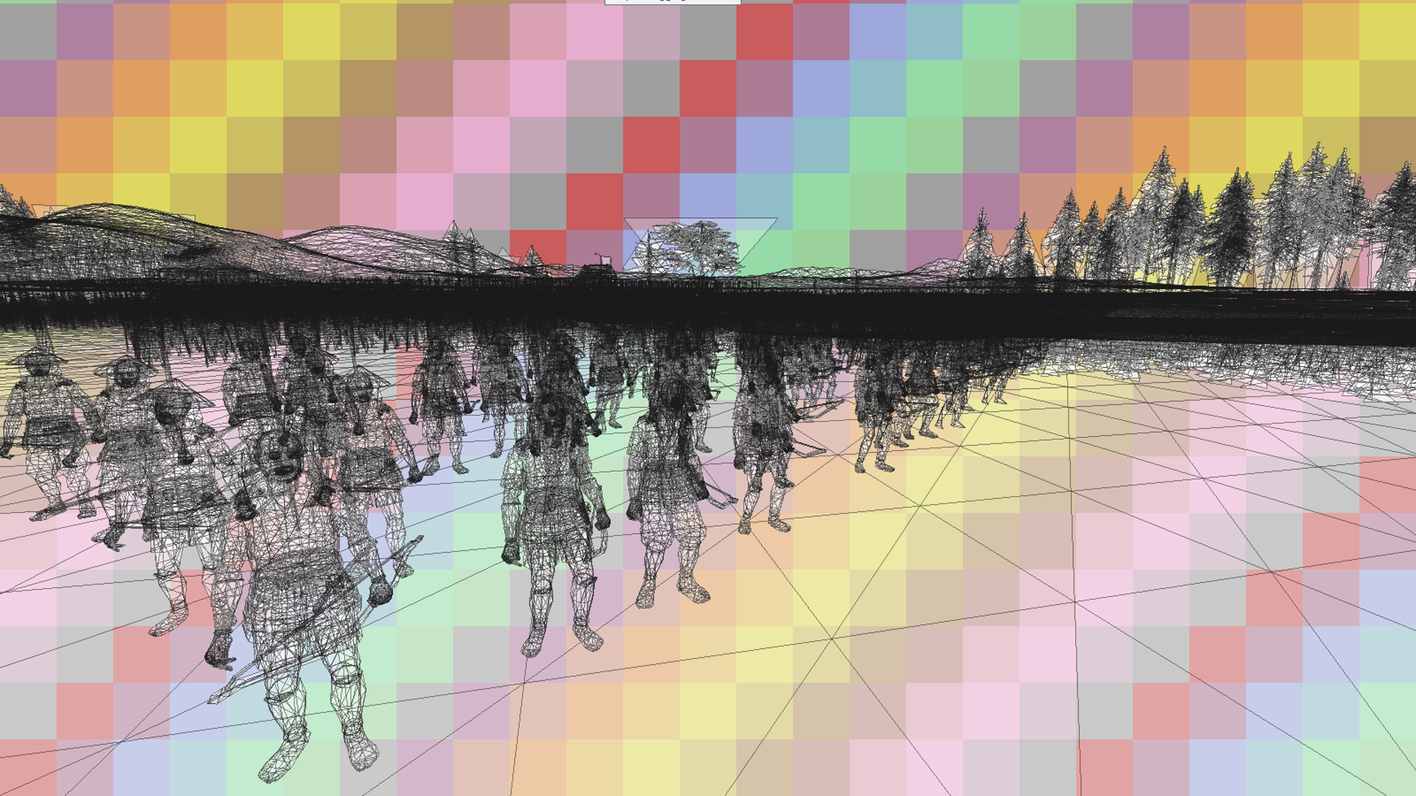

Slide 22
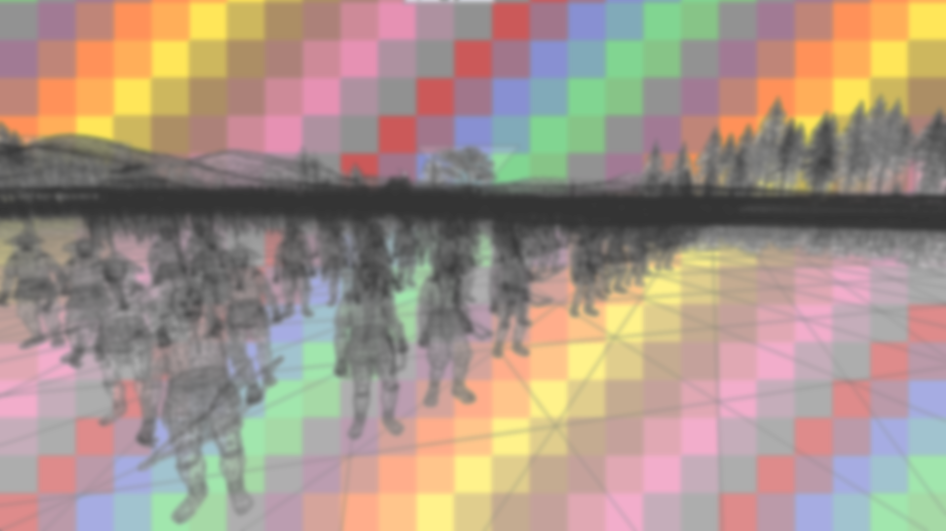
Geometry Orientation
Assumption: most real-world objects align horizontally or vertically
Combined influences of gravity, evolution and culture
Consequently, perfectly diagonal structures are rare
Requires realistic perspective (no tilted view)

Slide 23
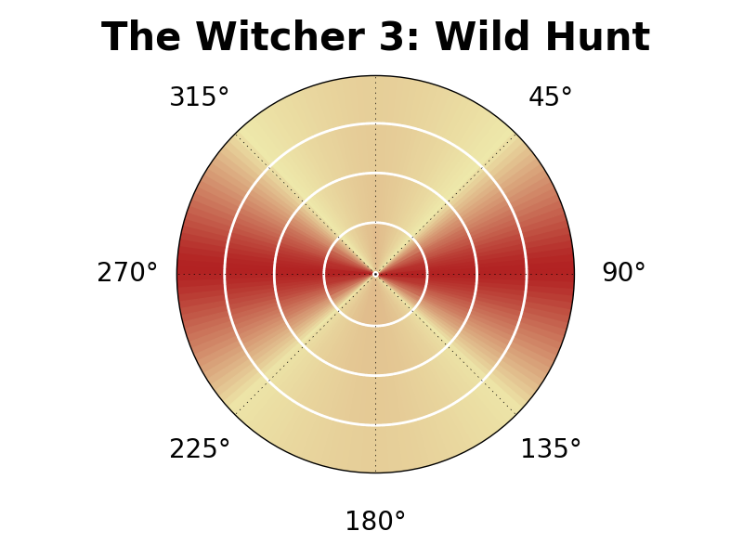
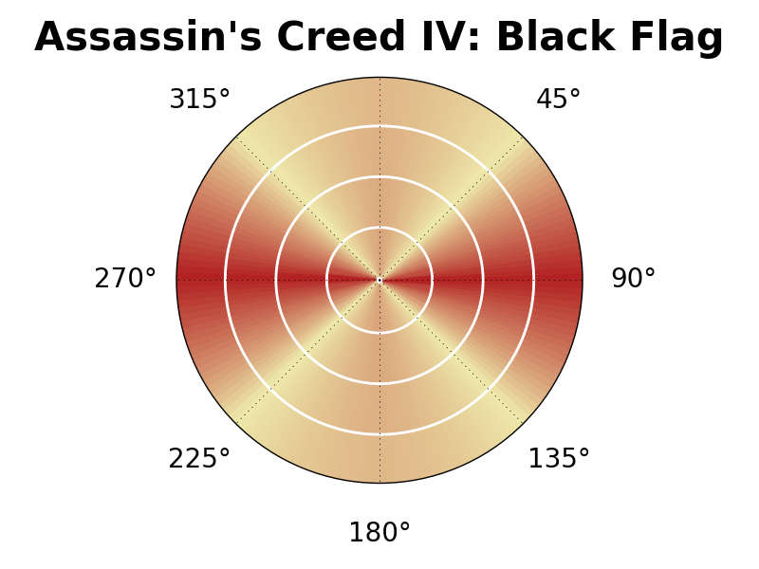
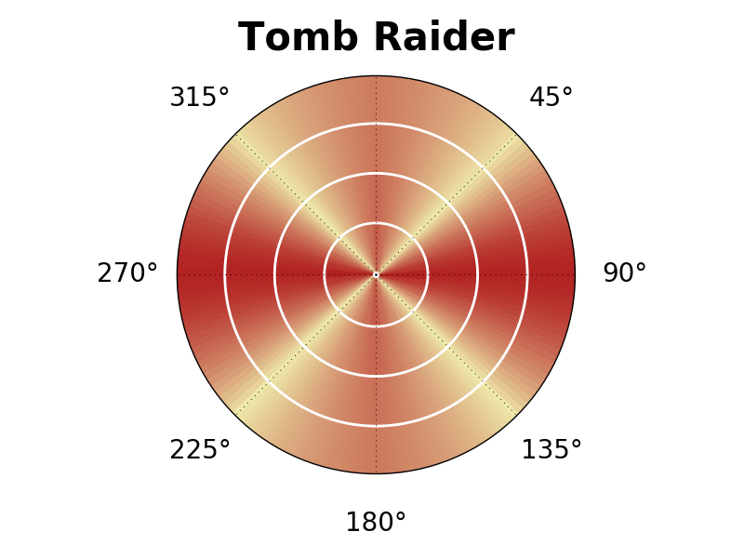
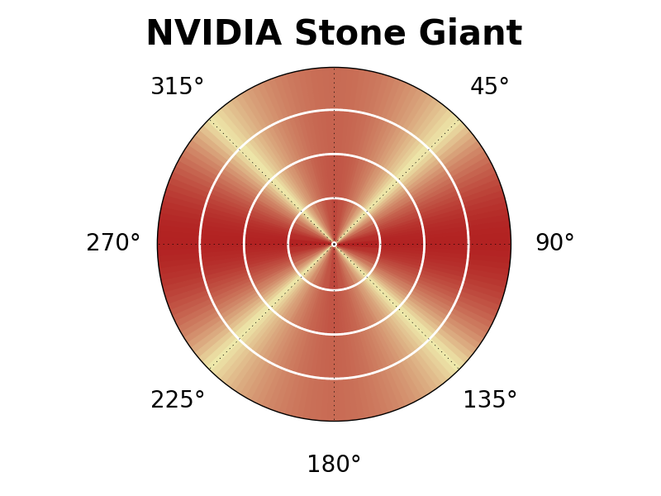
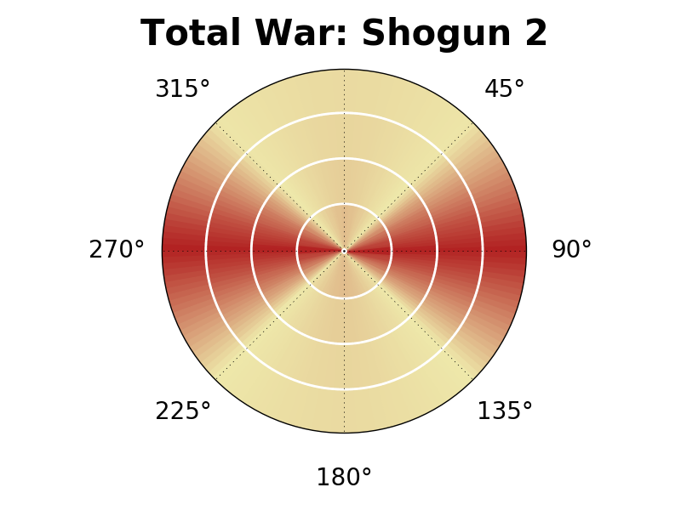
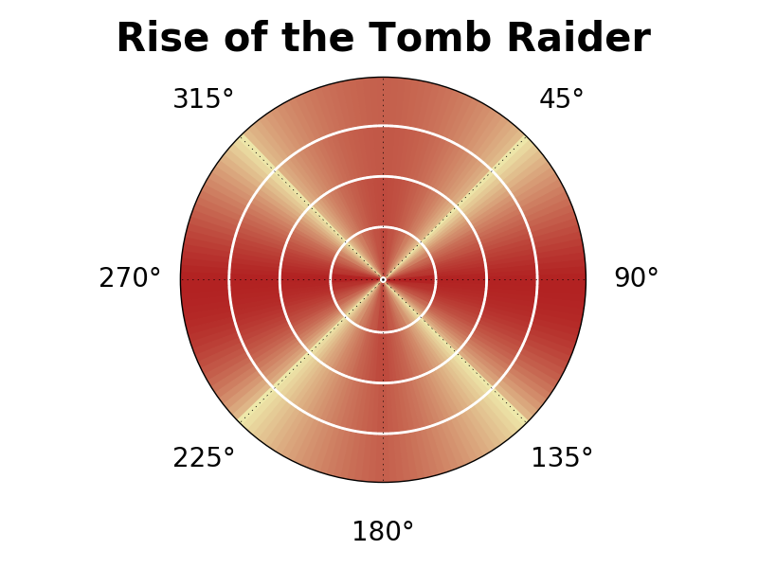
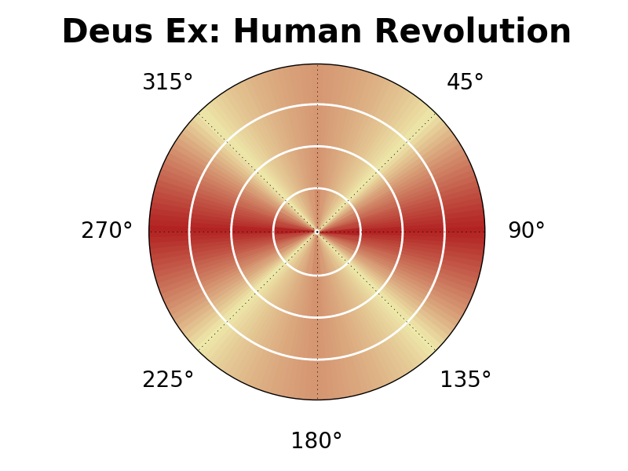
Geometry Orientation

Slide 24
Geometry Orientation
Avoid horizontal and vertical repetitions in rasterizer assignment
Diagonal pattern revisited → → →
Frequently used in previous NVIDIA flagships
GTX 560 Ti
GTX 580/680
GTX Titan Xp

Slide 25
Evaluated Patterns

Slide 26
Space Filling Curves
Commonly used for data storage and access patterns
Arrange tiles according to curve (Z-Curve, Hilbert Curve)
Rasterizer index = distance mod N
Compare fragment load variance
Z-Curve
Hilbert Curve

Slide 27
Randomization-based patterns
Random number generator (mt19937) for both patterns
Pseudo-random uniform distribution (PRUT) – no modifications
Hierarch. max. distance (HMD)
Iterative dart throwing approach
Generate samples for each index
Always choose farthest sample
PRUT
HMD

Slide 28
Fixed shift-based patterns
Y-shift: each column shifted by constant value $\frac{N}{k}$ where $k=\left\lfloor \sqrt{N}\right\rfloor$
X-shift: similar, but shift rows instead
X-shift+offset: additional offset
Off by 1 in every k^{th} row
Pattern only repats after N shifts
Y-shift
X-shift+offset

Slide 29
Variable shift-based patterns
Sudoku: pick shift value at random each row, disallow duplicates
Van der Corput (VDC): shift using base 2 Van der Corput sequence
Multiply by next power of 2 for N
Skip shifts that exceed N
Implicitly fulfills Sudoku constraint
Similar performance, VDC leads
Sudoku
Van der Corput

Slide 30
Overall comparison

Slide 31
Thank you
Questions?
Total War: Shogun 2 © SEGA. The Creative Assembly, Total War, Total War: SHOGUN and the Total War logo are trademarks or registered trademarks of The Creative Assembly Limited. SEGA and the SEGA logo are either registered trademarks or trademarks of SEGA Corporation. All rights reserved. Without limiting the rights under copyright, unauthorized copying, adaptation, rental, lending, distribution, extraction, re-sale, renting, broadcast, public performance or transmissions by any means of this Game or accompanying documentation or part thereof is prohibited except as otherwise permitted by SEGA.
TOMBRAIDER © 2017 SQUARE ENIX LIMITED. Rise of the Tomb Raider screenshot courtesy of Crystal Dynamics.
Stone Giant Tech Demo by NVIDIA.

Slide 32
Software Simulated Results
At higher number / greater bin size, differences show
Dynamic balancing between vertex and fragment stage cannot compensate fragment load discrepancy

Slide 33
Tested Pattern Categories
Space Filling Curves
Randomization-based patterns
Fixed shift-based patterns
Variable shift-based patterns

Slide 34
2D Binning Parameters
Bin size in pixels, fixed size assumed (8x8, 16x8, 16x16, …)
Rasterizer capability (uniform/varying)
Number of rasterizers employed
Arrangement scheme (pattern)
GPU Pattern Design

Slide 35
Software Simulated Results
Full streaming software rendering pipeline running on GPU
DirectX 9 features (vertex/fragment processing, shading, ...)
Developed with C++/CUDA
Evaluate best patterns for our test suite of 200 captured scenes

Slide 36
Binning Pattern Deviants (NVIDIA)
GTX Titan X
GTX 960
GTX 980 Ti
GTX Titan
Uniform rasterizer capabilities
Variable rasterizer capabilities

Slide 37
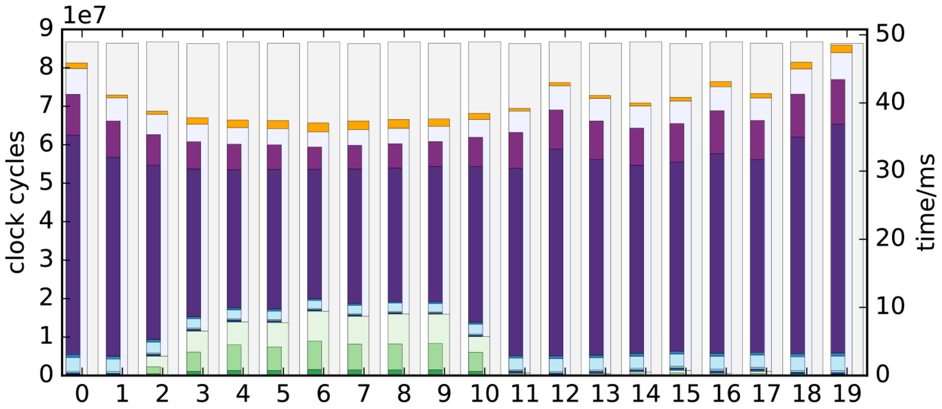
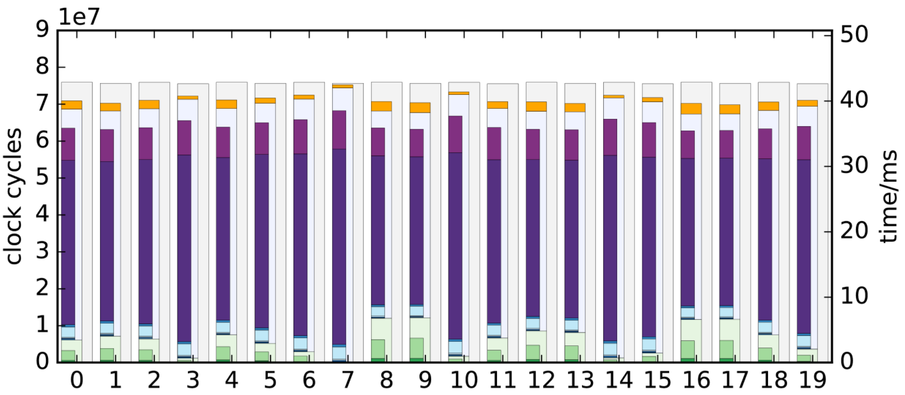
Software Simulated Results
At higher number / greater bin size, differences show
Dynamic balancing between vertex and fragment stage cannot compensate fragment load discrepancy
Diagonal
Van der Corput

Slide 38
You can try this yourself
General approach – timing based:
Write complex fragment shader performing $M$ instructions
Draw $2×N$ triangles covering one pixel at location $p$, record time
Alternately draw $N$ triangles at $p$ and N triangles at another location $p$‘
If elapsed time decreases significantly, a different „rasterizer“ was hit
Experiment with $N$, $M$ to get clear results
NVIDIA: Use shader_thread_group to find cores pixels submit to

Slide 39
Geometry Orientation
Subdivide viewport into pixel lines with given orientation (angle)
Sample along lines and compute total number of fragments
Compute variance of fragment count over all lines
Repeat for all desired orientations / angles and compare

Slide 40
