Slide 1
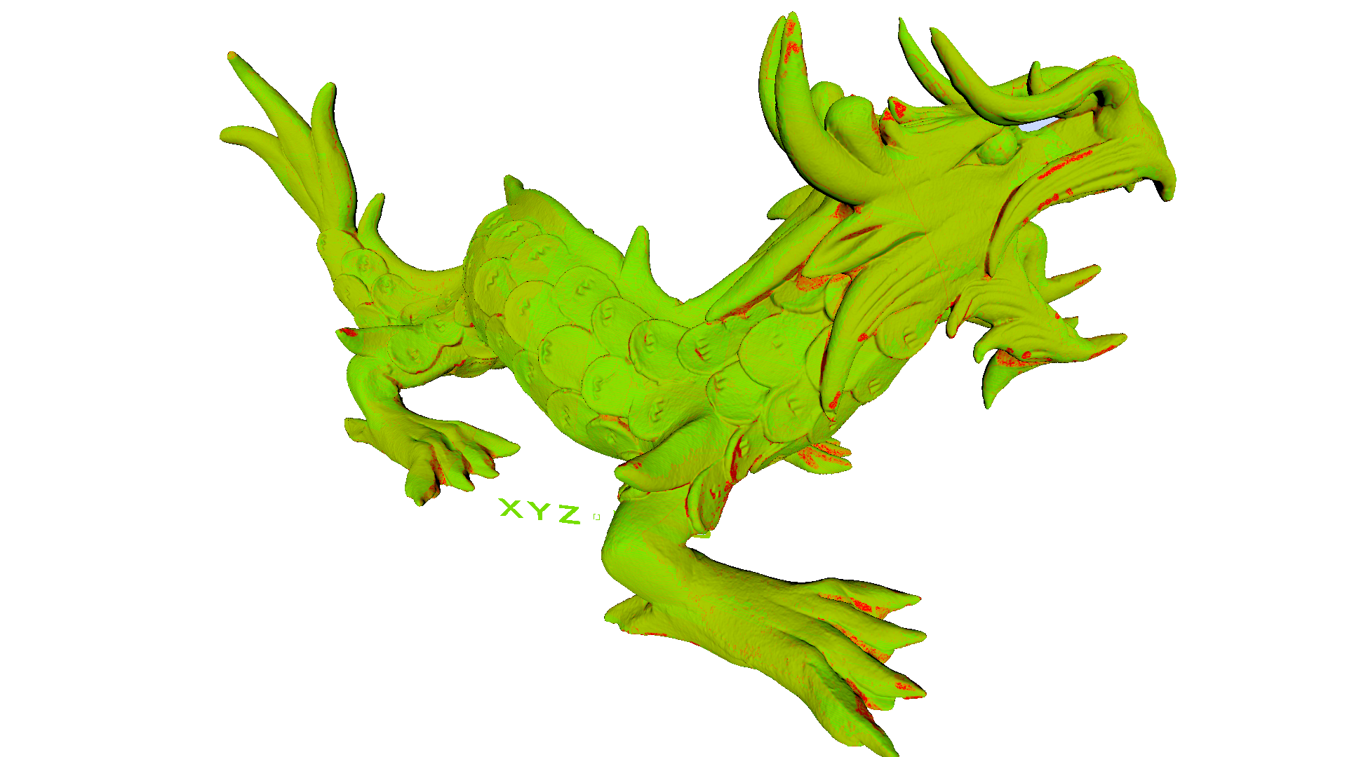
On-the-fly Vertex Reuse for Massively-Parallel Software Geometry Processing
Michael Kenzel
Bernhard Kerbl
Wolfgang Tatzgern
Elena Ivanchenko
Dieter Schmalstieg
Markus Steinberger

Slide 2
5
4
3
4
2
5
3
7
2
6
6
1
0
1
0
…, 0,1,7, 7,1,2, 3,4,2, 2,4,7, 7,4,5, 7,5,6, 7,6,0, …
0
1
2
3
4
5
6
Notes:
let’s start by looking at the basic problem of vertex reuse
for real-time rendering, we typically use indexed triangle lists
during processing/rendering of this mesh, the same vertex is referenced multiple times

Slide 3
Vertex Processing
5
4
3
4
2
5
3
7
2
Primitive Processing
6
6
1
0
1
0
…, 0,1,7, 7,1,2, 3,4,2, 2,4,7, 7,4,5, 7,5,6, 7,6,0, …
0
1
2
3
4
5
6
Notes:
let’s start by looking at the basic problem of vertex reuse
for real-time rendering, we typically use indexed triangle lists
during processing/rendering of this mesh, the same vertex is referenced multiple times

Slide 4
Vertex Cache
Vertex Processing
Classic Approach [Hoppe 1999]:
cache last $k$ shaded vertices
During Primitive Processing:
vertex needed ⇨ check cache
cache miss ⇨ rerun vertex processing
Vertex Cache
Primitive Processing

Slide 5
Why?
Rise of Compute Mode Rendering
our ongoing research on GPU Software Rendering Pipelines
A High-Performance Software Graphics Pipeline Architecture for the GPU [Kenzel et al. 2018]
Thursday, August 16 @ SIGGRAPH’18
Vertex Attributes
Geometry Processing
Rasterization
Input Assembly
Vertex Shading
Primitive Assembly
Clipping/ Culling
Triangle Setup
Triangles
Rasterizer
Fragment Shading
Raster Operations
Framebuffer
Indices
Vertex Processing
Primitive Processing
Fragment Processing
Notes:
Need for efficient vertex processing
How does the hardware do it?
How could we do it in software?
come to our talk titled A High-Performance Software Graphics Pipeline Architecture for the GPU

Slide 6
Motivation
More and more things are done in Compute Mode
cannot leverage hardware vertex reuse
Just implement Vertex Caching!?
Scalability
not efficient to do in Software

Slide 7
Aspects of Vertex Reuse
Vertex Reuse
Mesh Optimization
Scheduling of Vertex Processing to
exploit locality of vertex references
This work
Reordering of the index stream to
maximize locality of vertex references
Most previous work

Slide 8
Parallel Vertex Reuse
Need to divide input stream among processors
Basic Tradeoff:
reuse potential $↔$ parallelism
…,0,1,7,7,1,2,3,4,2,2,4,7,7,4,5,7,5,6,7,6,0,6,0,8…
0,1,2,7
2,3,4,7
4,5,6,7
0,6,7,8
0,1,2,3,4,5,6,7,8
Notes:
more parallelism -> less communication overhead
more communication -> more reuse potential

Slide 9
Building Blocks
Two components go into enabling Vertex Reuse:
Batching: How do we divide the input stream?
Deduplication: How do we identify duplicates?

Slide 10
Batching
Static Batching
Dynamic Batching
equally-sized
$N_{p}$ indices per batch
batches independent
some underutilization
variably-sized
max. $N_{u}$ unique indices per batch
each batch depends on previous
full utilization guaranteed
Notes:
batch same size but number of indices within batch may vary

Slide 11
Deduplication
Compare each index with each other index
⇒ Warp Voting
Sort indices and skip identical values
⇒ Sorting
Use a hash table to map indices to threads
⇒ Hashing

Slide 12
Deduplication: Warp Voting
…,2,3,9,3,4,9,4,5,6,4,6,9,9,6,7,9,7,8,9,8,2,…
9
4
5
6
.
.
2
3
9
3
4
4
5
6
.
2
3
9
4
2
4
5
6
3
9
4
5
6
● ● ●
● ● ● ● ●
Vertex Map
●
●
●
●
●
thread
●
●
●
●
register
shared memory
Notes:
assume warp size of 5
Introduce glyph for thread
on chip vs off chip
time left right

Slide 13
Deduplication: Sorting
…,4,5,6,4,6,9,9,6,7,3,6,9,9,6,7,9,7,8,9,8,2,…
sort
4,4,5,6,6,6,7,9,9
1,0,1,1,0,0,1,1,0
Vertex Map
scan
0,0,1,2,2,2,3,4,4
Transformed Vertices
thread
● ● ● ● ●
register
●
●
●
●
●
shared memory
●
●
●
●
Notes:
here we use blocks

Slide 14
Deduplication: Hashing
…,4,5,6,4,6,9,9,6,7,3,6,9,9,6,7,9,7,8,9,8,2,…
4,5,6,4,6,9,9,6,7
5
7
4
6
9
Transformed Vertices
● ● ● ● ●
thread
●
●
●
●
register
●
●
●
●
●
shared memory

Slide 15
Methods Overview
 | Static Batching | Dynamic Batching
Warp Voting | ●
Sorting |  | ●
Hashing |  | ●
Collaborative Hashing |  | ●

Slide 16
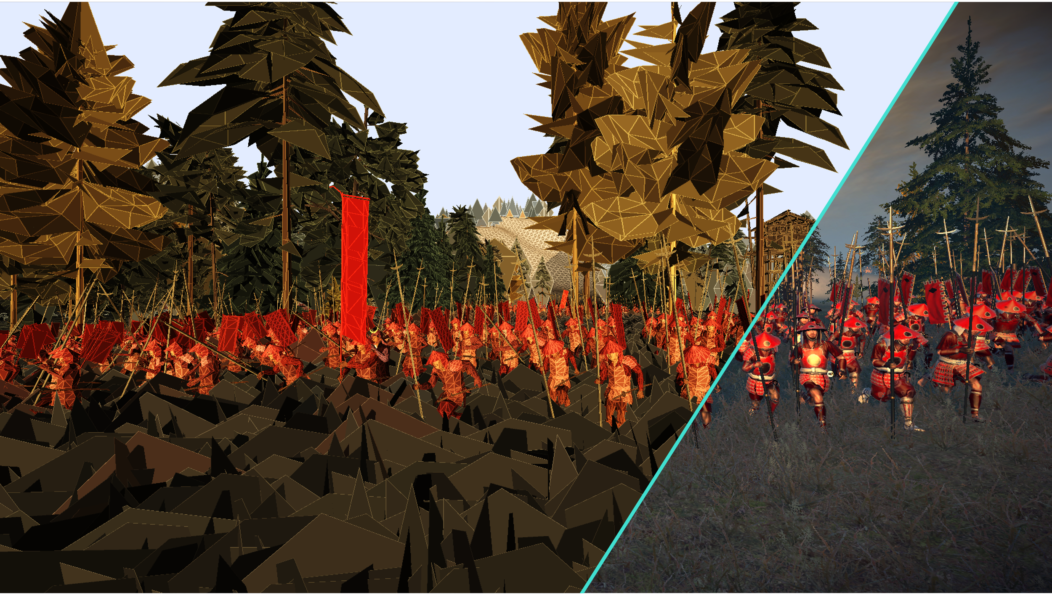
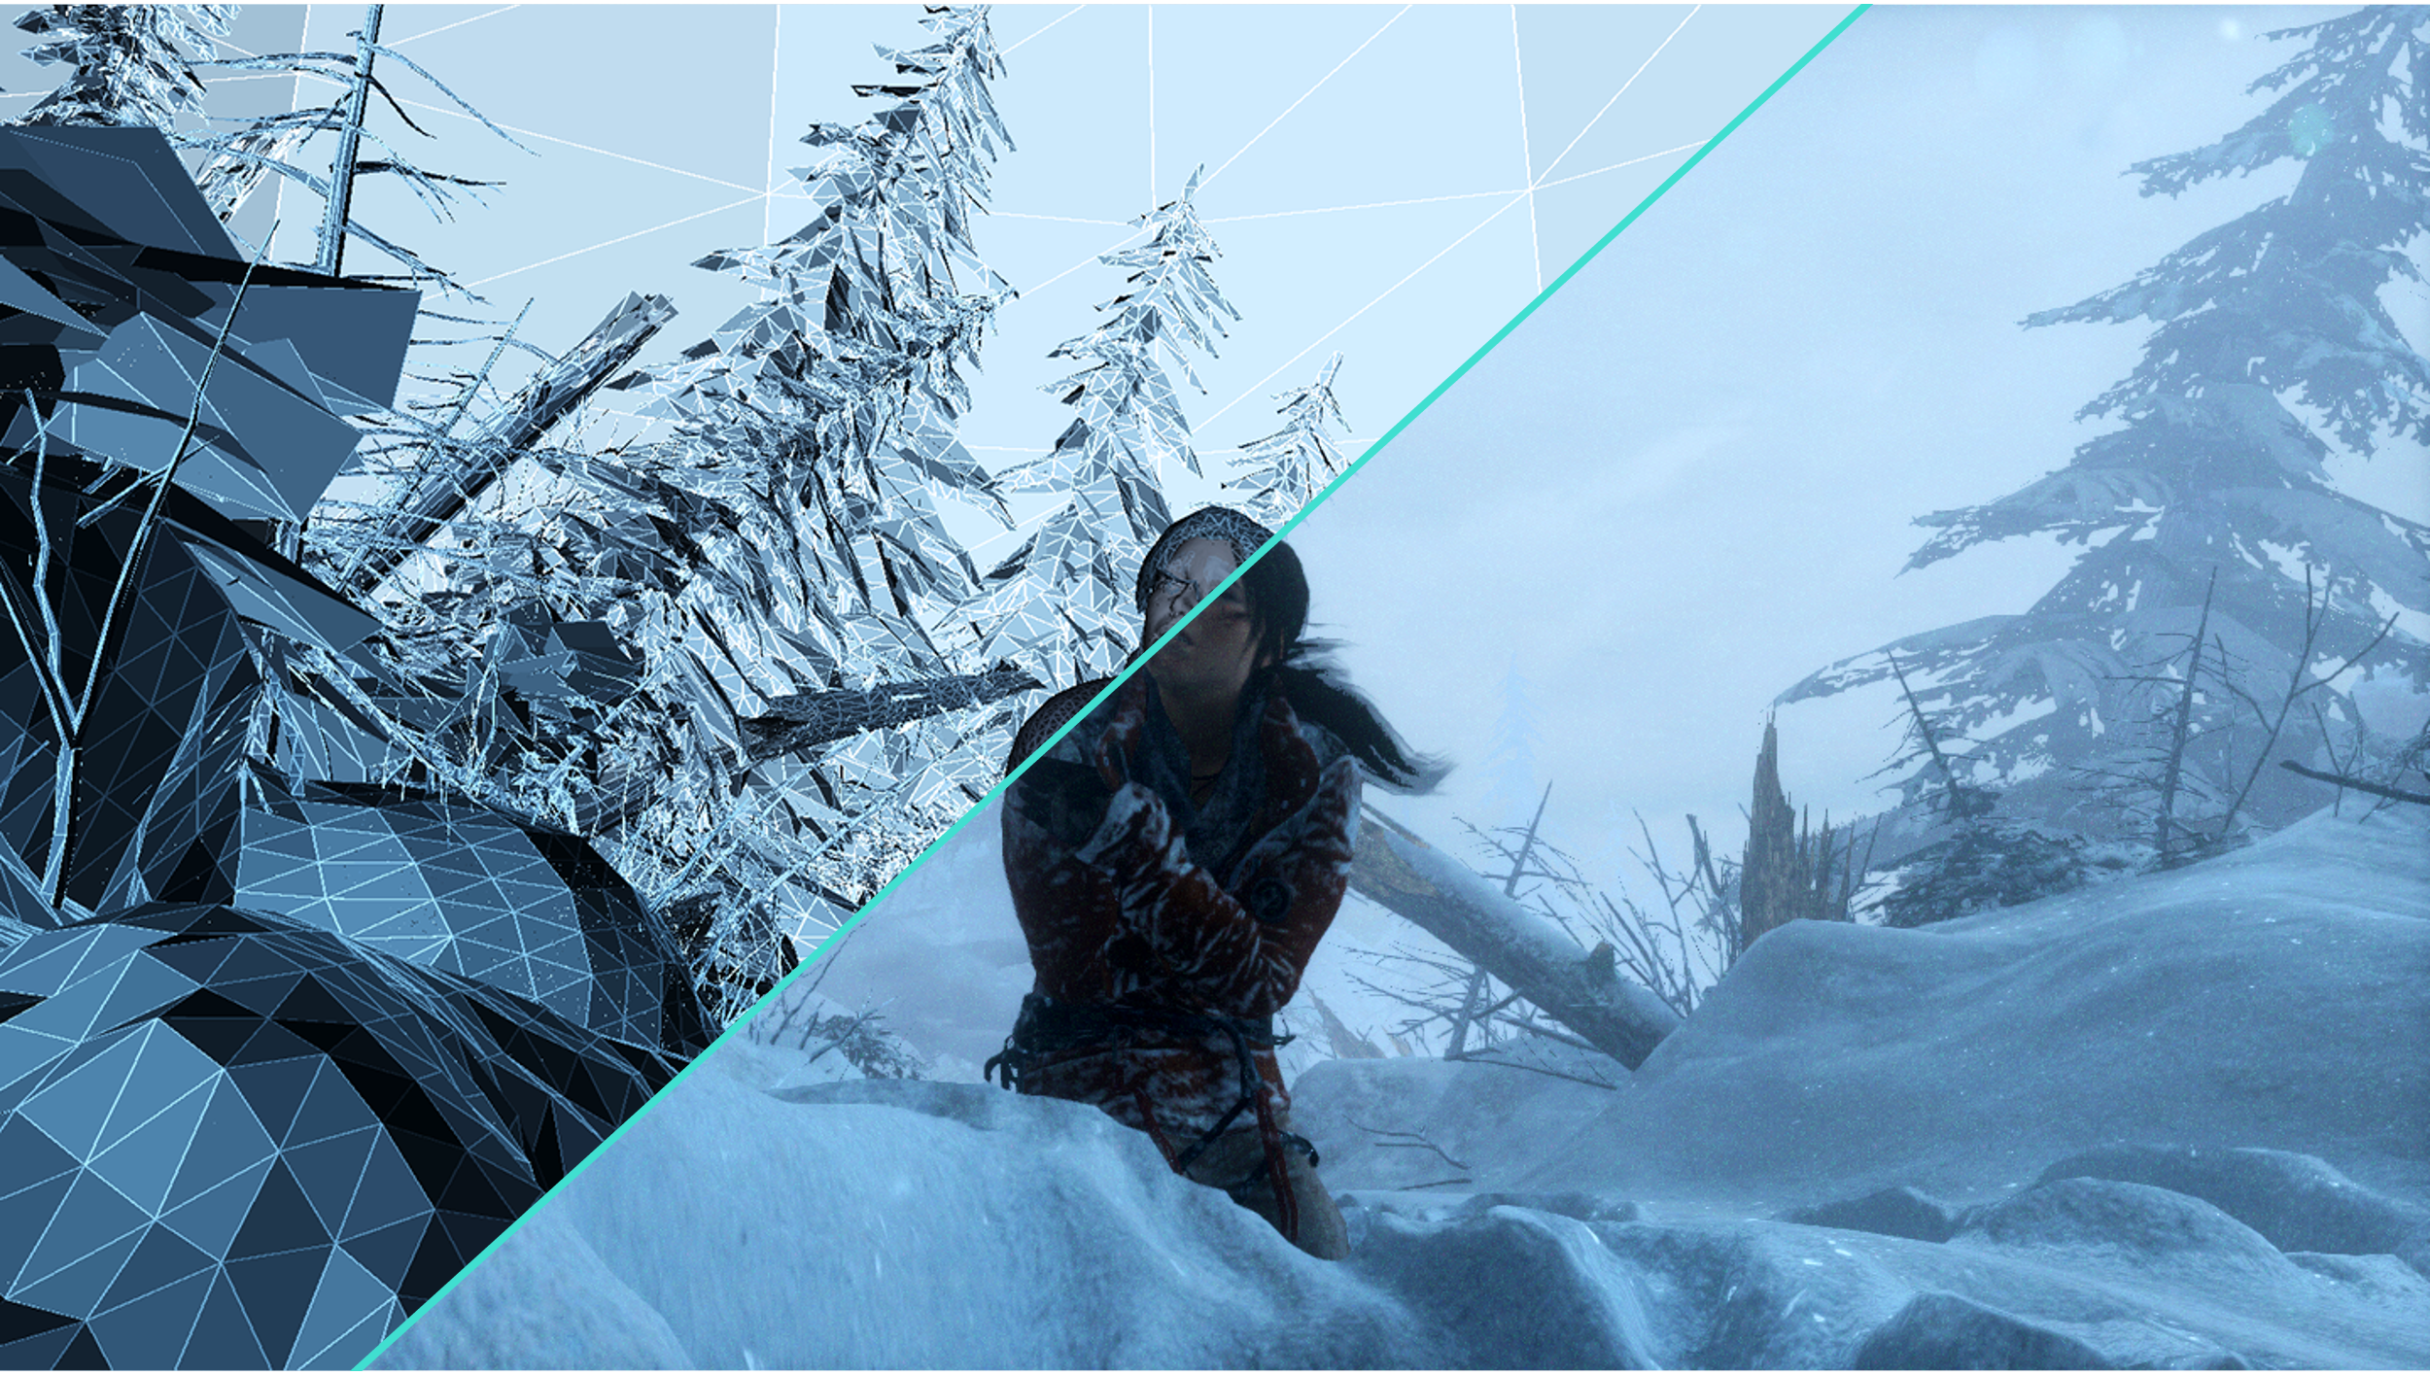
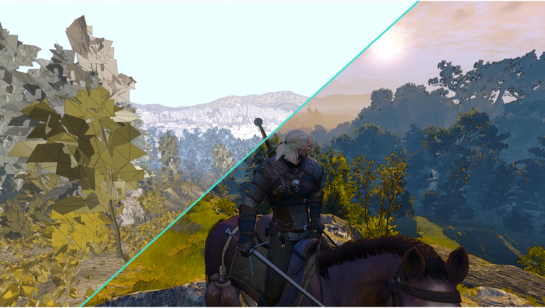
Evaluation
Perform Vertex Shading
Test Set: ~100 scenes
captured from video games
preprocessed with methods of
Hoppe [1999], and Forsyth [2006]
Varying shader complexity
simple Matrix Vector Multiplication
simulated load of $N$ Fused Multiply Add instructions
Total War: Shogun 2
Rise of the Tomb Raider
The Witcher 3: Wild Hunt
Notes:
Explain what forsyth is, introduce acronym tomf

Slide 17
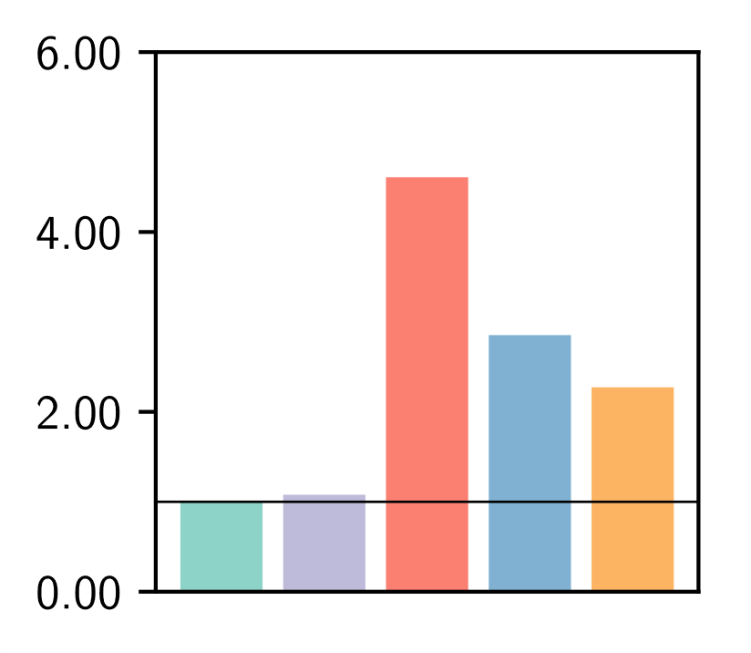
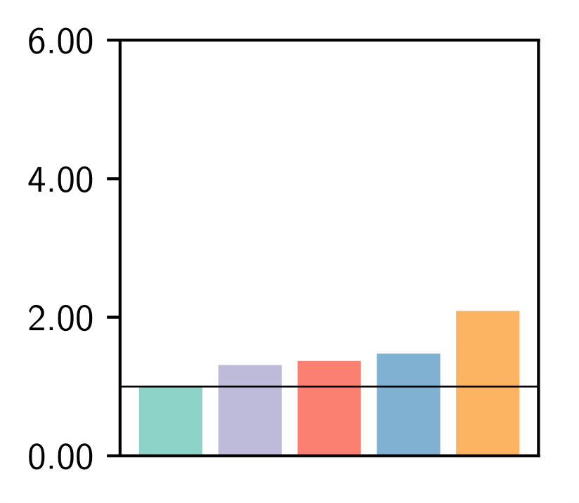
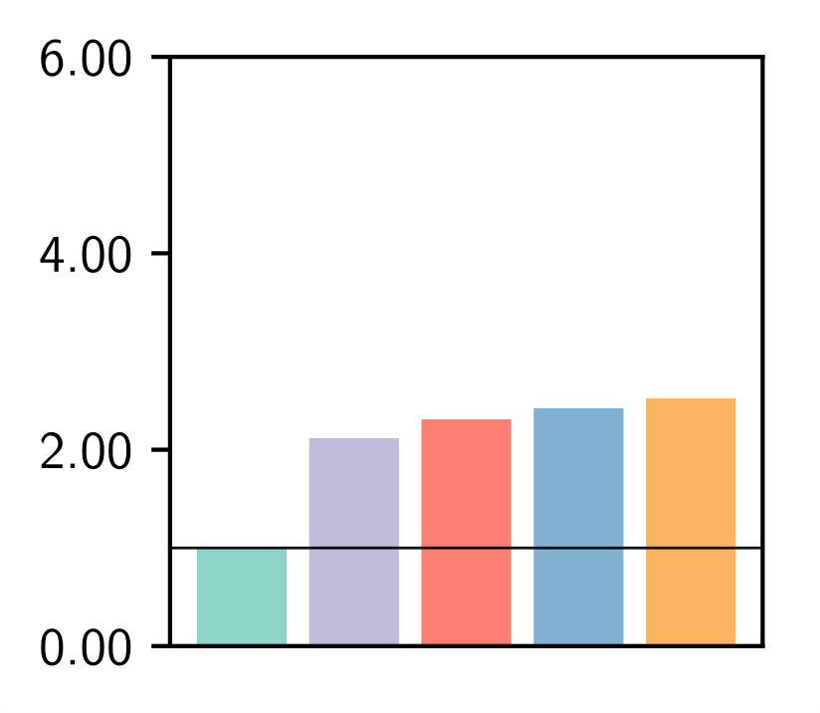
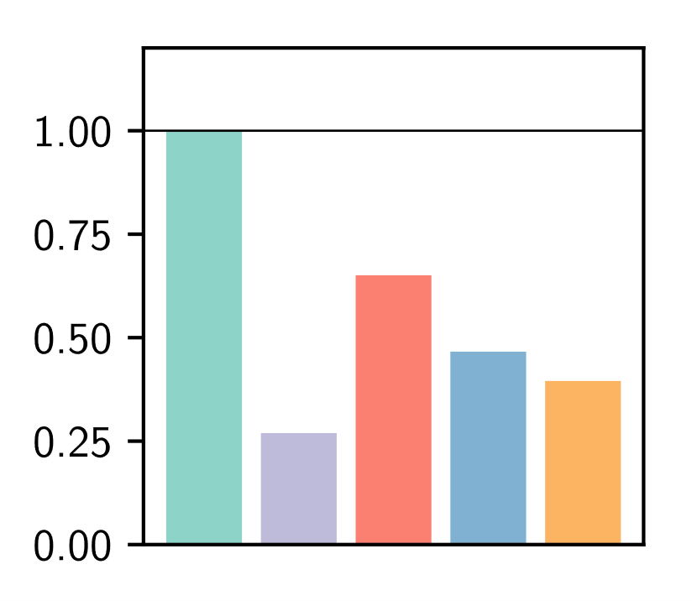
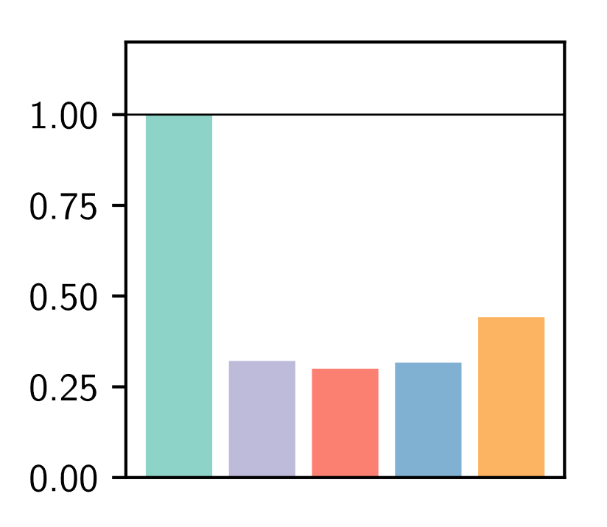
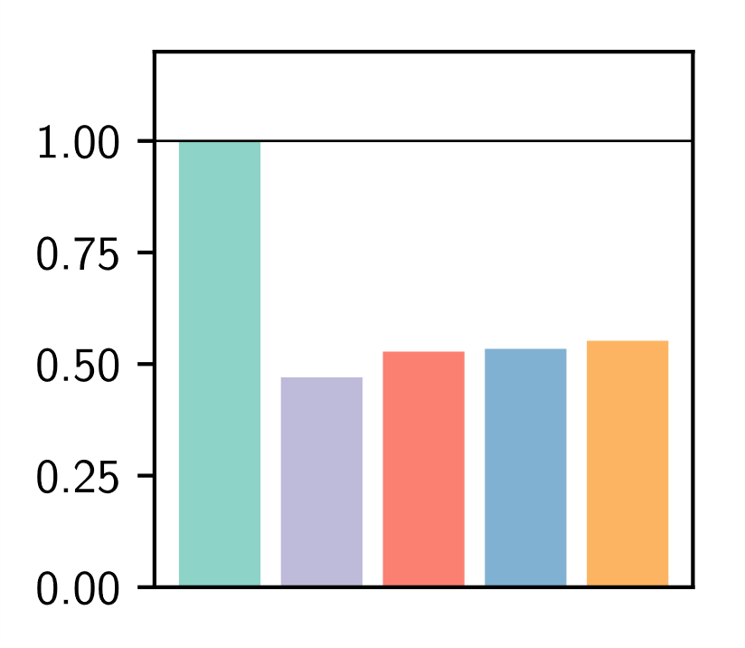
Results: Processing Time
Simple Shader
relative processing time
Complex Shader
relative processing time
GTX 780 Ti
GTX 980 Ti
GTX 1080 Ti
Notes:
animate, first row then second

Slide 18
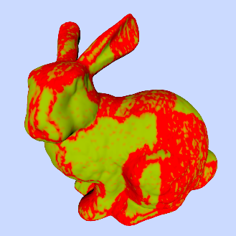
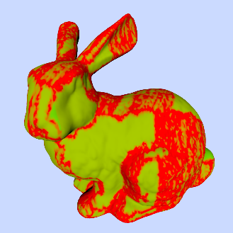
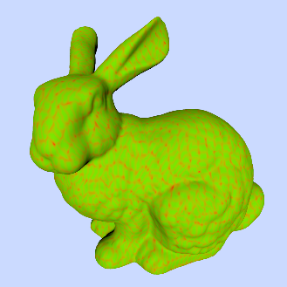
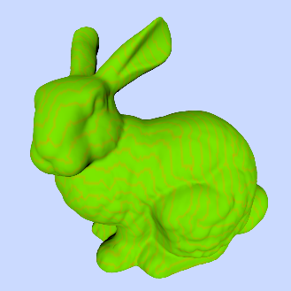
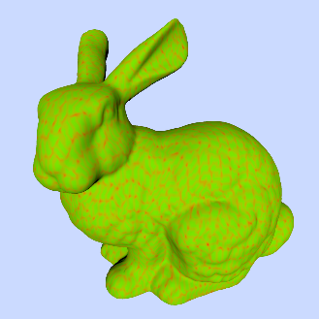
Results: Shading Rate
unprocessed
Hoppe
NVIDIA GTX 1080 Ti
Intel HD Graphics 630
AMD RX Vega 64
Our Warp Voting
Our Sorting

Slide 19
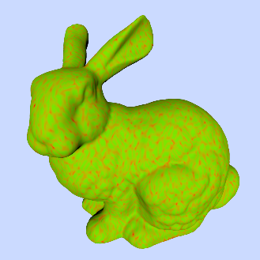
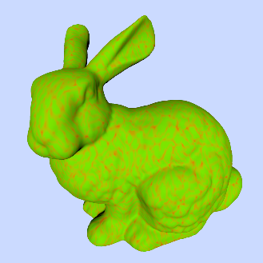
Results: Shading Rate
unprocessed
Forsyth
NVIDIA GTX 1080 Ti
Intel HD Graphics 630
AMD RX Vega 64
Our Warp Voting
Our Sorting

Slide 20
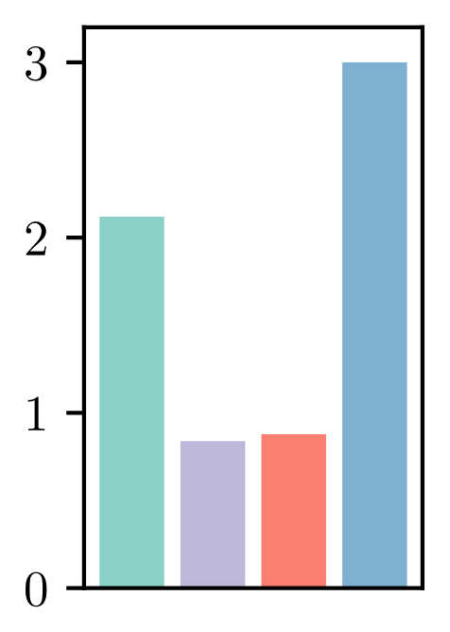
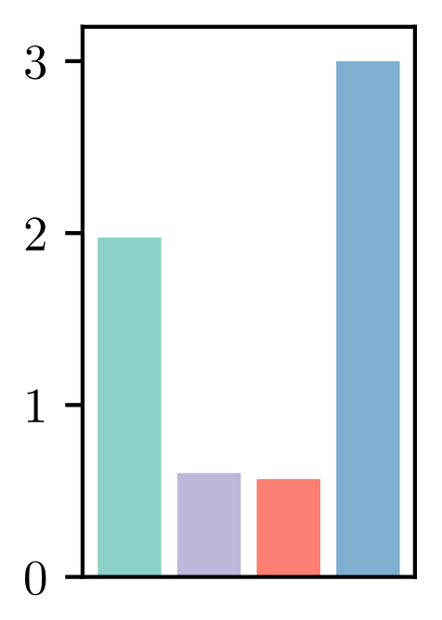
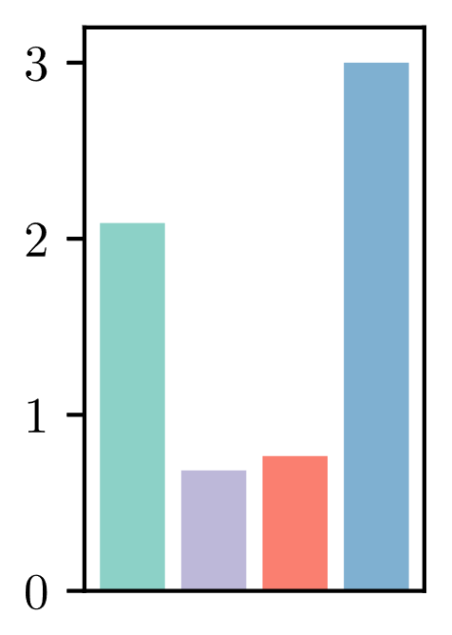
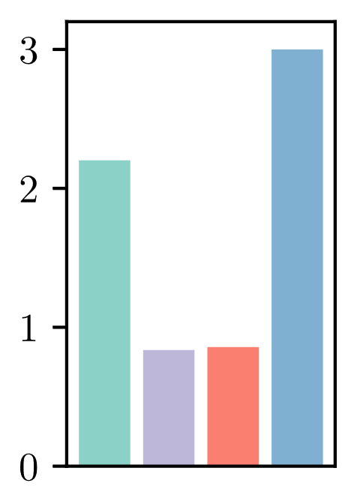
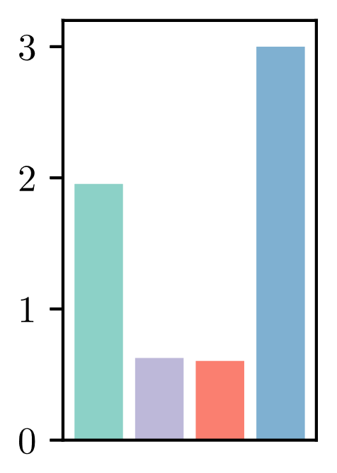
Results: Average Shading Rate
ASR
NVIDIA GTX 1080 Ti
Intel HD 630
AMD Vega 64
Our Warp Voting
Our Sorting
$$ASR=\frac{\#vertex shader invocations}{\#triangles}$$
Notes:
unprocessed
Rename tomf to forsyth
Random order

Slide 21
Conclusion
Very simple shaders: no benefit from vertex reuse
Low to medium complexity ⇨ Warp Voting
best allrounder
Very high complexity ⇨ Sorting or Hashing

Slide 22
Future Directions
Vertex Reuse generalizes to a more abstract problem
The same solutions may be useful beyond graphics and rendering pipelines…

Slide 23
https://github.com/GPUPeople/vertex_reuse
Notes:
Logo in corner
Bottom: name, short title, slide #

Slide 24
Remember the Bunnies
unprocessed
Forsyth
NVIDIA GTX 1080 Ti
Intel HD Graphics 630
AMD RX Vega 64
Our Warp Voting
Our Sorting

Slide 25
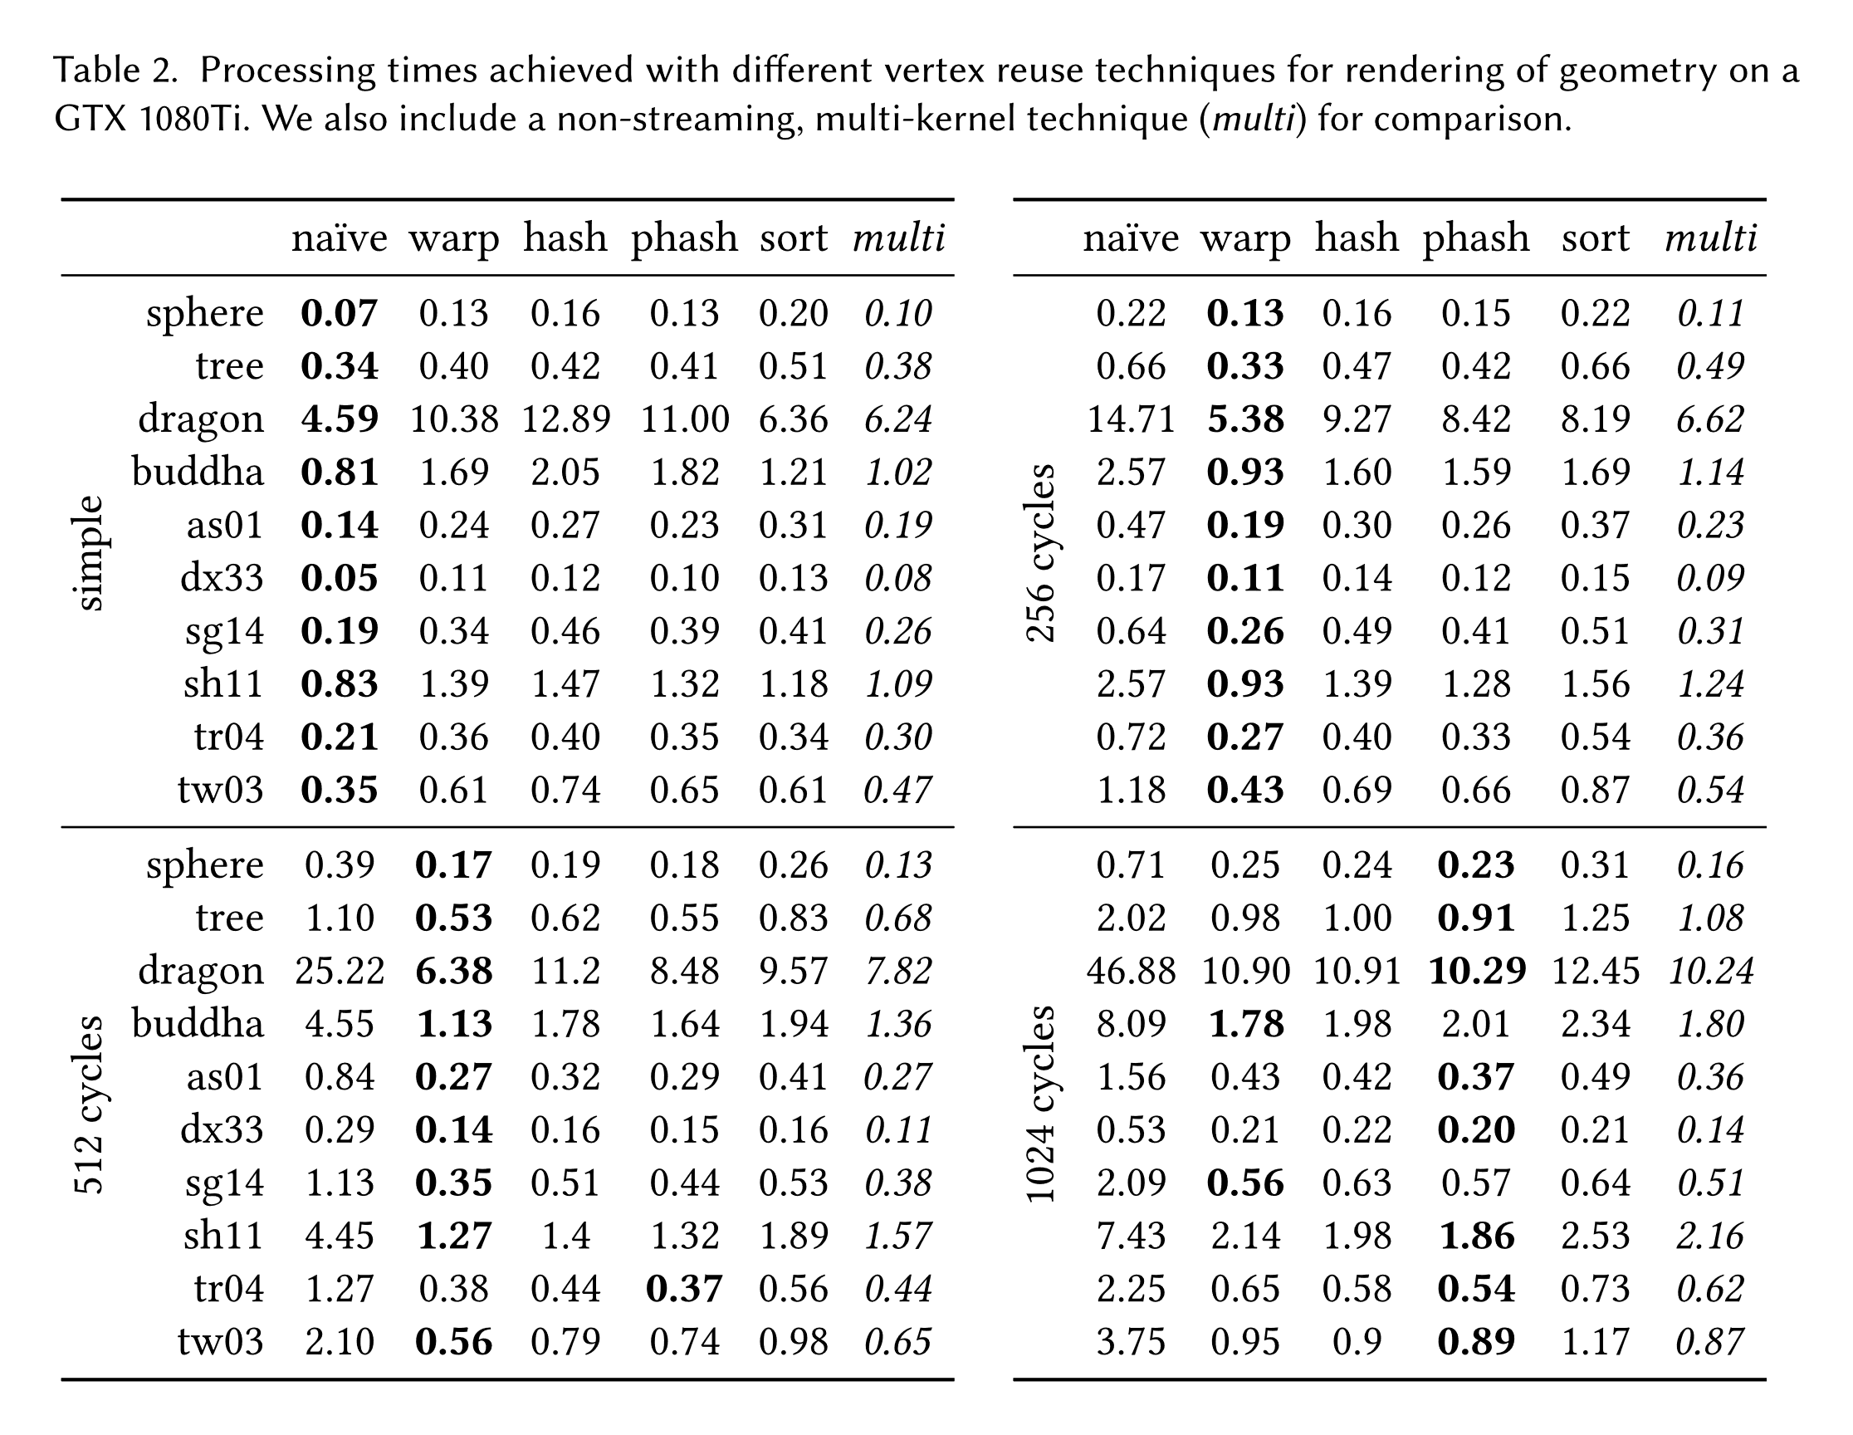
Results: Processing Time

Slide 26
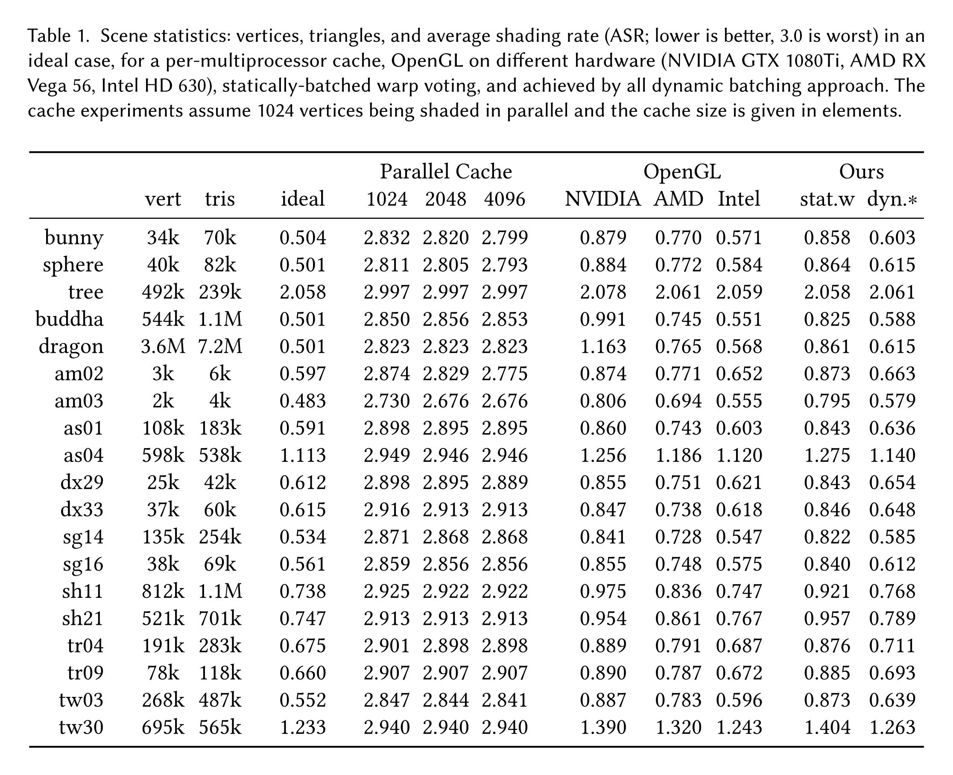
Results: ASR

