Slide 1
Brook GLES Pi: Democratising Accelerator Programming
www.bsc.es
Matina Maria Trompouki, Leonidas Kosmidis
HPG 2018

Slide 2
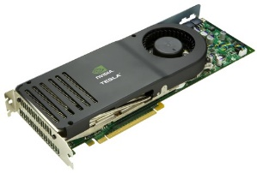
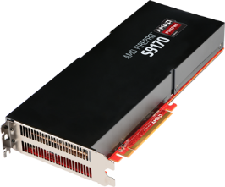
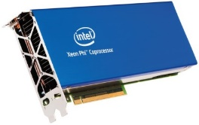
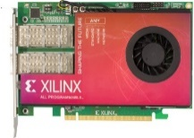
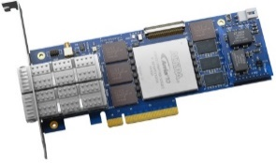
Introduction and Motivation
Modern and future computing relies on general purpose accelerators
Increased public and scientific interest
Increased importance of learning and experimenting with their programming paradigm
However their cost is high
Accelerator is expensive
Requires a high-end host computer to be used
GPUs
manycores
FPGAs

Slide 3
Introduction and Motivation
Traditional educational model shifted to self-education
Homework practice
Massively Open Online Courses (MOOC)
Experimentation with educational computers
Unaffordable for these target groups
Accelerator programming opportunities are limited!
GPUs
manycores
FPGAs

Slide 4
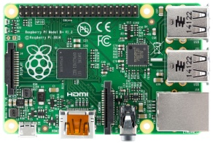
Brook GLES Pi
Port of the open-source accelerator programming language Brook on the low-cost ($25) educational computer Raspberry Pi
Enables the use of its embedded GPU
VideoCore IV, capable of 24 Gflops
Standalone development on the device
Large and collaborative community
Open-source implementation
Portability across every embedded GPU supporting OpenGL ES 2
(99% of the embedded devices with a GPU in the market)
Allows teaching, experimenting and learning GPGPU programming with affordable devices

Slide 5
Brook
We implemented our solution in the Brook programming language [1]
open source language developed circa 2004
predecessor of CUDA and OpenCL
Commercially adopted by AMD before OpenCL, rebranded as Brook+
Source-to-Source compiler and Runtime
Restricted subset of C (no recursion, no goto, no pointers)
transforms CUDA-like programs to graphics operations
supports multiple backends
[1] I. Buck et al, Brook for GPUs, SIGGRAPH 2004

Slide 6
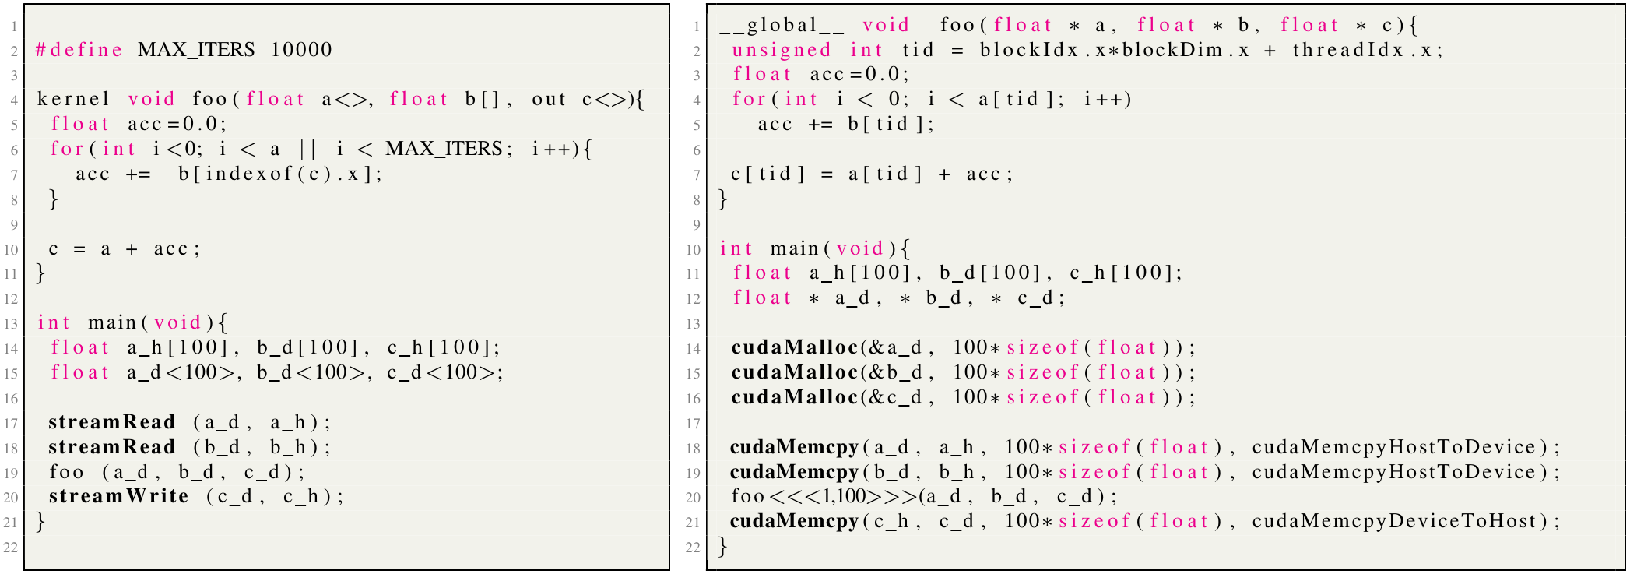
Brook vs CUDA Example

Slide 7
Additions
Ported Brook on the Raspberry Pi
Introduced an OpenGL ES 2 compiler backend and runtime
Optimised for the Raspberry Pi
Based only on the core OpenGL ES 2 standard
No vendor specific extensions
Maximum portability across all embedded devices with GPUs supporting OpenGL ES 2 (>99% of the market)
Shares common code base with Brook Auto [1]
2K Lines of code in the compiler and runtime
4K Lines of code in regression tests and benchmarks
[1] Trompouki et al, Brook Auto: High-Level Certification-Friendly Programming for GPU-powered Automotive Systems, DAC 2018

Slide 8
Additions
The compiler backend uses Nvidia’s Cg compiler like the original Brook
Provided only in binary form for x86
Raspberry is ARM-based
Emulate compiler using the binary translator qemu-x86
Enables standalone development and compilation on the device
Compilation time is similar to the native compilers, e.g. gcc
Original Brook only supports floating point (and their vector) streams
Added support for char and int
Signed and unsigned versions
Vector additions

Slide 9
Additions
Stream datatypes limitations due to OpenGL ES 2
Input and output streams are limited to 32-bit
up to vectors of 4 chars, 1 int, or 1 floating point
Only a single output stream is permitted per kernel, up to 32-bit
When a kernel violates these rules and the OpenGL ES 2 backend is enabled, the programmer is instructed to rewrite the code

Slide 10
Dropped Features
Iterators
Unusual Brook feature, syntactic sugar for creating and initialising streams of indices
No mapping with any CUDA/OpenCL concept
AMD’s Brook+ examples use indexof instead
Would complicate unnecessarily the implementation
We want equivalence of CPU/GPU code but
OpenGL ES 2 only supports normalised coordinates

Slide 11
Dropped Features
GatherOp
CPU emulation of gather operations
Only needed in GPUs not supporting dependent texture lookups
All known OpenGL ES 2 GPUs support it
ScatterOp
CPU emulation of read-modify-write
Slow performance
Scatter to gather transformation is encouraged for accelerators whenever is possible
Neither have an equivalent in CUDA/OpenCL

Slide 12
Currently Unsupported Features
Structs
Supported in accelerators but their use is discouraged
Limits vectorisation
Under-utilises memory bandwidth
Memory layout transformation is recommended
Array of Stuctures (AoS) to Structure of Arrays (SoA)
Plans to be supported in the future to allow experiencing the performance difference

Slide 13
Results
Experimental Setup
AMD Brook+ SDK applications, different input sizes up to 2048 elements
Raspberry Pi
Brook GLES Pi backend and runtime, OpenGL ES 2
$25 cost
Comparison with:
NVIDIA GeForce GTX 1050Ti (High/Medium-End desktop GPU)
$250 GPU cost, $2500 total cost including the host
NVIDIA Jetson TX2 (High-End embedded GPU)
$600 platform cost
Original Brook OpenGL backend and runtime

Slide 14
Relative Performance of the Systems used in the comparison
Relative performance CPU vs GPU of the systems used in comparison
Reported by the flops benchmark
OpenMP CPU support is disabled in the multicore high-end systems
Their speedups are higher
Platform (GPU/CPU) | Performance Ratio | Bandwidth Ratio
Raspberry Pi VideoCore IV vs ARM | 23 x | 1/33 x
NVIDIA GTX 1050 Ti vs AMD CPU | 19 x | 1/11 x
NVIDIA Jetson TX2 Pascal GPU vs ARM | 11 x | 1/4 x

Slide 15
Brook GLES Pi Evaluation: Weak scaling GPU Programs
Benchmarks that do not scale with input size in high-end GPUs do not scale either in Brook GLES Pi
Relative performance in the same order of magnitude

Slide 16
Brook GLES Pi Evaluation: Strong scaling GPU Programs
Same performance trends, relative performance within 2 orders of magnitude

Slide 17
Conclusion
Brook GLES Pi
Port of the Brook Programming Language over OpenGL ES 2
Optimised for the low-cost educational computer Raspberry Pi
Portable OpenGL ES 2 allows the use of any embedded GPU
Similar performance trends with original Brook on high-end GPU systems
Democratises accelerator programming
Code:
http://github.com/lkosmid/brook

Slide 18
Thank you!

Slide 19
Brook GLES Pi: Democratising Accelerator Programming
www.bsc.es
Matina Maria Trompouki, Leonidas Kosmidis
HPG 2018

